Slide 1
ITSO - Basics of Satellite Communications
Nishaal Goure Sunkurh
17 July 2017
Notes:
Choosing the “Title Slide” from the “New Slide: Slide Layout” dialog will give you this slide, the sub-section divider slide.

Slide 2
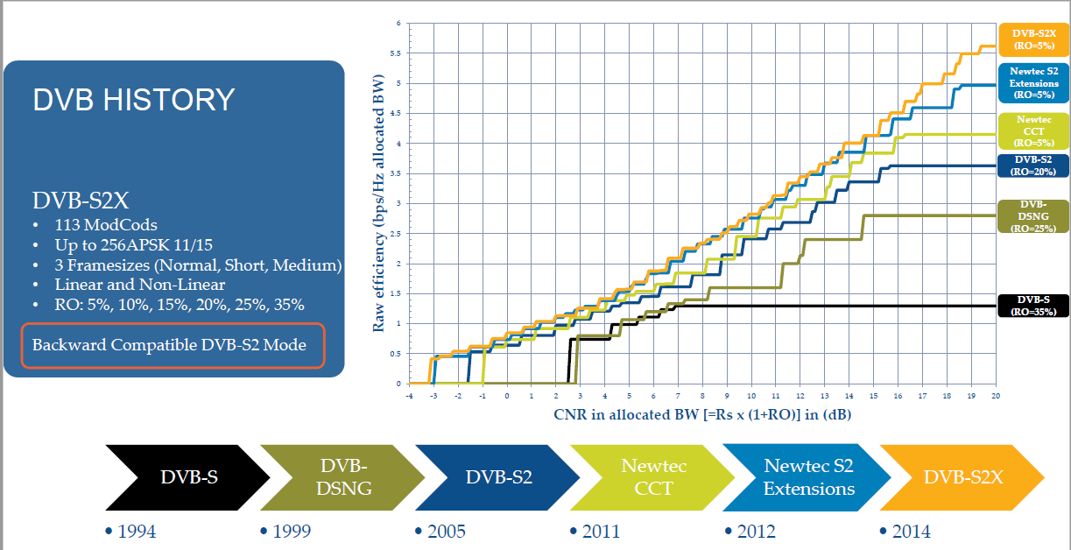
DVB-S2 & Extensions

Slide 3
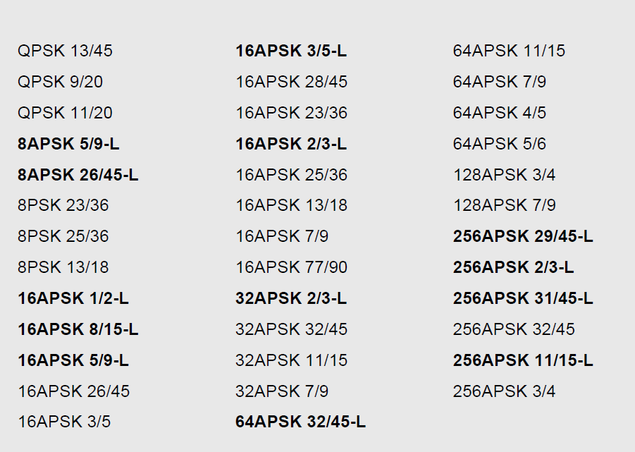
DVB-S2 & Extensions

Slide 4
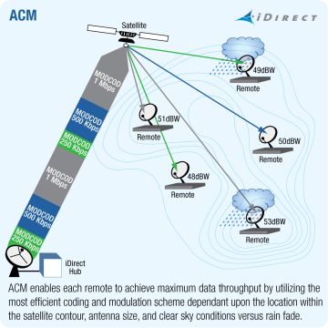
Adaptive Coding & Modulation
Higher throughput for the same amount of resources
When rain fade issues arise, the modulation can adjust so as to ensure the remote stays in the network
Allows lower per Mbps price points to be achieved, leading to more competitive prices in the market
Maximum achievable data throughput by utilizing the most efficient coding and modulation scheme at any moment in time, depending on location within the satellite contour, antenna size and atmospheric conditions

Slide 5
Carrier Cancellation Technology

Slide 6
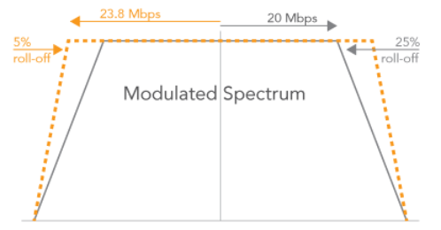
Roll Off
Allocated BW directly proportional to Symbol rate X Roll off
Typical roll off – 35%
Most recent roll off available 5%
Drives efficiency

Slide 7
Combination of Features
Equipment Vendors are integrating options to their products
  DVB-S2 with ACM
    Satellite equipment vendors (eg. HNS, iDirect)
  Carrier in Carrier
    ComtechEFData CDM-625
    Viasat PCMA
  DVB-S2, Carrier in Carrier with ACM
    ComtechEFData CDM-750

Slide 8
New Technology in Satellites
Intelsat Satellite network evolution

Slide 9

Satellite Network Evolution
What is a High Throughput Satellite?
  Traditional satellites currently deliver a system data throughput of 2Gbps to 5Gbps
  A High Throughput Satellite is a satellite that can deliver system data throughputs of 15Gbps or more.
  This is done by the ability of frequency reuse and a combination of Spot Beams and Wide Beams
  Spot Beam provide the ability to concentrate power (EIRP and G/T)
Intelsat is the first in this next advancement of satellite technology and it is called:

Slide 10
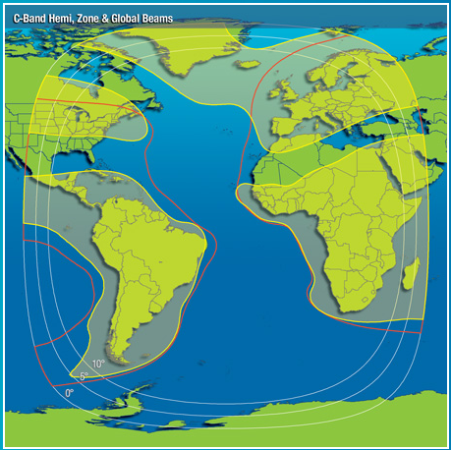
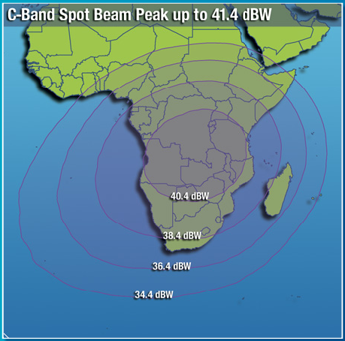
Intelsat brings well known principles of “Frequency Reuse” & “Spot Beams” in a new configuration
CSE
Frequency reuse
(Any frequency band: C, Ku, Ka)
+
Spot Beams & Wide Beams
= Intelsat Epic^{NG}

Slide 11
Frequency Reuse Methodology
CSE
500 MHz
Reduce beam size.
  This increases G/T and EIRP
Split frequency into 4 or 7 or 8 etc. segments or “colors”.
Assign each color the segmented bandwidth taking care not to assign any similar colors next to each other.
250 MHz
250 MHz
250 MHz
250 MHz
4 Color reuse
Notes:
8 color or ring re-use. Jupiter uses a 4 color, lot of spectrum in the beam with a commercial grade product. Looking at having higher performance so we used a color scheme that has less interference, that is how we ended up with more colors. 4-color C/I in the order 8 to 12 dB vs. 8-color typically around 20 dB.

Slide 12
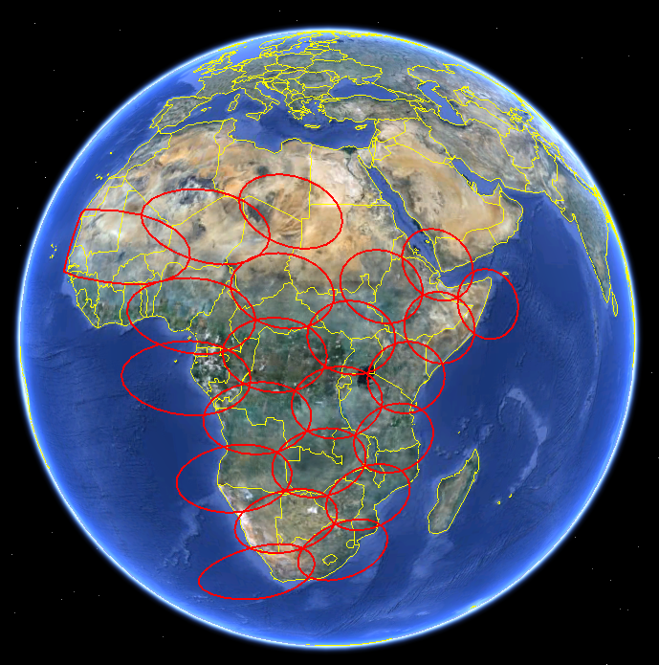
IS-33e Ku-Beams
User Beams
  Standard Ku-band frequencies (non-planned FSS)
  Bandwidth from 56.25 to 225 MHz
Core Beams
  Use BSS and Ku-band Planned bands
    Different bands for User Beams
  Bandwidth sized to support all user beams in corresponding country or region, for example:
Connectivity
  Connectivity between any user and core beam

Slide 13


High Performance Satellite Platform
High Capacity
Open Platform
High Efficiency
Backward Compatible
High Throughput
Flexible
High Performance
Complementary Overlay
Multi-band
All-region Coverage
Resilient and Secure
Lower Cost of Ownership
Page: 13

Slide 14




Bandwidth
EIRP
9MHz
G/T
36MHz
Notes:
This requires a rethink.
Shown here is a satellite network of today, depicting the current model for procurement of satellite capacity:
Customers acquire specific amount of capacity on specific beams.
Around this customers create their own supporting ground infrastructure to leverage the leased capacity.
For mobility applications this requires a lot of know-how and investment outlays to build a network to handle traffic.

Slide 15



Global coverage
25 satellites over Africa
Resilient C-band
and Ku-band transponders
This is our Existing Satellite Network…
Notes:
In the last 10 years, we have built our mobility network by launching satellites specifically designed to handle mobile requirement globally.
Our Mobility network today provides Global Coverage by using the wide beams of 20 satellites and the equivalent capacity of over 400 transponders.

Slide 16



Now Launching 7
Epic^{NG} satellites
Notes:
The change in paradigm about accessibility to the existing satellite network comes from adding a new layer of advanced High Throughput Satellites.
Also these span the globe.
The Intelsat Epic satellites will deliver up to 10 times the throughput of the previous generation and thanks to their digital payload, they can be flexibly configured in orbit to follow the requirements of maritime, aero and other mobile vehicles.

Slide 17

And adding OneWeb
First and only fully global, pole-to-pole high throughput satellite system
The OneWeb satellite constellation:
Counts 700 LEO satellites
(moving in 18 planes of 36 satellites)
Very Low latency
(less than 30ms round trip delay)
Perfect for Internet across Africa
with look angles better than 57°
(“overhead IP coverage”)
Total Throughput of the system:
5 terabits per second
Credit: Airbus Defence and Space
Notes:
Additionally, working with our partner OneWeb, we will bring an additional 5 terabits per second of connectivity in a global LEO network that is interoperable with the Intelsat network.
A third complementary network layer - from 2020 and onward - will be the OneWeb constellation of Low Earth Orbiting satellites.
GEO and LEO satellites will work together to provide ubiquitous high speed access to the Intelsat network, which will also include the Polar regions on Earth.

Slide 18


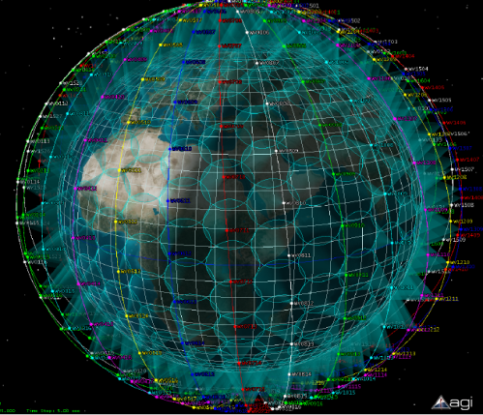
Providing a Truly Global Network in the Sky
Notes:
The three network layers provide a high degree of flexibility and control for customers that acquire access to the network, rather than capacity on a specific beam, on a specific satellite.

Slide 19








Designed as an overlay to the existing Ku-band Network, Intelsat Epic^{NG} Capacity will scale over time, offering CONTINUITY, GROWTH, & RESILIENCE
IS-32e
IS-33e
IS-35e
IS-35e
IS-29e
H-3e
IS-37e
H-3e

Slide 20






Example: Ku-band Spot Beam Network
1.8M/4W KU-BAND REMOTE
150 Mbps
Network
2 Mbps
Remote
Page: 20

Slide 21
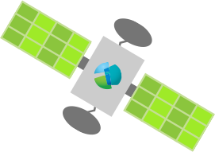



Example: Ku-band Spot Beam Network
Focused Epic^{NG} Ku-band Spot Beam
Epic^{NG}
200 Mbps
Network throughput*
same 1.8m/4W remotes
Same platform technology
Projected growth now supported
%
30
THROUGHPUT INCREASE
Up to
14 Mbps
Return
X
7
REMOTE THROUGHPUT
INCREASE
NETWORKVOLUME
BOOST
RETURN TRAFFIC
ACHIEVED
GOAL
*Limited by platform technology
Page: 21

Slide 22
Example: Ku-band Spot Beam Network
Focused Epic^{NG} Ku-band Spot Beam
Up to
2.1 Gbps
Network throughput on 3 spots
Epic^{NG}
same 1.8m/4W remotes
Advanced platform technology
Scale to full spot capability
%
70
THROUGHPUT INCREASE
Up to
14 Mbps
Return
X
7
REMOTE THROUGHPUT
INCREASE
NETWORKVOLUME
BOOST
RETURN TRAFFIC
ACHIEVED
GOAL
Page: 22

Slide 23




Example: Ku-band Spot Beam Network
Epic^{NG} Ku-band Spot Beam
Up to
1.6 Gbps
Network throughput
on 3 spots
Epic^{NG}
New 1.2m/2W remotes
Advanced platform technology
Scale to full spot capability
%
30
THROUGHPUT INCREASE
Up to
6 Mbps
Return
X
3
REMOTE THROUGHPUT
Up to
%
INCREASE
NETWORK
VOLUME
BOOST
RETURN TRAFFIC
ROLL OUT CHEAPER SITES
50
CAPEX SAVING
ACHIEVED
GOAL
Page: 23

Slide 24
Antenna Advancements

Slide 25


Redefinition of the satellite antenna
Electronically Steered Antennas (ESA)
No moving parts
Ultrathin and light
Metamaterial
Passive array
Active phased array
Panels may be laid CONFORMABLY

Slide 26
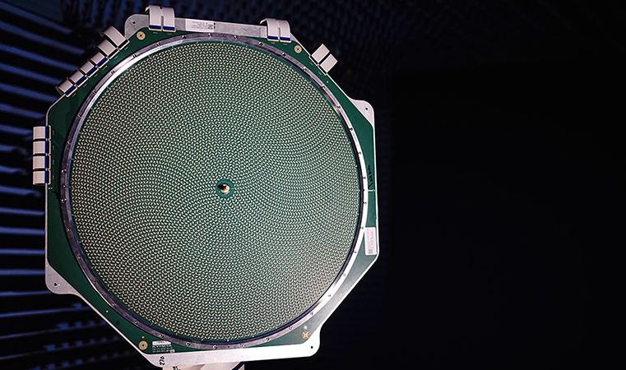

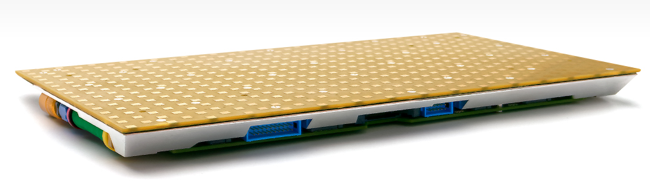


Slide 27
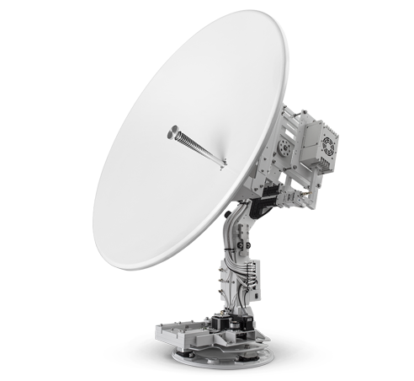
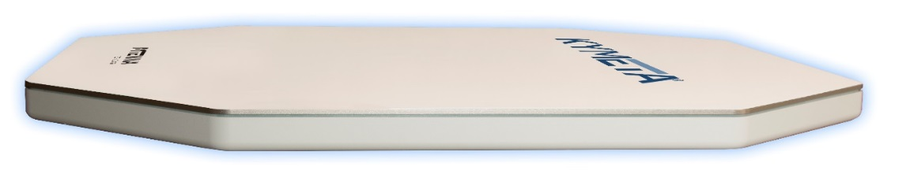
Flat
Lightweight
No Moving Parts
Auto-Acquiring
Self-Provisioning
Affordable

Slide 28
Mobility & Internet of Things
Customer Benefits: IoT
  Affordable terminal
  Hand-carry, self installation
  Connects to existing sensor / WiFi networks
  Efficient, intelligent data backhaul
  Auto-acquisition and self-provisioning
  Reliability – no moving parts
  Global network with scalable throughput
  Remote and/or mobile connectivity
Form factor, affordability,
and production scalability
make mTenna technology
ideal for Mobility & IoT

Slide 29
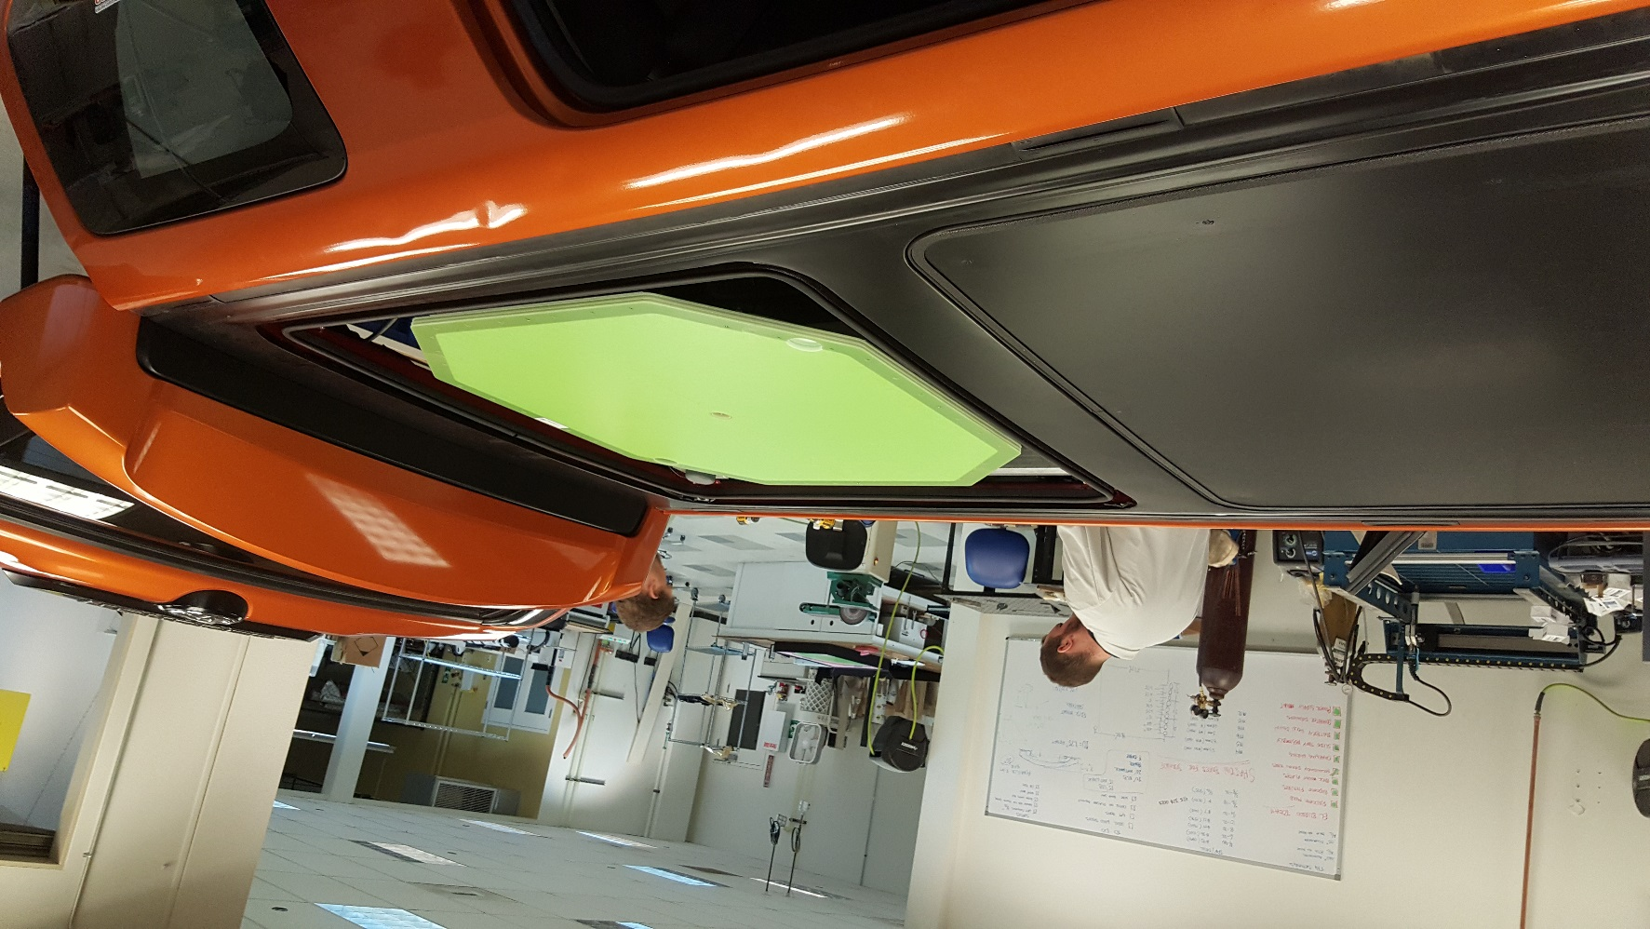
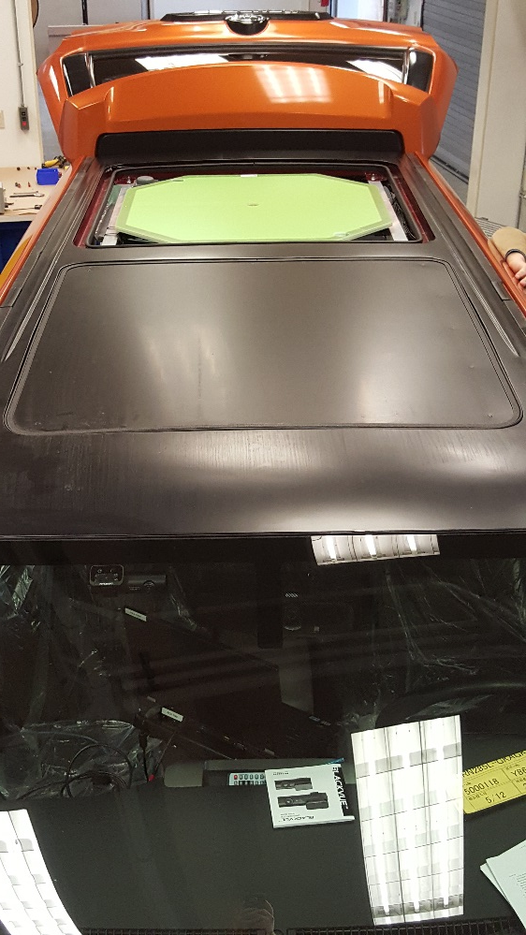
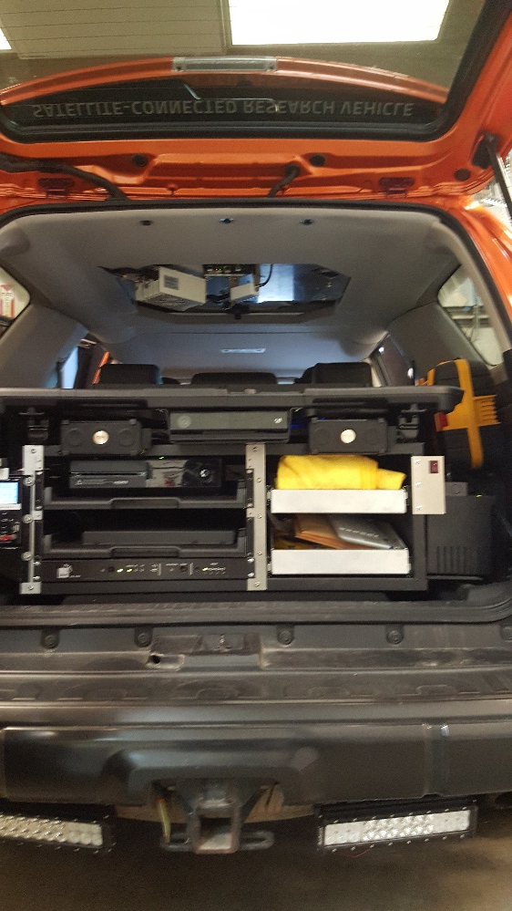
Toyota 4Runner Equipped With mTenna Tech
Notes:
70 cm two way

Slide 30


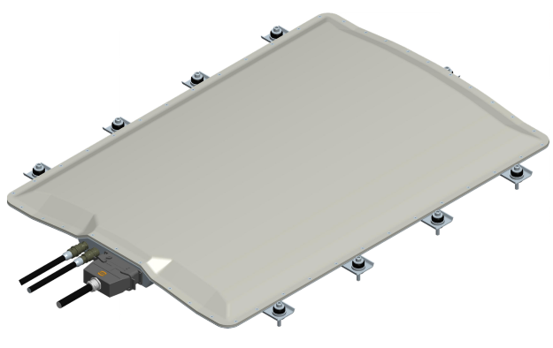
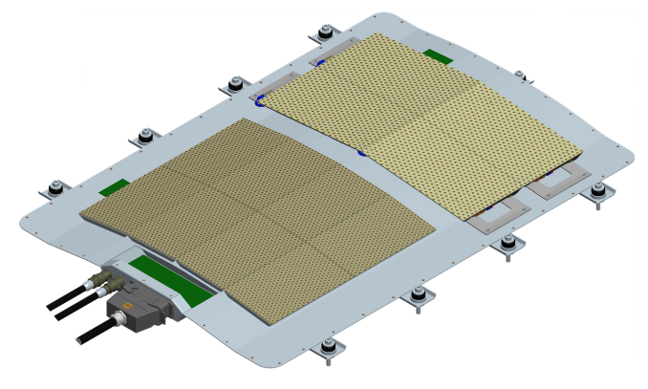

Enables mobile-broadband communications: at-sea, over land and in-flight
Revolutionary, flat, electronically steerable antenna (ESA)
Thin
Very low profile, (aerodynamic, inconspicuous)
Superior form-factor, (smaller footprint, light-weight)
Reliable
Accurate, (faster scan, better tracking, fewer network drops)
Robust, (no-moving parts, gradual degradation vs. total system failure)
Broadband
Delivers true broadband service, (supports networks > 100Mbs)
Very high gain (efficient, powerful)
Modular
Adaptable, (expandable to support wide requirements, lowering OpEx)
Better logistics-tail (easier, less costly & less timely to repair )
Versatile
Broad functionality, (multi-beam, flat or conformal, distributed or contiguous)
Dynamic control, (beam forming, tapering, ASI mitigation)
Notes:
Kymeta Q2 2017 maritime
Phasor current Q1 2018

Slide 31
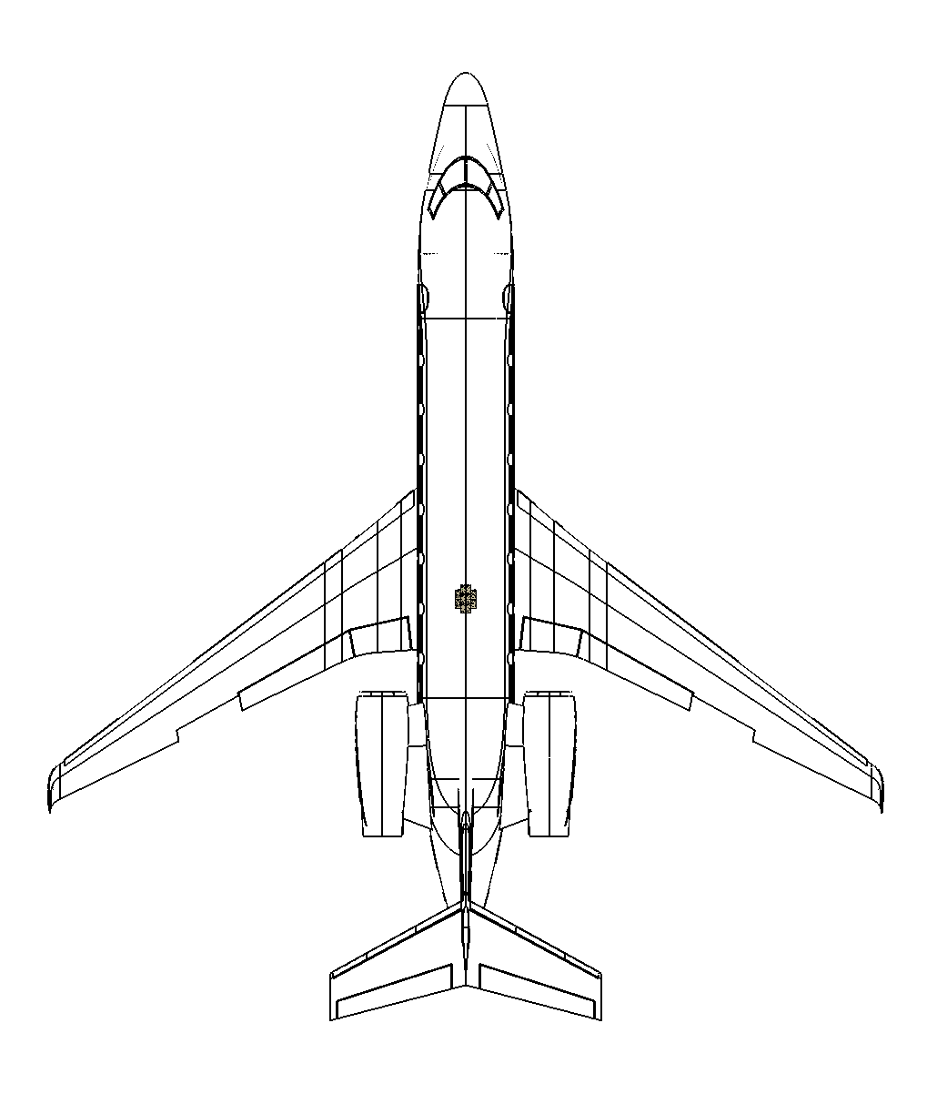
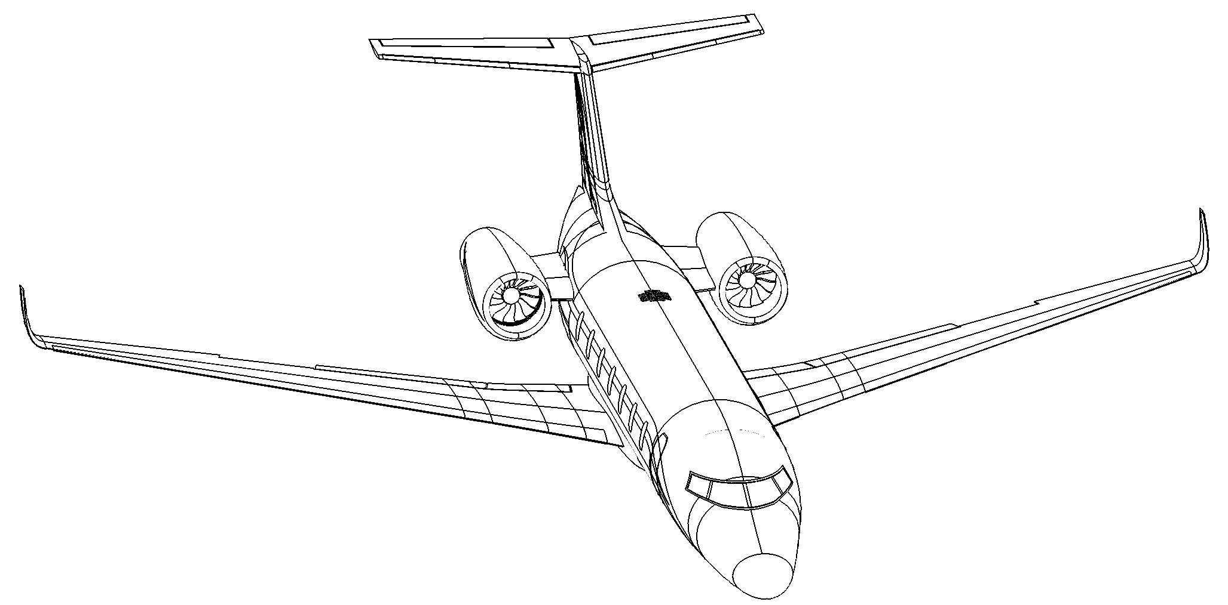
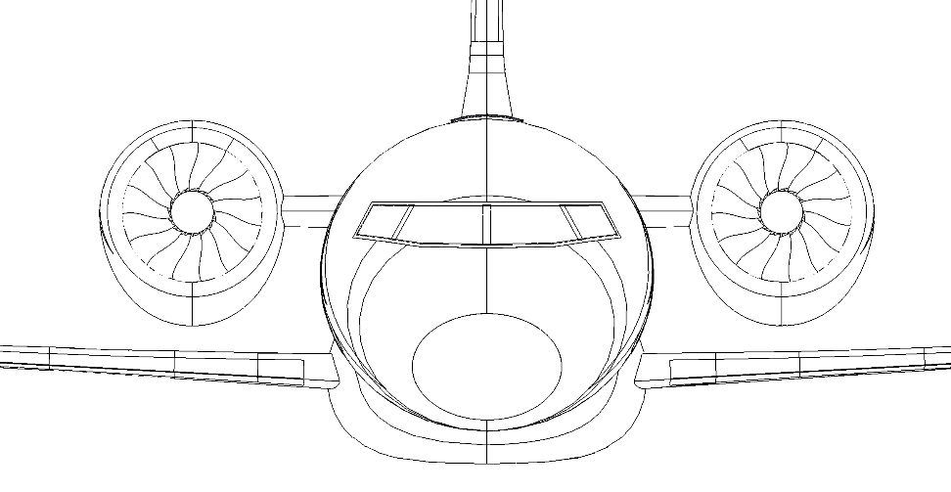
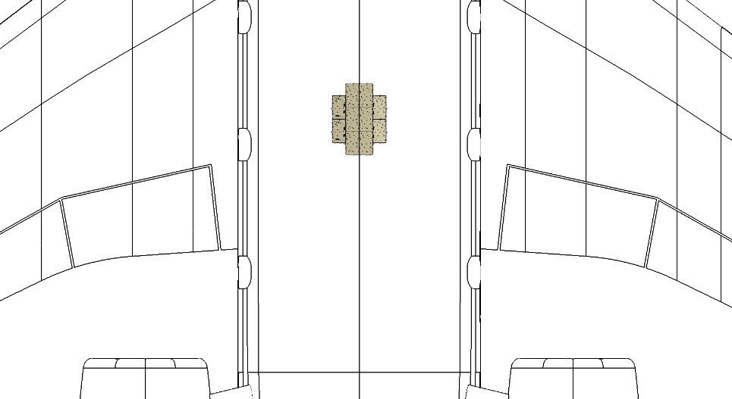
Designed to be flat or conformal – enables Aeronautical Mobile Broadband
Notes:
STC: installation per AC
License antenna peuvent lover

Slide 32




Navigation maps
Weather information
Over-the-air updates
Streaming
Sensors Analytics
Video conference
Video surveillance

Slide 33
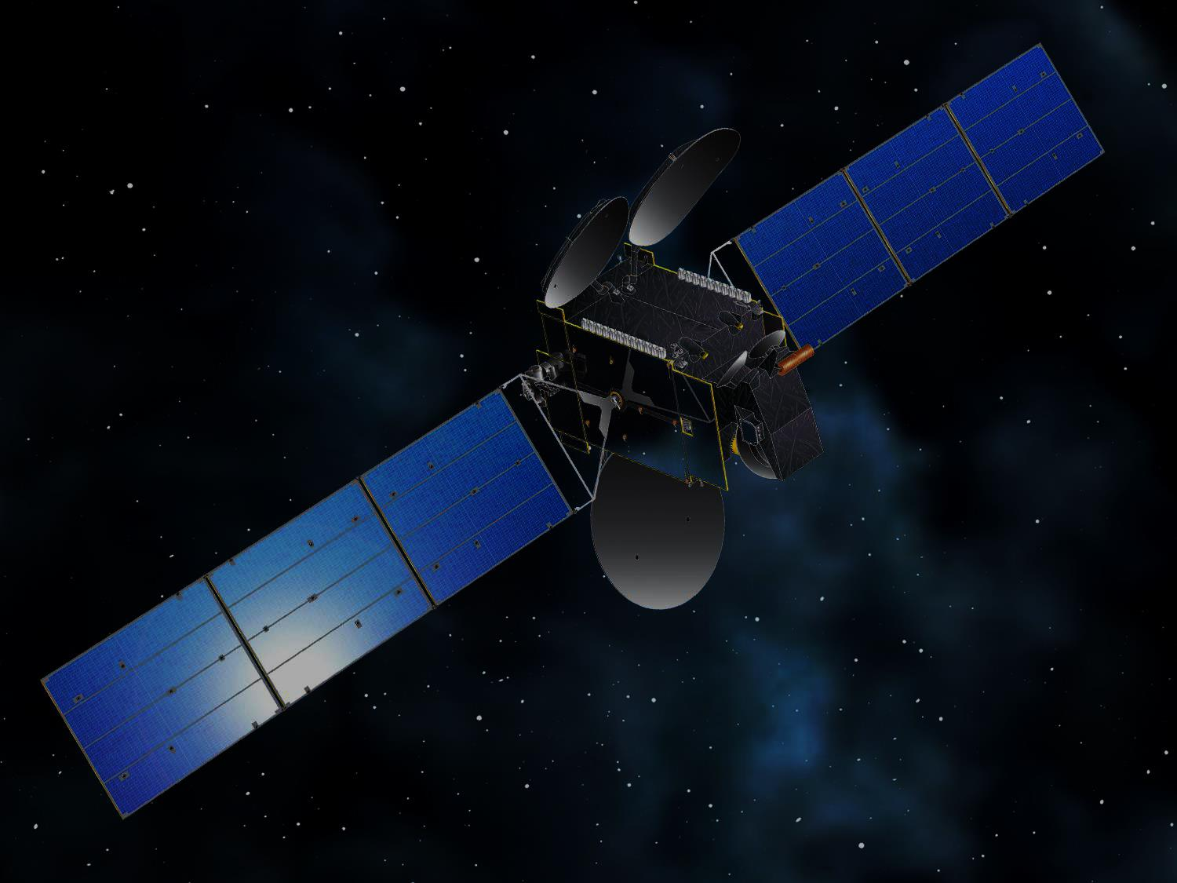
Thank you
Questions ?

