Slide 1


ITU Overview
                Presented by :
                ITU (International Telecommunication Union)
                BR-Space Services Department
                Akim FALOU DINE

Slide 2
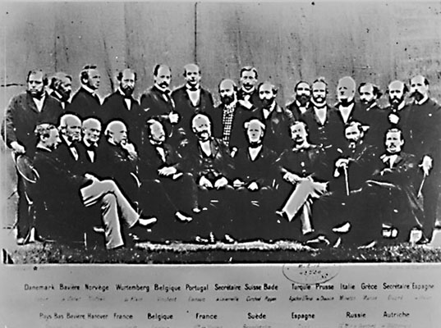
ITU at a glance
20 countries founded on 17 May 1865 the International Telegraph Union (ITU)
Notes:
World Telecommuncation and Information Society Day
International Telegraph Convention signed.
Set framwork to standarzation telegraphy quipment, operation istruction and accountin rules.

Slide 3
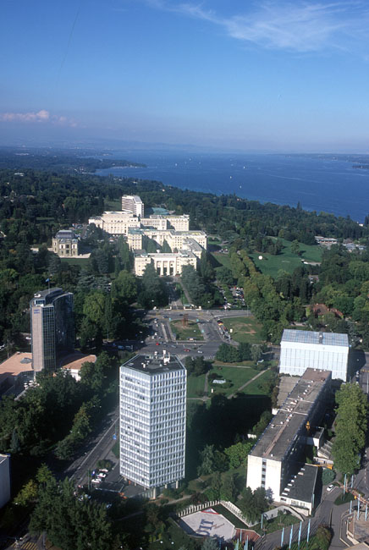
International telecommunication Union
ITU is the leading United Nations agency for information and communication technologies

Slide 4




















ITU at a glance
About us
Specialized Agencies of the United Nations
UNESCO
WHO
ILO
UPU
ICAO
WMO
IMO
IAEA
WB
UNWTO
FAO
IFAD
UNIDO
WIPO
WFP
IMF
Specialized UN agency with focus on Telecommunication / ICTs

Slide 5
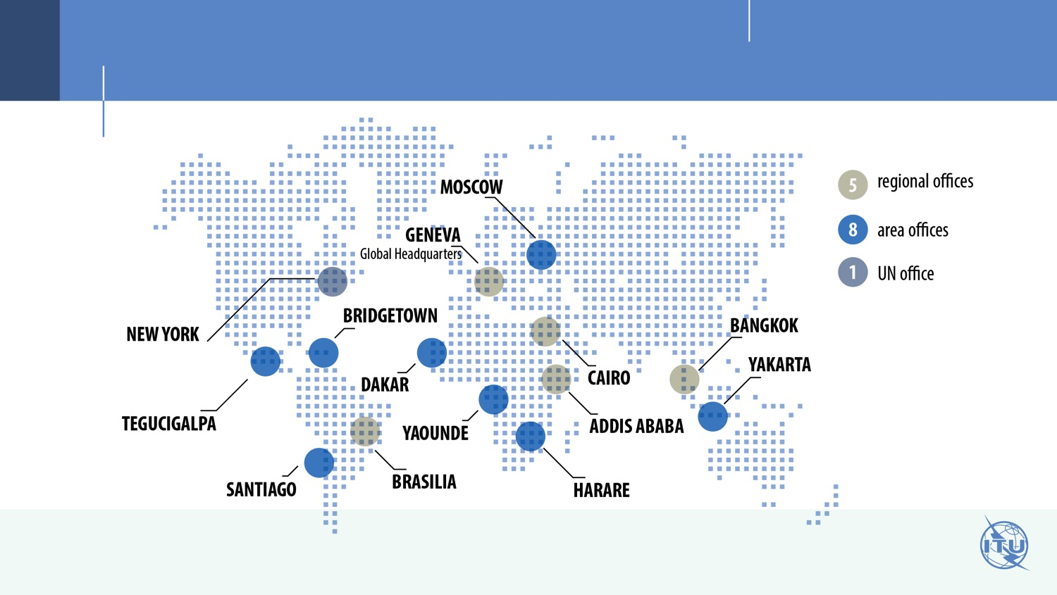
ITU at a glance
Where are we?
PRESENCE

Slide 6
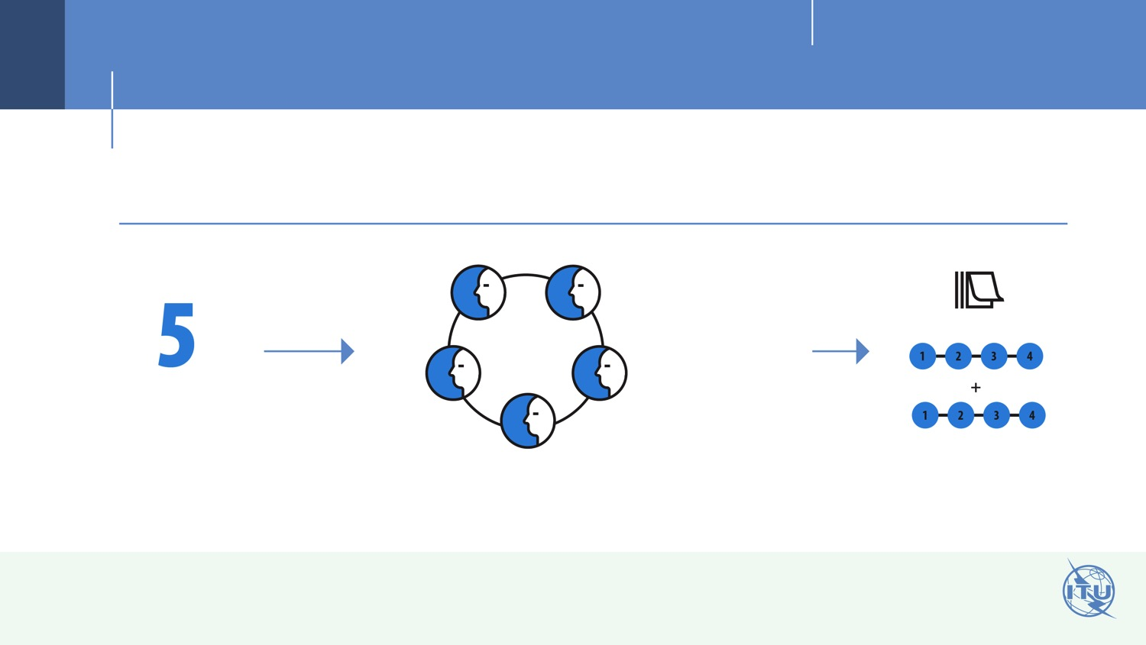
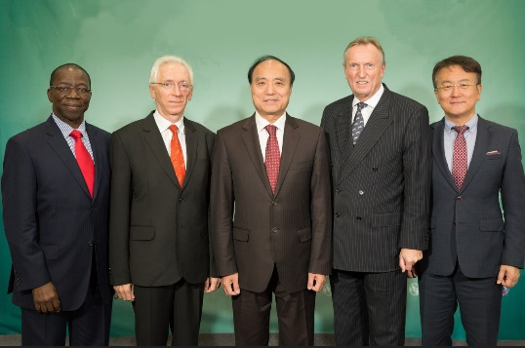
ITU at a glance
Management
WHO ARE WE?
ITU Elections
ITU Officials
DURATION
Secretary
General
Deputy Secretary
General
ELECTED OFFICIALS
Director of the Radiocommunication Bureau (BR)
Director of the Telecommunication Development
Bureau (BDT)
Director of the Telecommunication Standardization Bureau (TSB)
A maximum of two four-year terms in any elected post

Slide 7

ITU at a glance
Meet us
WHO ARE WE?
Our numbers
193
700
70
MEMBER STATES
PRIVATE SECTOR
ORGANIZATIONS
ACADEMIA
MEMBERS

Slide 8
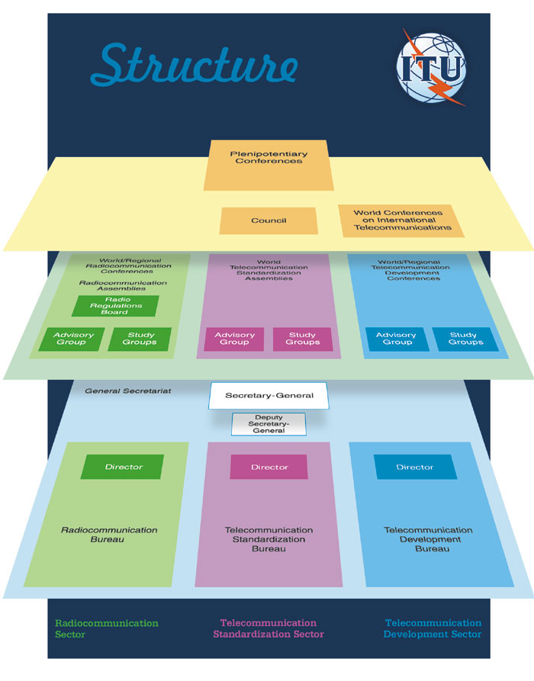
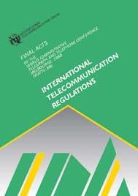
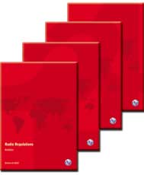
Radiocommunications
- regulations
- standards
Standardization
Development

Slide 9

ITU-T
/STANDARDIZATION/

Slide 10

ITU at a glance
Meet the sectors
ITU - T
KEY
ROLE
Crucial role in defining operation and interoperability of technologies that underpin global communications network
200 - 300 new global standards approved every year, with over 4,000 in use today

Slide 11

ITU-D
/DEVELOPMENT/

Slide 12

ITU at a glance
Meet the sectors
ITU - D
KEY
ROLES
Spread equitable and affordable access to telecommunications to help stimulate social and economic development
Human capacity-building particularly in developing and least developed countries (LDCs)
Helps to ensure that people everywhere are empowered to reap the benefits that connectivity delivers

Slide 13

ITU-R
/RADIOCOMMUNICATIONS/

Slide 14

ITU at a glance
Meet the sectors
ITU - R
KEY
Mission
to ensure rational, equitable, efficient and economical use of the radio-frequency spectrum
effect allocation & allotment and the registration of radio frequency & GSO orbital position
coordinate efforts to eliminate harmful interference

Slide 15
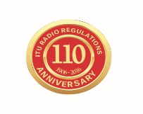

ITU-R history in brief
1906 (Berlin) | International Radiotelegraph Convention (1st Radio Regulations)
1927 (Washington DC) | CCIR (International Radio Consultative Committee)
1932 (Madrid) | Telegraph & Radiotelegraph Conventions merged: the International Telegraph Union became the International Telecommunication Union
1947 (Atlantic City) | IFRB (International Frequency Registration Board) ITU as UN specialized agency
1992 (Geneva) | ITU-R (Radiocommunication Sector ): RRB (Radio Regulations Board) BR (Radiocommunication Bureau)
2016 | 110+ years of ITU Radio Regulations

Slide 16



Roles of ITU-R
global standards
& guidelines
international regulations
assistance to administrations
Rights of access to the spectrum
Efficient use of spectrum
Operation free from interference
Economies of scale
Interoperability and roaming
Global harmonization
Guidelines for national
& regional regulations
Good quality
and less costly equipment
More favorable investment environment (clear & stable )
16

Slide 17
ITU-R mission
• To ensure interference-free operations of radiocommunication systems by implementing the
Radio Regulations and regional agreements, as well as updating these instruments in an efficient and timely manner through the processes of world and regional radiocommunication conferences.
• To establish Recommendations intended to assure the necessary performance and quality in
operating radiocommunication systems.
• To seek ways and means to ensure the rational, equitable, efficient and economical use of
the radio-frequency spectrum and satellite-orbit resources and to promote flexibility for
future expansion and new technological developments.
Role conducted through
(inter alia):
World and Regional Radio-
communication Conferences
Radiocommunication
Study Groups
Radio Regulations Board
Radiocommunication Bureau
In implementing this mission, the actions in
ITU-R aim at creating the conditions for harmonized development and efficient operation of existing and new radiocommunication systems,
taking due account of all parties concerned.

Slide 18

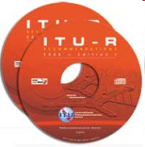
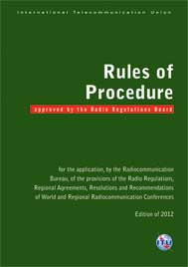
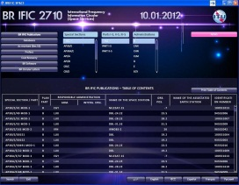
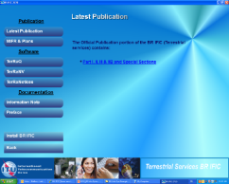
ITU-R structure & activities
Notices
RA
WRC
Rec
RAG
CPM
RRB
Director
Radiocommunication Bureau
SPACE & TERRESTRIAL services
SGD
SSD
TSD
IAP
SG
Reg. & Tech.
examinations
Draft RoP
Harm. Interf.
RoP: Rule of Procedure
RR: Radio Regulations (treaty status)
RRB: Radio Regulations Board
SG: Study Group
WRC: World Radiocommunication Conference
RoP
Findings
MIFR
CPM: Conference Preparatory Meeting
MIFR: Master International Frequency Register
RA: Radiocommunication Assembly
RAG: Radiocommunication Advisory Group
Rec: Recommendations (international voluntary standards)
IFIC: International Frequency Information Circular
BR IFIC

Slide 19
Radio Regulations (RR)
The Radio Regulations (international treaty)
incorporates the decisions of the World Radiocommunication Conferences, including all Appendices, Resolutions, Recommendations and
ITU-R Recommendations incorporated by reference.
Frequency block allocations to defined radio services (Article 5)
Mandatory or voluntary regulatory procedures (coordination, plan modification, notification, recording) that are adapted to the allocation structure

Slide 20
Radio Regulations
Status
RIGHT for international recognition
OBLIGATION to eliminate harmful interference
Art7-8
Frequency
TABLE
(9k-275GHz)
Art4-6
Interference
& monitoring
Art15-16
App9-10
Definitions – Art1-3, App14, 42
Administrative
Secrecy/Licences/
Interception/Identification of stations/
call signs/Service Publications
Art 17-20
Bureau & RRB – Art13-14
Procedures
Coordination,
Notification &
Recording
Art9, 11
App4-8
Limits
technical/operational
Arts21, 22
Apps1-3
Services
Aeronautical – Art35-45
Maritime – Art46-58
Amateur, broadcasting,
fixed, radiodetermination,
standard freq. & time - Art12, 23-29
App11-13, 16, 19
Plans
Maritime HF, VHF (App17-18)
Maritime coast stations (App25)
Aeronautical (OR) (App26)
Aeronautical (R) (App27)
Broadcasting-satellite (App30-30A)
Fixed-satellite (App30B)
GMDSS
Art30-34
App15
MIFR
(register)
Notes:
The objectives of the Radio Regulations
From the Preamble of the Radio Regulations (2004 edition):
0.5 With a view to fulfilling the purposes of the International
Telecommunication Union set out in Article 1 of the Constitution, these
Regulations have the following objectives:
0.6 to facilitate equitable access to and rational use of the natural
resources of the radio-frequency spectrum and the geostationary-satellite orbit;
0.7 to ensure the availability and protection from harmful
interference of the frequencies provided for distress and safety purposes;
0.8 to assist in the prevention and resolution of cases of harmful
interference between the radio services of different administrations;
0.9 to facilitate the efficient and effective operation of all
radiocommunication services;
0.10 to provide for and, where necessary, regulate new applications
of radiocommunication technology.
The various objectives of the Radio Regulations may in some cases be in contradiction with each other.
The ITU Radio Regulations is an international treaty, which successfully provided for the harmonious and coordinated use of radio systems. The RR is based on technical and operational standards, frequency allocation to radio services, procedures for vesting rights and establishing obligations. They exist for more than 100 years now!

Slide 21
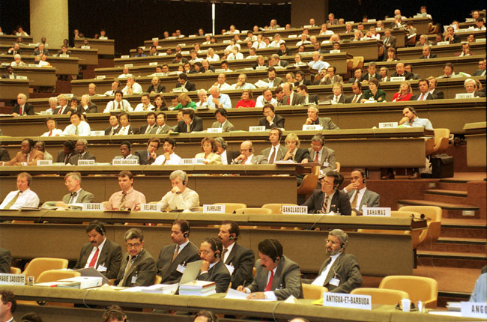
World Radiocommunication Conference
Updates the Radio Regulations (treaty status)
  Spectrum Allocation
  Notification procedures
  Administrative and operational procedures
Adopts Resolutions
Held every 4 years
WRC
http://www.itu.int/ITU-R/go/wrc

Slide 22
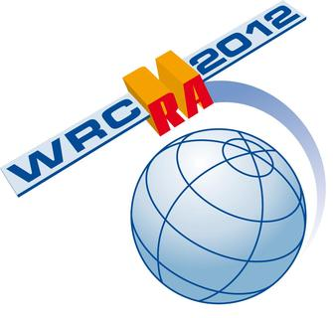

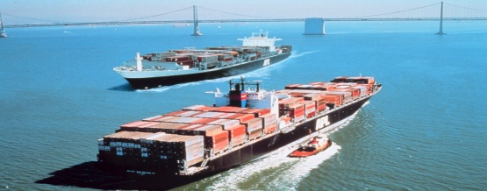
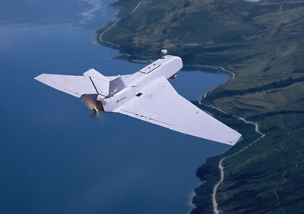
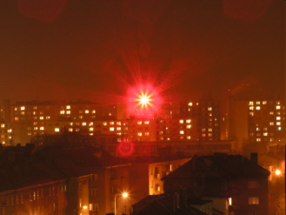
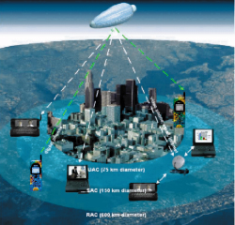
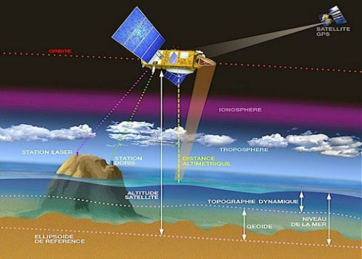
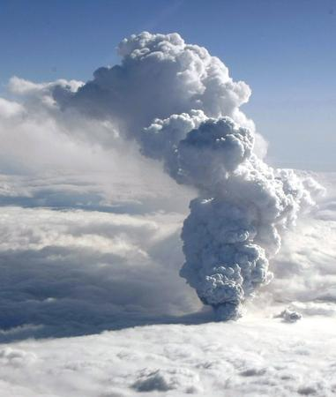
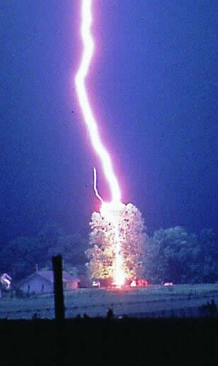
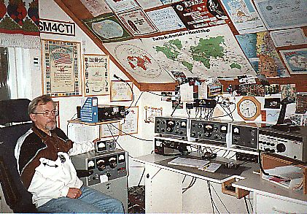
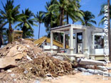
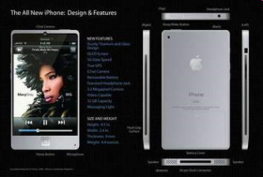
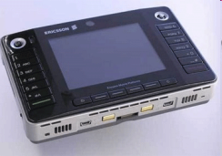
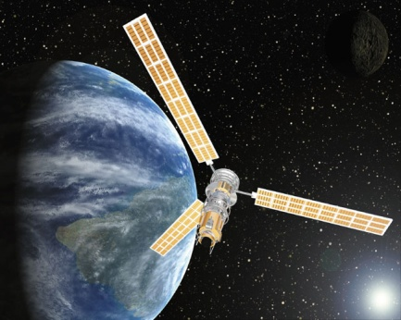
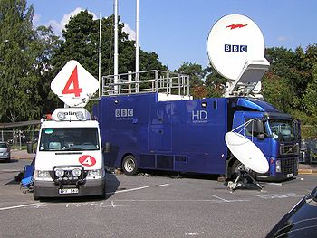
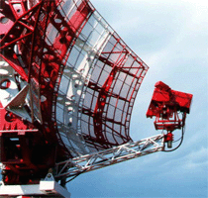
WRC-15
9 kHz < proposals < 3000 GHz
http://www.itu.int/en/ITU-R/conferences/wrc/2015
Notes:
WRC-12 will cover many agenda items/subjects including the preparation of the next WRC (2015 or 2016).
ITU plays a leading role in establishing the standards and spectrum arrangements for IMT, which provides the global platform for the next generations of mobile broadband services.
It is now timely to review the initial forecasts of spectrum requirements and to assess what further actions may be required to realize global mobile broadband’s vast potential to connect the world.
This review is being addressed in the ITU-R’s Study Group and Conference activities.

Slide 23
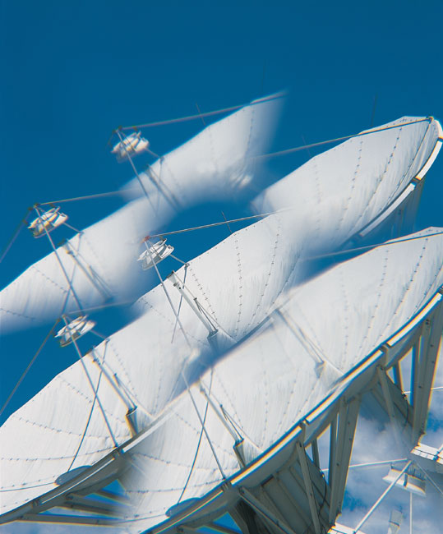
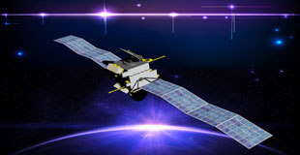
Space Services
WRC
Coordination and recording procedures for space systems and earth stations: capture, processing and publication of data and examination of frequency assignment notices submitted by administrations for inclusion in the formal coordination procedures or recording in the Master International Frequency Register (MIFR).
Procedures for space related assignment and allotment plans
Assistance to administrations on all of the above issues
http://www.itu.int/ITU-R/space

Slide 24
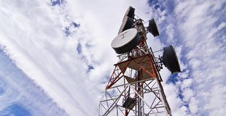
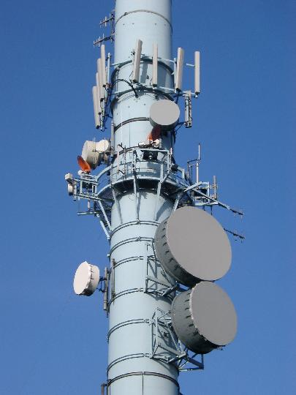
Terrestrial Services
Regulatory and Technical Functions
  Broadcasting / Fixed and Mobile /
  Maritime Mobile / Aeronautical Mobile
Terrestrial Plans
  AP25, AP26, AP27, ST61, GE75, RJ81, GE84, GE85M, GE85N, RJ88, GE89, GE06
HF Broadcasting (Art.12)
Administrative and Operational Procedures
  International means of identification
    - call sign series / maritime identification digits /
    blocks of selective call sign numbers
  Service Documents
    Ship stations / coast stations / radio determination / call signs / MARS, etc
Harmful interference & monitoring programs
http://www.itu.int/ITU-R/terrestrial

Slide 25
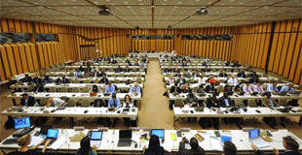
ITU-R Study Groups
>900 Recommendations
“Standards” in areas of spectrum management and radio technology
Result of consensus from meetings of world-wide experts
Some referred to in RR
Used by spectrum planners and system designers
SG 1: Spectrum management
SG 3: Radiowave propagation
SG 4: Satellite services
SG 5: Terrestrial services
SG 6: Broadcasting service
SG 7: Science services
In addition:
CCV: Coordination Committee for Vocabulary
CPM: Conference Preparatory Meeting
http://www.itu.int/ITU-R/go/rsg

Slide 26
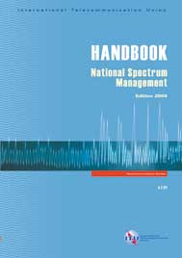
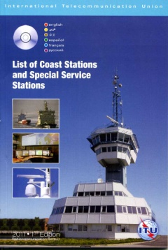
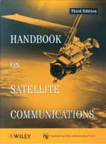
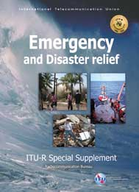
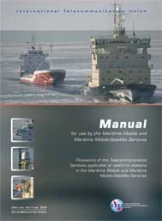
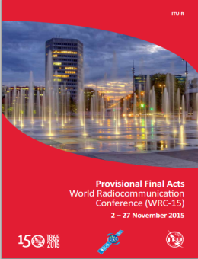
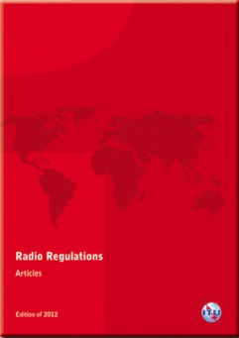

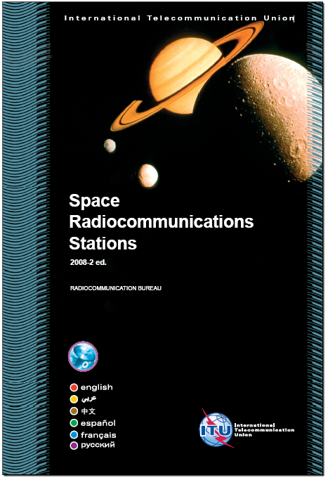
ITU-R Publications
Radio Regulations (RR)
Service documents
  e.g., BR International Frequency Information Circular (IFIC)
ITU-R Recommendations
  Online subscriptions
  CD/DVD-ROM
  Paper
Handbooks & Reports
http://www.itu.int/publications

Slide 27
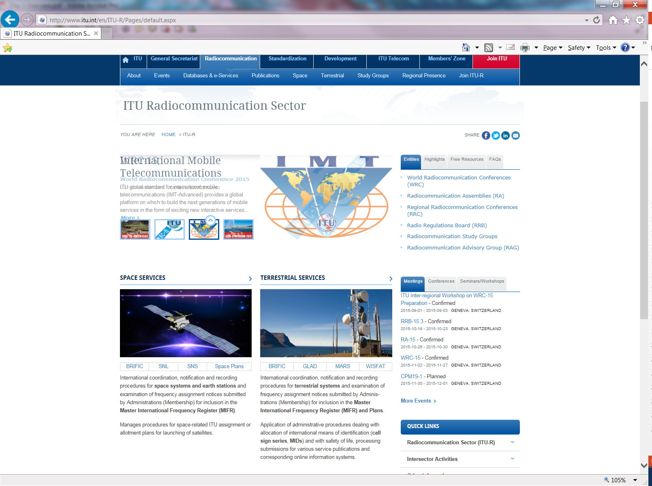
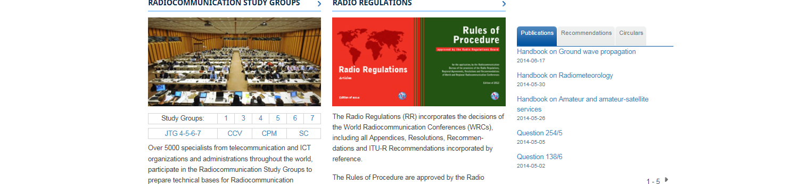
ITU-R Homepage

Slide 28
Thank you !

