Slide 1
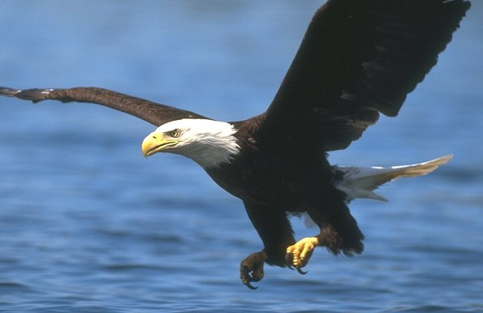
Human Capital Development Forum - in ICT
Preparing Ourselves to Excel

Slide 2
Session Goals
To provide an opportunity to reflect on the current challenges of our leadership role
To explore some different models/ concepts on leadership
To reflect on opportunities for a different approach to our leadership role
Make some personal commitments to action for change

Slide 3
Resilient Leadership for Challenging Times!!...???
Notes:
Notes:

Slide 4
Four Approaches To
HCD Leadership
Inactive:
“Going with the flow”
Reactive:
Planning through the rear view mirror.
Preactive:
Preparing for the future.
Proactive:
Designing to create or, at least, to influence the future.

Slide 5
Why?
Why Consider a New Approach to HCD Leadership?
“The significant problems we face cannot be solved
at the same level of thinking we were at when we created them.”
~ Albert Einstein

Slide 6




Learning Styles
Activist
Pragmatist
Reflector
Theorist
Notes:
Sam (9:45 – 9:55 am)

Slide 7
The Experiential Learning (Model)
Having an
experience
Activists
Planning the
next Experience
Pragmatist/Planners
Reviewing the
Experience
Reflector/ Analysts
Concluding from
the Experience
Theorist

Slide 8
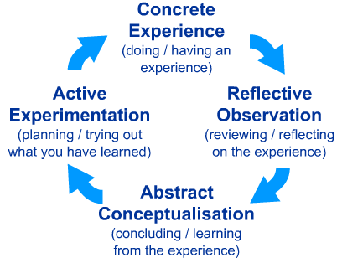
Forum – Stepping Back:
Kolb’s Learning Cycle
Retreat
from
work
Back
to
work
Activists
Pragmatists / Planners
Reflectors
Theorists / Analysts
"teaching is only demonstrating that it is possible.
learning is making it possible for yourself"
– paolo coelho (the pilgrimage)

Slide 9
Process Content Model
CONTENT
What is done/ discussed,
Which tasks are performed.
WHAT?
HOW?
ASSIGNED TASK
RESULTS
ACHIEVED
PROCESS
How discussions are conducted
and how tasks are performed.

Slide 10
Process Content Model
Create an Agenda
Develop a
Solution
Make
Decisions
Identify & Evaluate Alternatives
Gather data & information
Formulate
Goals
Communicate
Opinions
Develop Strategies & Plans
WHAT
(CONTENT)
HOW
(PROCESS)
RESUL
TS
TASK
Degree of openness/
Frankness
Use/Degree of influence & power
Personal
Goals/Motives
Stress
& Pressure
Degree of Teamwork
Degree of Teamwork Vs. individual interest
Conflicts
Level of Group maturity
Level of
Trust

Slide 11
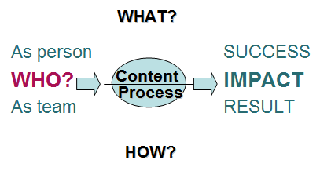
It’s not just What? And How?, but Who & Why?
It is not just about
what we do, or how we do it,
but first of all about who you are
and why you do it!
What is your purpose & who do you need to be – as a person, as the HCD Leader in an organisation
so that you can achieve & create! –
the vision, objectives and goals you truly want?
WHY?
Notes:
Notes:

Slide 12
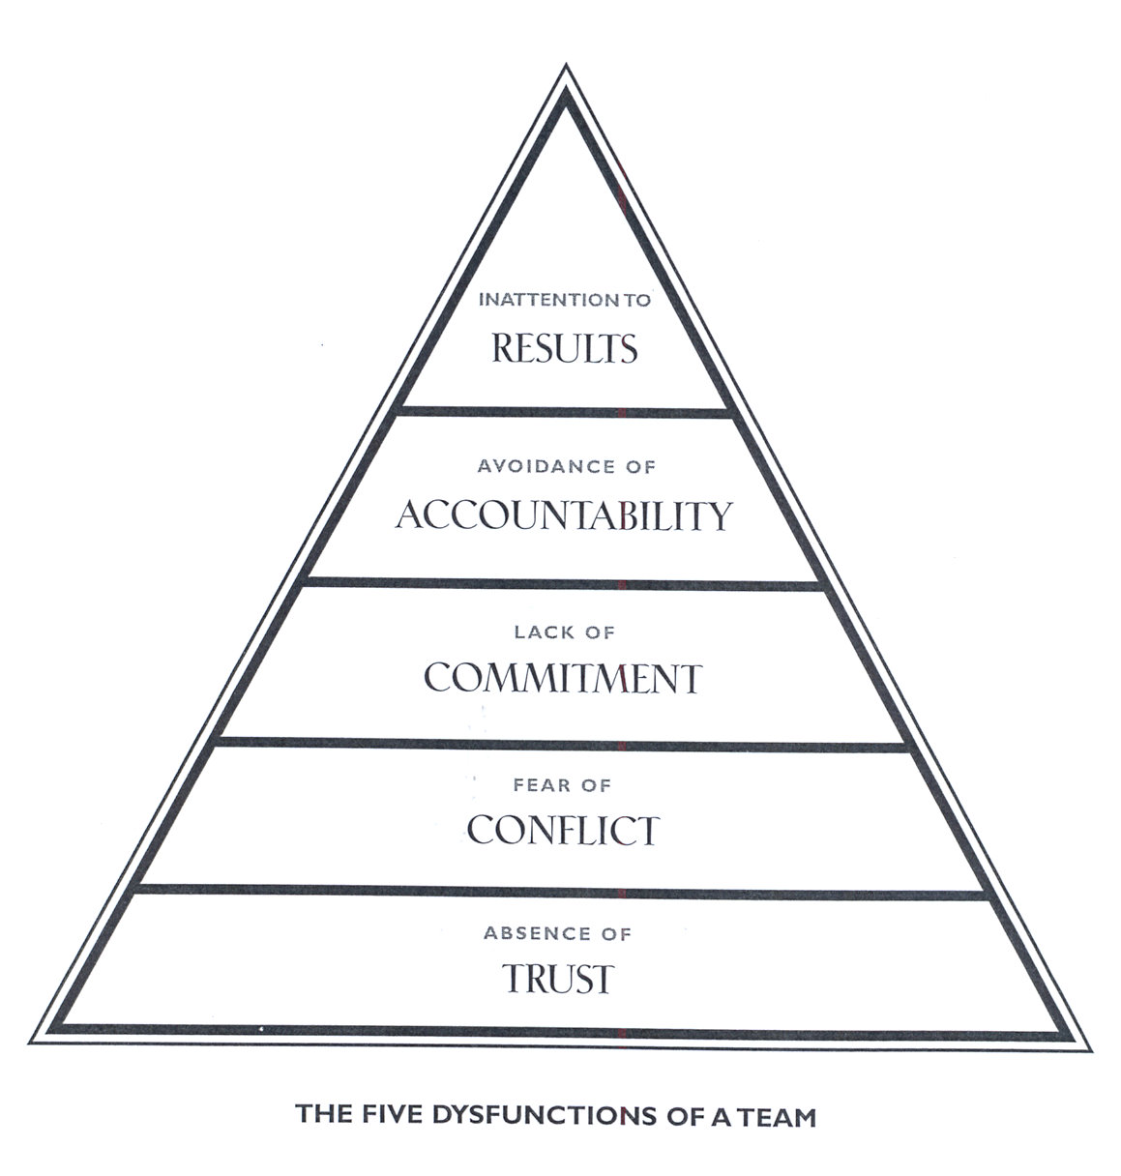
5 Team Dysfunctions Model
PRETENCE OF NON
VULNERABILITY
HIDING OUR
AUTHENTICITY
Your Life Purpose
Talents/Strengths – Values - Passions

Slide 13
Importance of Trust
It’s the foundation of all cooperation
Enables
co-creation and innovation
Creates a safe environment
in the team
Enhances resilience
in good and tough times
Allows open discussion
Provides support

Slide 14
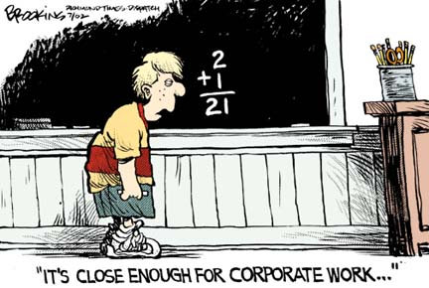
HCD Accountability – How Am I Going to
Measure My Leadership Effectiveness?
Is this Close Enough for the HCD Leadership Role….??

Slide 15
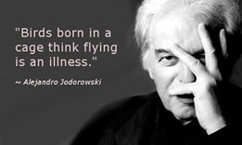

Slide 16

There’s Always Other Options

Slide 17
Reflection Questions
What are the things that as an HCD Leader you’re doing that excite (need to continue/ Keep doing)?
What does not feel good (do less/ Quit doing)?
What seems to present potential opportunities (do more of/ Start Doing)?

Slide 18
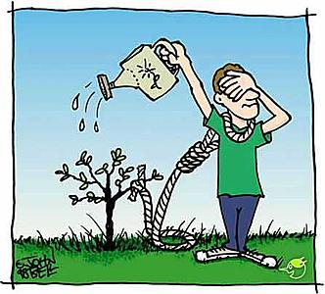
Do you have a sense of internal security around the process and your HCD role? What needs to be done to secure this?

Slide 19
Mafuno Abwino!!
Notes:
Notes:

