Slide 1

The
INTERNET of
EVERYTHING
Stephen Gachogu, AFRALTI

Slide 2
Objectives
Describe the Internet and its evolution to the Internet of Things and Everything
Explain the four pillars of IoT i.e. people, process, data, and things.
Explain how things that are non-IP-enabled and IP-enabled devices can be connected to a network to communicate in the Internet of Things
Explain security concerns that must be considered when implementing IoE solutions
Describe the M2M, M2P and P2P interactions

Slide 3
What it is?
Internet of Things refers to the networked connection of people, process, data, and things.
The benefit of IoT is derived from the compound impact of connecting people, process, data, and things, and from the value this increased connectedness creates as “everything” comes online.

Slide 4
History of the Internet
Began in 1969, where it interconnected a few sites
The Internet has evolved in ways that we could never have imagined
Internet will interconnect 50 billion things by 2020.
The Internet now provides global connections that make web surfing, social media, and smart mobile devices possible.

Slide 5
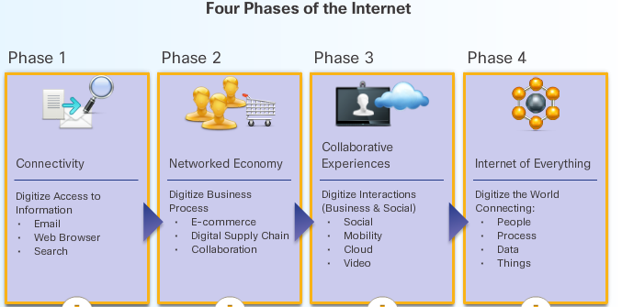
Evolution of the Internet

Slide 6
The Internet: The Place to Go
Normally, when people use the term Internet, they are not referring to the physical connections in the real world.
They tend to think of it as a formless collection of connections.
It is the “place” people go to find or share information. It is the 21st century library, video store, and personal photo album.

Slide 7
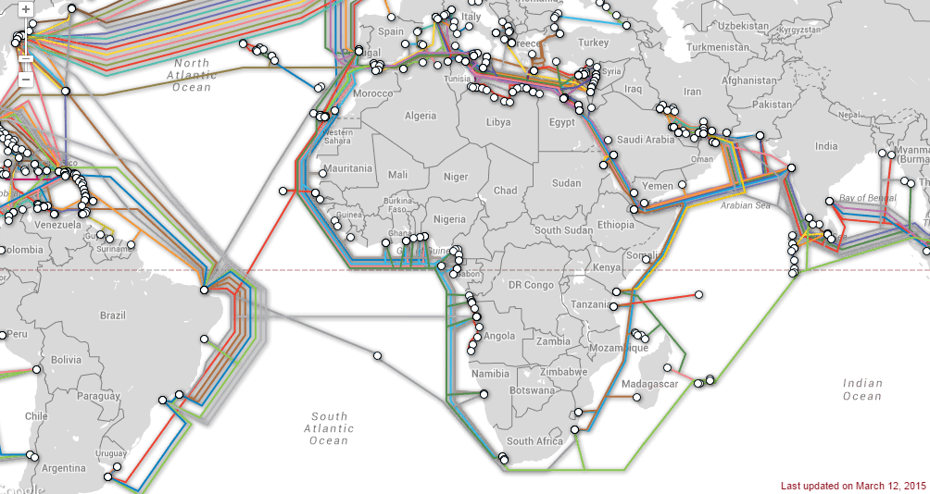
Interconnection of Countries
Source: http://www.submarinecablemap.com

Slide 8
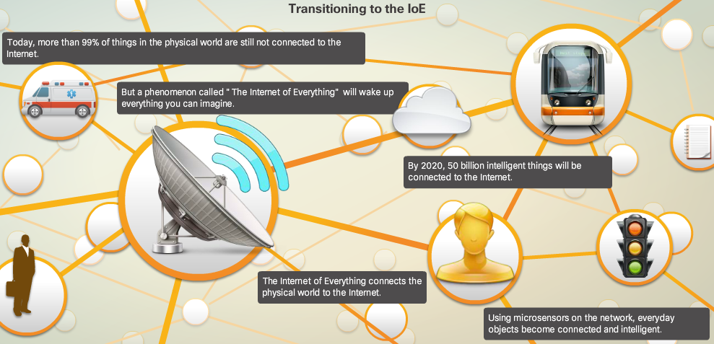
Transitioning to IoT

Slide 9
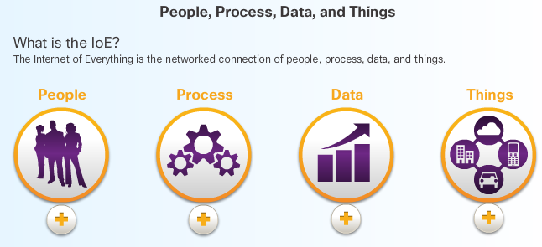
Pillars of IoT

Slide 10
People, Process, Data, and Things
People: Today, most people connect socially through their web-enabled devices
Processes occur between all of the other pillars in the IoE. With the correct processes, connections become more valuable.
Data is the information generated by people and things. This data, when combined with analytics, delivers actionable information to people and machines.
Things are physical objects that are connected to the Internet and to each other.

Slide 11
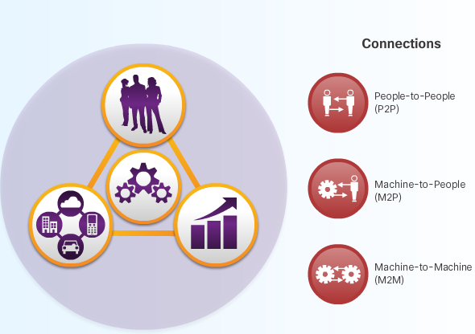
Interactions of the IoE

Slide 12
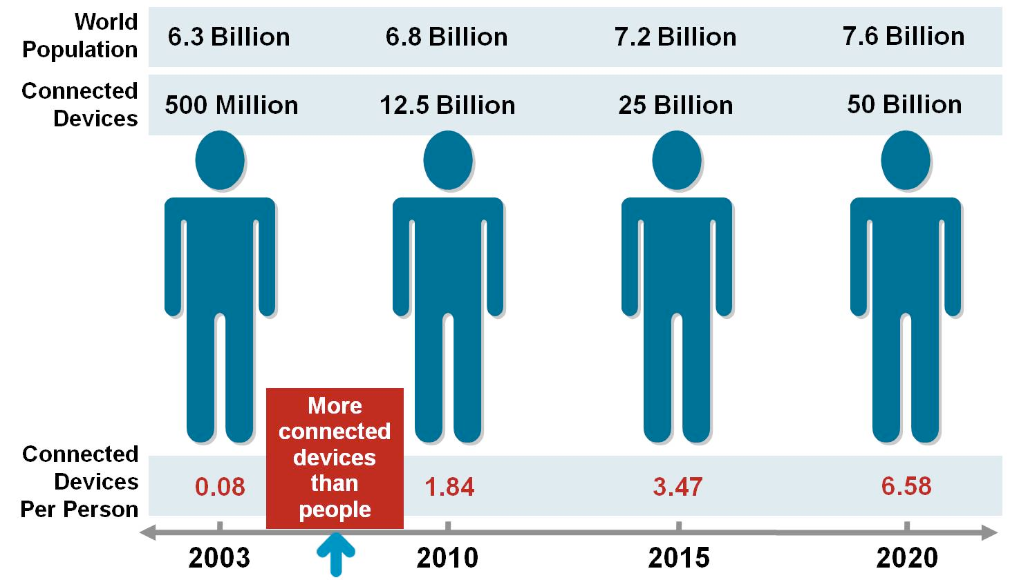
Need to Adapt
The Internet is changing the way we communicate, collaborate, and learn.

Slide 13
Governments and Technology
Governments are not immune to the change caused by rapid information exchange through technology.
Officials can respond quickly to emergencies through real-time data.
Citizens can connect through social media and gather support for change.

Slide 14
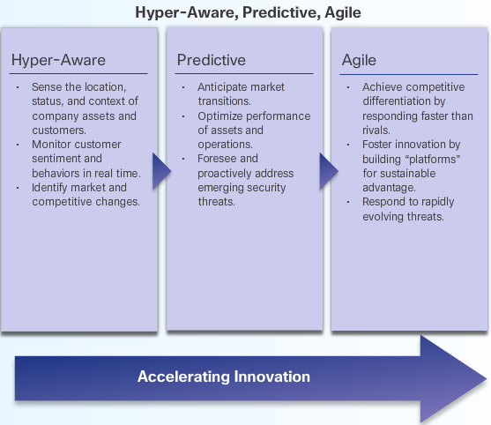
Preparing for IoT

Slide 15
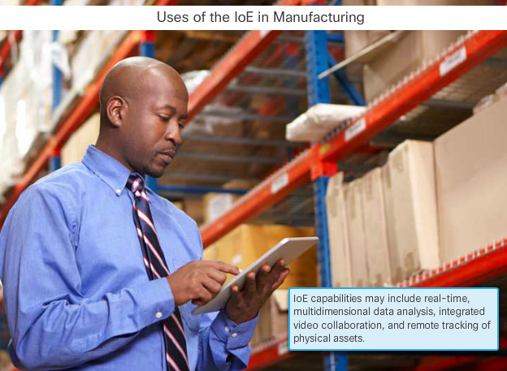
IoE and Industries

Slide 16
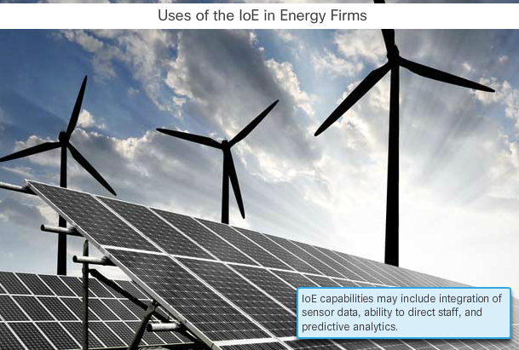
IoE and Industries

Slide 17
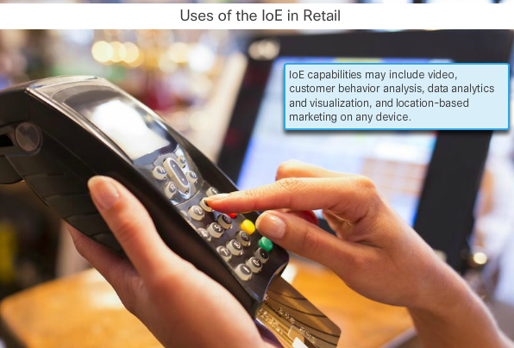
IoE and Industries

Slide 18
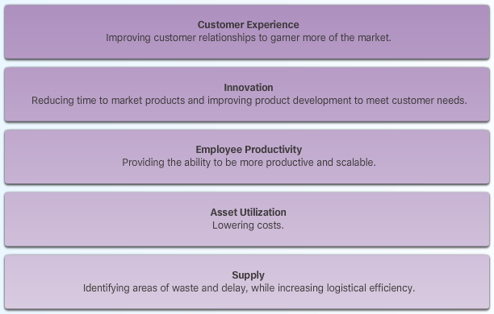
IoT affect the following five priorities in an organization

Slide 19
Maximizing IoE Value
For organizations to join the IoE economy, and maximize the value of their IoE implementation, they must consider:
Investing in a high-quality technology infrastructure and tools
Adopting and following inclusive practices in which the employees feel as though they are part of the change
Developing effective information-management practices embracing and promoting change.

Slide 20
Networks: Foundation of IoT
Fifty billion things provide trillions of gigabytes of data. How can they work together to enhance our decision-making and interactions to improve our lives and our businesses?
Enabling these connections are the networks that we use daily. These networks provide the foundation for the Internet and, ultimately, the IoT.

Slide 21
Networks: End Devices
Some examples of end devices are:
Computers
Network printers
VoIP phones
Video conferencing endpoints
Security cameras
Mobile handheld devices
Sensors such as thermometers, weight scales, and other devices that will be connected to the IoE

Slide 22
Networks: Intermediary Devices
Switches and wireless access points (Network Access)
Routers (Internetworking)
Firewalls (Security)

Slide 23
Networks: Media
Metallic wires within cables
Glass or plastic fibers (fiber optic cable)
Wireless transmission

Slide 24
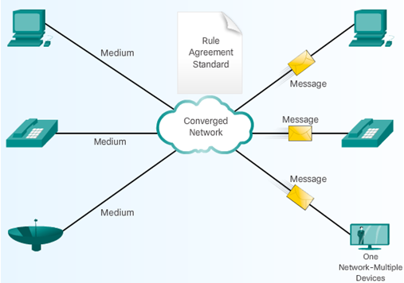
Converged Networks

Slide 25
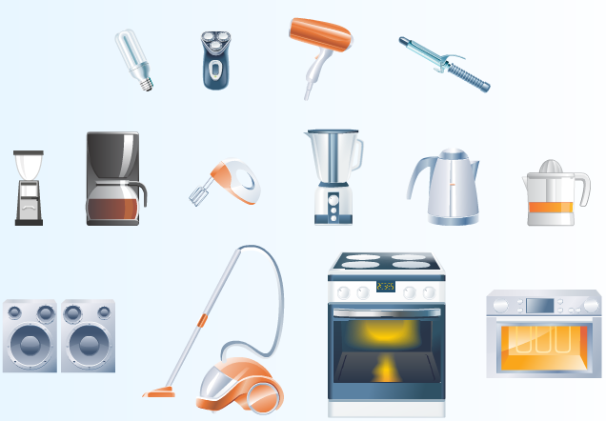
Unconnected Devices

Slide 26
Sensors
Sensors are one way to collect data from non-computers. They convert physical aspects of our environment into electrical signals that can be processed by computers.
Some examples are soil moisture sensors, air temperature sensors, radiation sensors, and motion sensors.
Sensors of all types will play an important role in connecting what has traditionally been unconnected in the IoE.

Slide 27
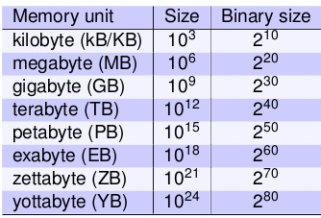
Data as a Pillar
Within the last decade, the volume of data that was produced in a year is now produced in a week.
That amounts to over 20 exabytes of data produced a week.
Data continues to grow
exponentially as more
of the unconnected
become connected.

Slide 28
Big Data
There are three primary dimensions of Big Data that must be accounted for:
Volume - Volume describes the amount of data being transported and stored.
Variety - Variety describes the type of data it is
Velocity - Velocity describes the rate at which this data is moving – dependent infrastructure (input/output, bandwidth, and latency)

Slide 29
Big Data
Big Data refers to the way in which organizations collect and analyze vast stores of data for insights that can help identify trends, predict behavior, and empower decision makers. It considers:
  How much data is generated
  How this data is identified and managed as an asset to the organization
  How this data is turned into usable information
  How organizations use this data to make decisions

Slide 30
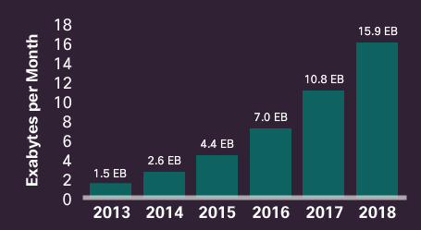
Big Data
Source: Cisco VNI Mobile, 2015

Slide 31
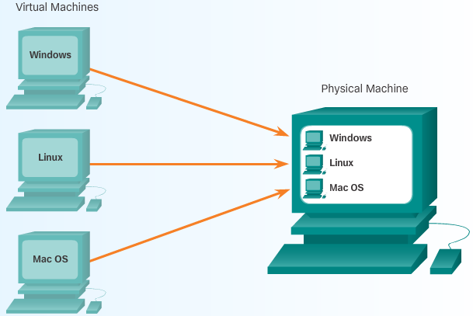
Virtualization
By virtualizing the servers and networks, companies can reduce operational and administrative costs.

Slide 32
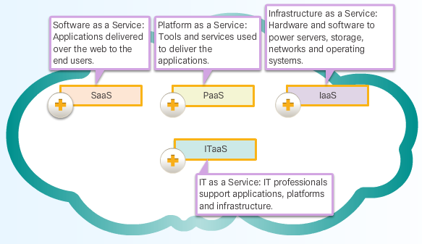
Cloud computing

Slide 33
Data Centers
Data centers are a critical enabler of Cloud computing. Provide business continuity by keeping the computing services available.
Location
Security
Electrical
Environmental
Network

Slide 34
Clouds
Cloud computing uses a shared pool of computing resources (e.g., networks, servers, storage, applications, and services) to provide on-demand network access.
Private
Public
Community
Hybrid

Slide 35
Businesses & Data
A modern business is aware of targeted marketing that creates differentiated offerings based on customer needs.
Example: E-commerce sites and loyalty programs allow businesses to know more precisely what kind of product or service you may require.

Slide 36
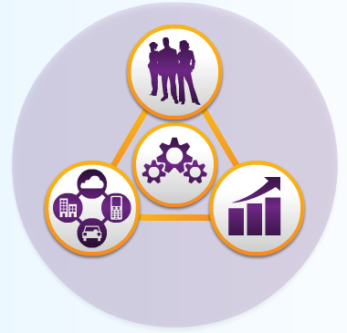
Processes as an IoT Pillar
Processes are facilitating interactions between people, things, and data. Today, the IoE brings them all together by combining
  Machine-to-machine (M2M),
  Machine-to-people (M2P),
  People-to-people (P2P)

Slide 37
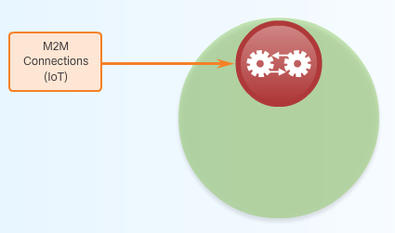
M2M
Machine-to-Machine (M2M) connections occur when data is transferred from one machine or “thing” to another over a network.
Machines include sensors, robots, computers, and mobile devices. These M2M connections are often called the Internet of Things

Slide 38
M2M Applications
Vending machines
Measure vibration, load, and other factors
Traffic Lights
Water/Electricity meter
Weather forecasting.
In air and water pollution.
Measuring agricultural conditions such as soil temperature and moisture.
Earthquake monitoring, Japan

Slide 39
Impacts of M2M on Telecommunication Networks
A tremendous increase in the volume of data they will be expected to carry.
Periodic peaks in demand when many devices access the network at the same time

Slide 40
Issues with M2M communications
Huge data( bandwidth intensive)
Devices are battery powered therefore need replacement
Standardization is essential for innovation
The protection of data and privacy is also key from a user perspective
Protecting privacy must not be limited to technical solutions, but encompass regulatory, market-based and socio-ethical considerations

Slide 41
M2M Opportunities and Benefits
The revenue opportunity is enormous.
  Forecasted >15B Connected Devices by 2015; >50B by 2020!
With saturating mobile subscribers, machines and sensors represent the clearest way for mobile revenue and services to grow.
Many telemetry applications do not use much bandwidth.
  Attraction is similar to short message service: high margins, low bandwidth consumption.

Slide 42
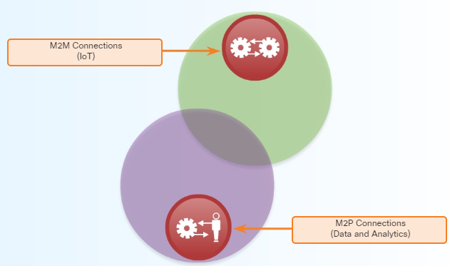
M2P
Machine-to-People (M2P) connections occur when information is transferred between a machine (such as a computer, mobile device, or digital sign) and a person

Slide 43
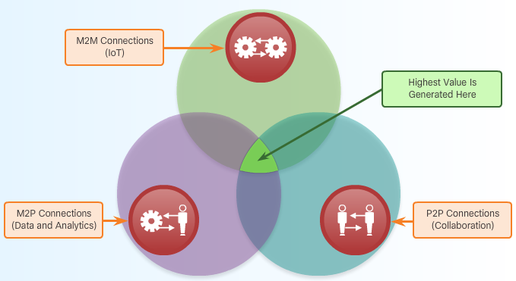
People-to-People (P2P)
P2P connections occur when information is transferred from one person to another. Increasingly, P2P connections happen through video, mobile devices, and social networks.
P2P connections are often called Collaboration.

Slide 44
Top Challenges to Realizing Value from IoE
Need to invest in new technology infrastructure
Ability to integrate new technologies with legacy IT environments
Ability to update processes to absorb new technologies

Slide 45
Summary
Describe the Internet and its evolution to the Internet of Things and Everything
Explain the four pillars of IoT i.e. people, process, data, and things.
Explain how things that are non-IP-enabled and IP-enabled devices can be connected to a network to communicate in the Internet of Things
Explain security concerns that must be considered when implementing IoE solutions
Describe the M2M, M2P and P2P interactions of a modeled winery and review an example of an IoE solution at a modeled winery

Slide 46
Thank you.

