Slide 1
The Impact of the Mobile Money Revolution in Africa

Slide 2
Objectives
Growth of the Industry
Mobile money services
Impact on the society
Regulatory issues

Slide 3
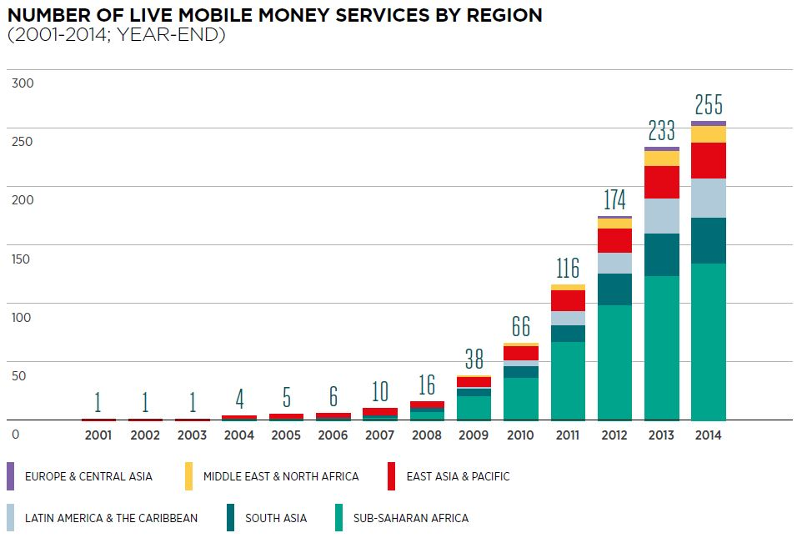
Mobile Money services in the world
With 255 services in 89 countries as of December 2014, mobile money is now available in 61% of developing markets worldwide

Slide 4
Mobile Access
As a result of fixed-line limitations, mobile services still represent more than 90% of all telephone lines in service in Africa.
The popularity of cheaper prepaid services, which in some markets account for up to 98% of all mobile subscribers
Source:internetworldstats.com

Slide 5
Mobile Growth
Sub-Saharan Africa (SSA) has been the fastest growing region over the last five years in terms of both unique subscribers and connections (i.e. SIM cards), with the unique subscriber base growing at a compound annual growth rate (CAGR) of 17% per annum over the period.
By mid-2014, there were 329 million unique subscribers, equivalent to a penetration rate of 38%.

Slide 6
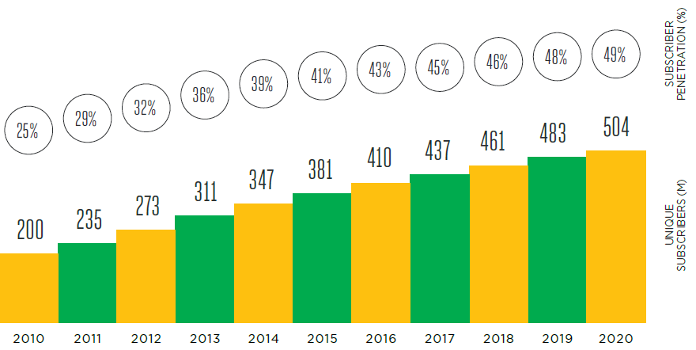
Growth of the Industry
Unique subscribers and penetration rates in Sub-Saharan Africa

Slide 7
Mobile Services
Consumers, governments and businesses across SSA are rapidly adopting mobile not only as basic communication tool but also to access information and a growing range of new applications and services.
Mobile money services are a clear success story for the industry, with mobile money bringing financial services to millions of previously unbanked citizens across the region, driving economic growth and promoting financial inclusion.

Slide 8
Enablers of Mobile Money
Conducive Environment
Substantial mobile penetration
Increasing ICT knowledgeable population
Strong demand for domestic fund transfers
Shift in customer preference for convenience
Reach difficulties for financial services
Spread of locations and working hour restrictions
Less / no medium available for short term storage of funds
Banks discourage low balances
Low service quality of existing alternatives

Slide 9
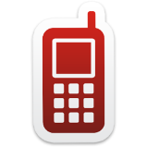



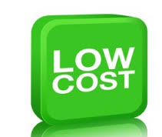


Significance Of Mobile Money
Mobile Platform extended for financial services
Competitive advantage over Traditional Money Systems.
Reduces unbanked and under-banked population
Usage based revenue model –profitable
Low cost transaction model

Slide 10
Access to finance
Access to finance remains a key challenge for populations across SSA, with only around 20% of families in the region having access to bank accounts
Mobile money services have already made a significant contribution to delivering financial inclusion, though there is still much to be done,

Slide 11
Mobile money services
Mobile money services have seen strong take-up in a number of markets, including Kenya, Uganda and Tanzania.
In Kenya alone, there were 26 million registered mobile money users at the end of 2013, with estimates suggesting that nearly 60% of the adult population in the country were using the service

Slide 12
Mobile phone-based Money Transfer (MMT
The recent introduction of mobile phone-based money transfer (MMT) services in developing countries has generated a lot of interest among development partners.
It facilitates transfer of money in a quick and cost effective way.
Offers an easy and secure platform for small savings to majority of rural populations with no access to formal financial services.

Slide 13
New Innovations
M-Shwari in Kenya - enables subscribers to save and borrow money
EcoCash by Econet Wireless Zimbabwe for saving money
‘Tigo Kiiray’ by Tigo Senegal in partnership with mobile micro insurance specialist Bima - offers micro insurance product
Safaricom in Kenya m-commerce platform - The operator has already signed up 122,000 merchants to accept M-PESA to pay for goods and services, including local supermarkets.

Slide 14
Impact on Society
Improving individual income
Improving Health
Improving Agriculture
Improving Business

Slide 15
Regulations
The role of the regulator is to create an enabling regulatory environment for mobile money.
By providing incentives for service providers to invest and avoiding overly prescriptive or burdensome requirements.
Example: Kenya’s central bank has managed to encourage innovation and growth while preserving the stability and soundness of the financial sector.

