Slide 1
Towards to the Digital economy –strategies and opportunities for Growth
Afralti Forum 2015
Jk Kandie
Communications Authority of Kenya

Slide 2
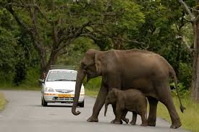
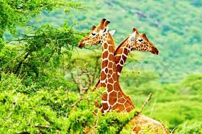
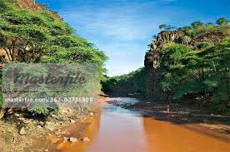
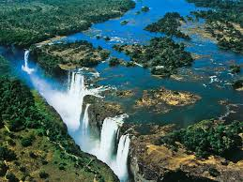
Africa: The wealthy continent
Our Region is endowed with great wealth;
Natural resources (Minerals, oil, rich soil, Wildlife, landscape)
Excellent & Diverse climate all year for farming & human Occupation
Africa can feed the world.

Slide 3
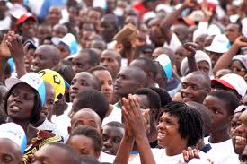
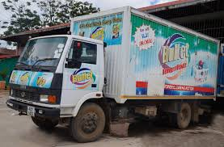
Population and Size
The 2nd largest Continent
The 2nd most populous continent on earth
Estimated population of 1.033Bilion
Made up of 54 states.
Huge Market for products & Services

Slide 4
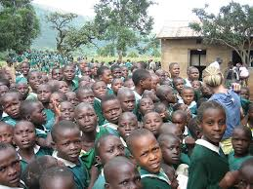
About 65% of the total population are below the age of 35
35% are between the ages of 15 and 35 years – making Africa the most youth full continent.
High population growth rates is experienced by most countries
Rich and diverse cultures across the continent
Huge potential
The Human Resources

Slide 5
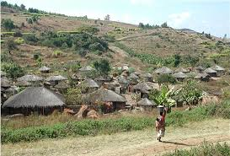
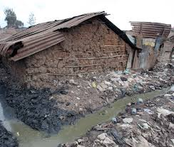
The Reality
We have not exploited our full potential; we have to content with;
High Un employment
Poverty levels are still high; old age poverty being a big challenge
Health care still a big challenge
Food deficiency in some parts
Low literacy levels
Poor Housing for most of the population

Slide 6
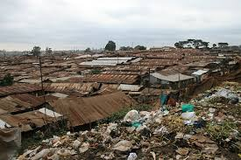
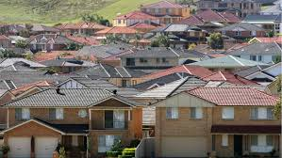
Can ICT cause the desired changes?
“ICT services can transform people’s lives both socially and Economically” Emmanuel Mwamba PS Ministry of Information and Broadcasting service

Slide 7
If this is possible, where do we start?

Slide 8
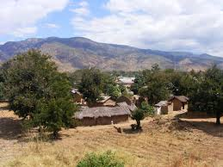
The Connected People
Prior to 1960s, most population in Africa lived in the villages.
Communities were closely connected.
Time and distance was not an issue
Zambia Village

Slide 9
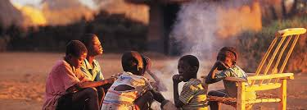
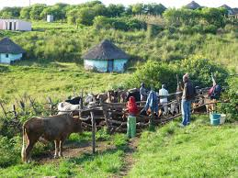
Personal interaction was key to information sharing.
Relationships were build around common issues
Work was communal with mutual benefit
The connected Community

Slide 10
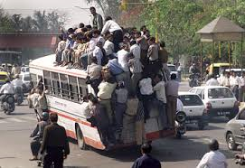
The migration
Immediately after independence, there was great migration to the cities
Bigger population in a small area meant higher demand for goods and service
Urbanization grew fast in the newly independent nations

Slide 11
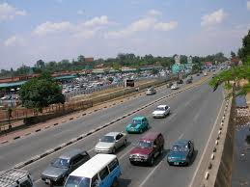
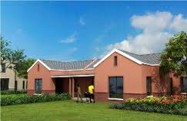
The Divide
Infrastructure development grew faster in the cities
Individuals aspire to improve lifestyles
Nuclear Families developed and family ties weakened with clan members

Slide 12
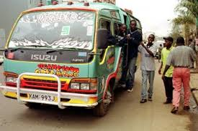
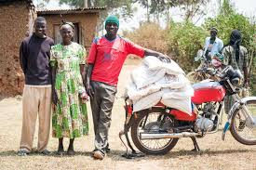
The Divide
Urban areas are perceived to be well off, with good infrastructure and jobs.
The rural areas are perceived to be poor and struggling for food
Created a divide between Urban and rural areas

Slide 13
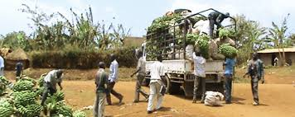
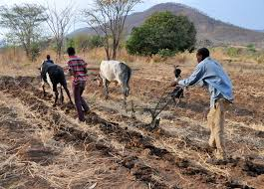
The Rich, Yet poor producers
Most of the food eaten in the urban areas come from the rural areas.
The rural producer has to however struggle with;
High Input costs
Challenges in accessing the market.
Selling to middlemen at low prices.
Lack of information on prices & new techniques
THERE LIES THE OPPORTUNITITES

Slide 14
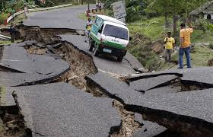
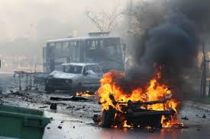
The power of ICT
We are in the age of information explosion.
An event taking place in one part of the globe is known in the entire globe within seconds.
The global community reacts to the events
The information influence people’s behaviour and buying habits

Slide 15
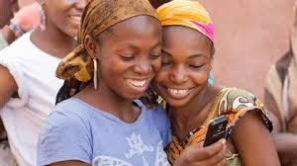
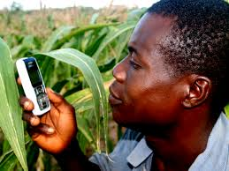
Being Connected again
With ICT people can be connected again.
Relationships strengthened and new ones developed.
Family ties with the rural areas can be strengthened

Slide 16
Information has power to alter Dynamics
Global brands use ICT to focus on the Market.
Products reach un expected areas
Firms do not have to be present in a region to sell their products
This strategy can also work for any enterprise and country

Slide 17
“I have learnt that even the best conditioned thinkers are using less than 1% of their mental reserves” – Robin Sharma (The monk who sold his ferari)
The Digital economy is a knowledge based Economy.
The Economy relies on the power of ICT to access markets and also develop new products.
The creative services form a big percentage of the products
Strategies and Growth Opportunities

Slide 18
Bumper Harvest
The marketing only reaches a small portion of the population
The producers remain as subsistence

Slide 19
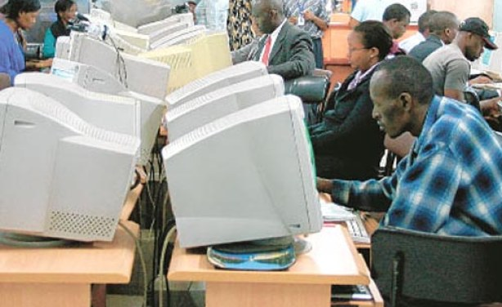
Create ICT enabled information centers in the rural areas
;
Farmers to access markets, getting to know the areas with high demand
Access to new farming techniques or high value products
Sell their produce to the global markets

Slide 20
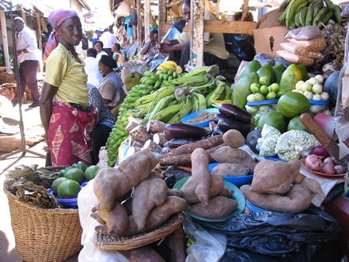
With Information using the mobile phone, the farm produce can move from the farm to the Supermarket with good prices o the producer

Slide 21
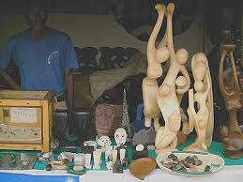
From Craft to work of Art
Most craft sellers wait on the road side for tourists.
The products can be sold to the global market through Virtual shops as work of Art
Need for Value additions, eg as gift items

Slide 22
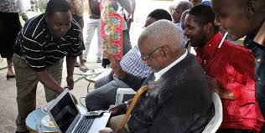
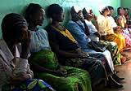
Skype a doctor
Most Countries have shortage of specialist doctors.
Most health centre provide the basic services
Skype can be used to access specialists
Create linkage between specialists and rural health centers

Slide 23
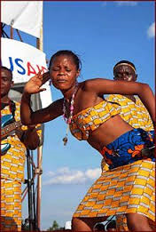
The creative Economy
The lack of sight does not mean lack of vision & creativity
Music and Entertainment to reach the global markets
On line sale of creative works opens the global markets
From Local to Global

Slide 24
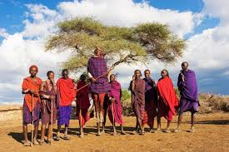
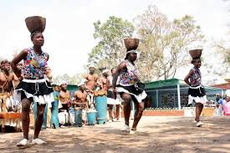
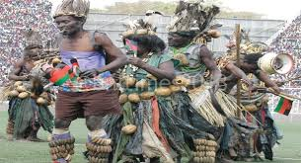
Cultural diversity
The rich cultural diversity can be part of the creative economy.
Producers of creative works to sell directly to the global markets
Entertainment groups can form companies, sell right and loyalties for their works

Slide 25
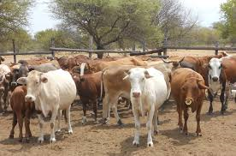
Courier /Postal to complement ICT
The courier and postal subsector can accelerate the digital economy.
The producers market their producers, buyers pay online and the courier/postal deliver the products

Slide 26
ICT as critical infrastructure for Development
Investment in ICT infrastructure should be treated at the same level as investment in Road, water and power.
They are all interdependent services that will transform the Economy.
They open the market, facilitates payment and movement of goods & services

Slide 27
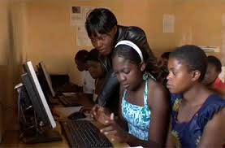
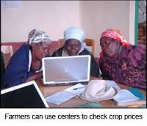
What is required
Invest in capacity building on use of ICTs – Use Associations & Societies – e.g cooperative societies.
Encourage investment in information centers
Develop capacity in software and applications

Slide 28
A secure and simple payment system
Strengthen use of mobile platforms since most of the population can access information directly
Strong and secure payment system will facilitate the digital economy

Slide 29
ICT has the potential to transform social and economic lives of the citizens.
ICT can tap into the creative talents of the people and also access markets
For this to happen, investment in Human capital is paramount.
Conclusion

Slide 30
Conclusion
The HR professional should take a proactive role in this development and exceed the boundaries
Consider the Microsoft approach to recruitment (short Video)
THANK YOU
Kandie@ca.go.ke

