Slide 1
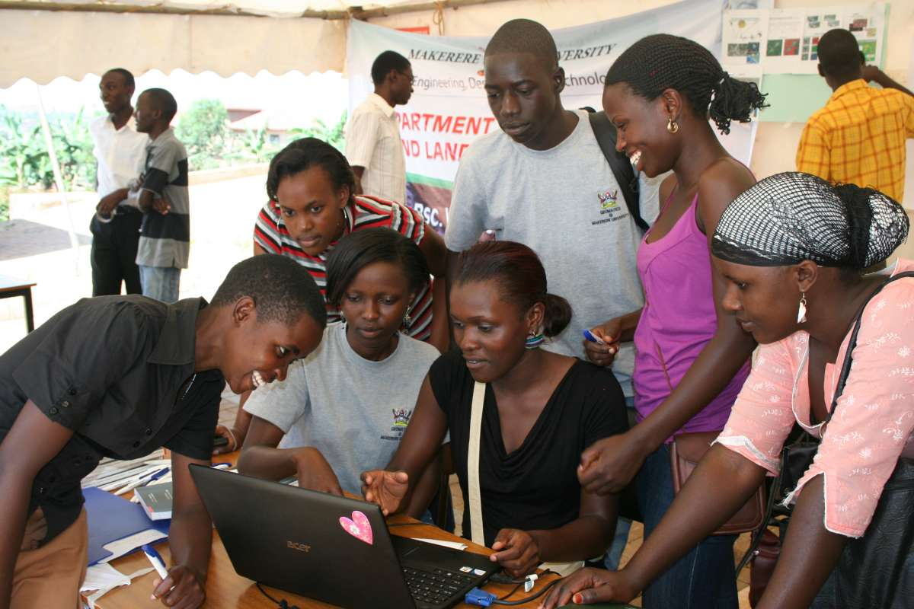
Challenges of ICT Skills Development in East Africa
Geoffrey Mark Kagarura
Makerere University
“Bridging the ICT Skills Gap through collaboration between The Industry and the Academia in the East African Region.”
Kigali, 20th June 2016
Notes:
EACO Members Academia/Training Institutions Consultants in the ICT Sector Policy makers which includes: Ministry of Information, Communication & Technology, Ministry of Education Telecom Operators and ICT Regulators ICT Service Providers Other ICT Service Providers who are not members of EACO Research Institutes Consumer Organizations. National training Authorities

Slide 2
Introduction
The skills in Africa are yet to match the needs of the employers. There is need to look at the school ecosystem from primary to the tertiary levels to be able to identify the challenges.
ICT has enormous potential to improve learning methods and overall quality of education, offer greater accessibility and mobility and support wider access to lifelong learning.
Africa has 226 million¹ people only 15-24 group alone in 2015, efforts should be channeled towards ensuring that these youths are fully and constructively engaged in ICT to play a critical role. 500bn
Today IT holds the promise to promote social inclusion, combat corruption, expand the digital economy and enable stronger links between citizens and governments, businesses and customers, NGOs and the communities they serve.
1. UN 2015: http://www.un.org/en/development/desa/population/publications/pdf/popfacts/PopFacts_2015-1.pdf

Slide 3
ICT Skills or e-skills?
The definition for ICT skills is more related to e-Skills
The European E-Skills Forum define three major types of e-skills
ICT practitioner skills,
ICT user skills and
e-Business skills.
UK definition e-Skills is extended to include
members of society using technology for private purposes.
“This ranges from the ability of businesses to understand and gain competitive advantage from the exploitation of IT, through to the IT user skills every person needs to participate in the e-economy.”
http://www.europeaneskills.eu/background.aspx
]e-skills UK Document - The Tech Partnership

Slide 4
Comparative areas of skills
Types of ICT Skills (e-skills)
Professional vs proficiency
ICT skills shortage vs skills mismatch
Human resources play in an Information and Knowledge Based Economy. A primary capital in nations to play a dominant role in the global scientific, cultural, economic and political scene --The knowledge-based economy - OECD

Slide 5
Challenges to skills development
Quantifying the skills
ICT skills availability is very difficult to ascertain
The skills categories are diverse e.g. programmers, technicians, developers, designers, level of computer usage or proficiency varies per qualification
ICT environment is ever-changing: Every 10 years a technology becomes obsolete, changes every year.
Employer or Social demands are diverse matching skills to jobs or development areas
Data collection procedures and results are ill-defined and difficult to interpret (indices)
Internet connectivity
unaffordable to many Africans.
coverage is low.
bandwidth is low (broadband is expensive)
Project monitoring (e-infrastructure)–appropriateness, effectiveness etc.

Slide 6
Challenges to skills development…
Investment or funding of ICTtraining initiatives
initially dependent and largely dependent on external funding
sustainability is affected when external funding ends
Inadequately ratified sectoral-specific ICT policies
Low focus on initiatives suggestive of ICTs (outside the line ministry) in some E. Countries
Negative view of legislation Interception of Communications Act 2010 (Uganda) Electronic communication Act 2015 –(Tanzania),
Limited depth of programmes –
Cover the selected areas especially urban
**Limited scope e.g. student training only without instructors

Slide 7
Challenges to skills development…
ICT illiteracy
(the inability to use digital tools, communication technology, and networks to manipulate and relay information)
Limited depth
Limited content is a disincentive
Few companies, government initiatives online even websites
Poor design layout, navigation
Cyber crime and poor netiquette
pornography, cyber terrorism (including radicalisation), publication of illegal content, social engineering, cyber prostitution, electronic fund transfer fraud, telecom fraud, software piracy, identity theft, scamming, online abuse and hacking,

Slide 8
Challenges to skills development…
Cultural issues
Low integration into indigenous cultures and Foreign influence (especially social)
Lack of “trust” on both government and users
Digital divide
Gender (male vs female) , Urabanisation (Rural-Urban)
Standardizations of training
Not harmonized, many participants Lecturers, engineers, technicians*
Employers cant assess the level available
Foreign based e.g. CISCO, Microsoft vs local training centres
Low intra-sector and inter-sector integrations
E.g. health and social, health and e-commerce, Government departments

Slide 9
Solutions to ICT Skills Challenge
Quantifying the skills
Quantify and categorise the skills through studies
Register the skills through e-portals or database e.g. linkedin style
Skills harmonization and standardisation
Establish gaps and the new skills required based on gaps
Job evaluation or re-evaluation mechanisms
Retooling existing skills
Industrial training and internships e.g. graduates : lack of in-service training makes skills obsolete)
Encourage employers to enhance current skills Versus demanding new skills
Regional Competitions and challenges

Slide 10
Solutions…
Innovation Hubs and Clusters
Technology transfer incl. Sharing of facilities, theoretical and practical skills and know-how among the producers and the consumers of knowledge. (HiveColab, Nairobi )
Implement ICT education initiatives that
Introduce new learning methods at both primary and secondary level schools _OLPC
Improve the infrastructure available in schools –computers, multimedia tools etc
use of eLearning techniques, and train teachers to use ICT in the teaching process.
Improve the quality of education for science and technology
greater accessibility and mobility and support wider access to lifelong learning.
Developing peer-to-peer networking
knowledge sharing at grassroots level (Tanzania ICT policy 2016

Slide 11
Solutions…
Infrastructure
Backbones, equipment, tax incentives
ICT training centres
Solving Universal access and Digital divide
Encourage partnerships among public, private and community at all levels in support of universal access
Creating incentives for service providers to deploy services in rural and underserved, disadvantaged groups
Integrating ICT within lifestyles and cultures
Documenting Culture online, community resource centres etc.
Valuing and Promoting Scientific, Cultural and Economic Heritage of the Country

Slide 12
Solutions…
Enhance online services through ICT
income tax, central excise, company affairs, property registration, passport and Visa, municipalities, police, pensions, land records, Road transport, e-courts, employment, Agriculture
Boost local content
Increase ICT expenditure as a % of GDP
Promote a Competitive Economic Sector
Private and public partnerships
Sharing of experiences
Clear openness
Regionally international best practices.
Improving the Legal, Regulatory and Institutional Framework

Slide 13
Success stories (Lessons to learn)
Mauritius¹
Integrating ICT into lower curriculum+ More hours a week of ICT training
Reducing pupil to computer ratio
Electronic services, data protection, cybercrime, online child protection
Support/ Boost ICT Exports
Increase ICT expenditure as a % of GDP
Ability to train skilled workers or develop new technologies
Presence of established companies and multinational corporations
Entrepreneurial drive in population to start new ventures
Availability of venture capital to help ensure ideas make it to market
Mauritius CT Development Index IDI 72 above China , SA, Kenya 124 (+2), Uganda 129 (2), Tanzania 157, Rwanda 164, Ethiopia 165
Source: ITU Measuring the Information Society Report 2015

Slide 14
Key comparisons ICT plans
Uganda
National Strategy in ICT 2012
-Ministry for ICT info & Comms MoICT)
--National backbone
-NEPAD e-schools
Kenya
National Strategy in ICT 2014*
-Ministry for ICT ICT)
--National backbone
-one laptop per child
Burundi
National Strategy in ICT
Ministry for Telecommunications
National backbone?
Rwanda
National Strategy in ICT 2015
-Ministry for ICT and Youth (MYICT)
--National backbone
-one laptop per child
Tanzania
National Strategy in ICT 2015
-Ministry for Comm , S&T ()
--National backbone
-one laptop per child
Notes:
MYICT - Hon. Jean Philbert Nsengimana,
Minister of Information, ICT & Communications ─ HON. TUMWEBAZE FRANK

Slide 15
Key comparisons broadband plans
Uganda
Uganda Broadband Infrastructure Strategy National Position
Paper 2009
Kenya
2013- National Broadband Strategy - Vision 2030
Burundi
Burundi/ ICT: National Projects for Broadband Connectivity: Burundi Community Telecentre Network (BCTN) 2011
Rwanda
Regional Connectivity Infrastructure Program (RCIP) 2006
Tanzania
National Information Communication and Technology
Broadband Backbone (NICTBB) 2004
Broadband commission.org -NationalBBPolicies-2015.

Slide 16
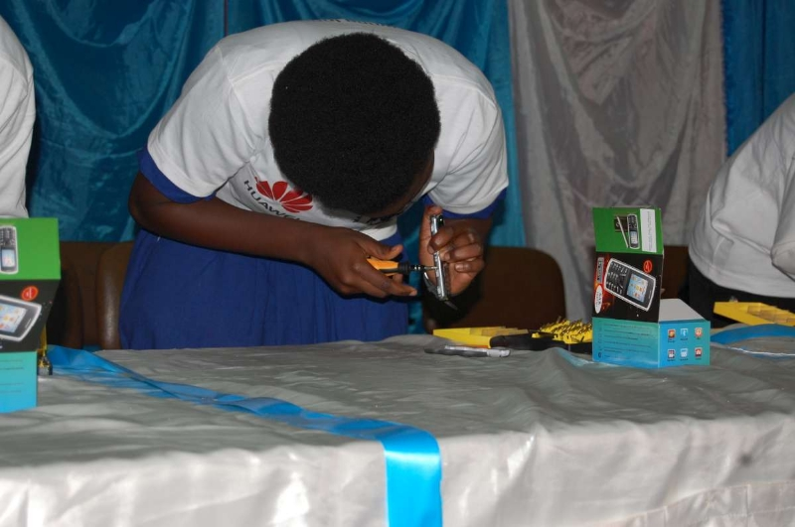
Thank you

