Slide 1
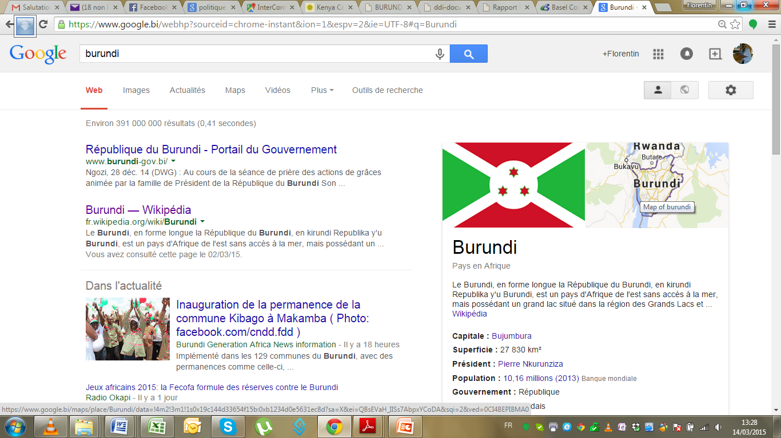

Challenges of ICT Skills Development in East Africa
THE CASE OF BURUNDI
Workshop: ICT Industry and Academia in the East Africa Region
Kigali, 2016 June 20th

Slide 2



Challenges of ICT Skills Development in East Africa
  Context➔we exploit the fact that:
  By definition Academia is a system of entities that collaborate to achieve a common goal. A goal of knowledge and skills production,sharing and development. The academia’s role is therefore preparing, providing the market and the society with highly qualified Human Ressources (HR) that meet expectations of the labor, the community and/or the research results.
  The ICT sector is a rapidly growing cross-cutting field and with the expansion, the ICT skills specialized requirements,
  As a specific area of the academia’s role, the ICT skills preparation, production is a long process that involves collaboration of many stakeholders and requires highly qualified HR. The ICT skilled people are rare and highly appreciated on the market. And It is known that rare and highly valued resources are priced high…
  The stakeholders like industries, universities or/and schools are expect(ed/ing) to be involved in the process of skills preparation and development by participating:
    In formulation /definition of the policy, of the strategies, of the motivation
    in preparation/formulation of the curricula in order to meet needed skills
    in managing (by providing, supporting, supervising or coordinating) the internships and/or research in order to meet the expectations
    In the choice of technological infrastructures & tools that facilitate and enable the ICT skills to be produced, to be acquired, to be shared, to be disseminated etc…
    In promotion of the use of the technologies as an enabler
Notes:
(i)Parteners and entities are made of actors like universities,goverments,instituts, schools services, etc…
(ii) Skills are practical, technical and technologicals like ICTs skills
(iii) labour market can be of industry/partners/communities…

Slide 3

Challenges of ICT Skills Development in East Africa
Objective is to be aware of
Policy and strategy need
  Promote and build the capacity in skills’ policy, strategy development of HR as required by industry or the community.
Collaboration expectations
  Create the curricula and harmonize it to achieve the academia’ goals that enable the production and development of highly qualified and skilled Human Resources (HR) as per requirements
Skills quality requirements
  Produce and provide critical mass of skilled people
  Take into consideration the digital inclusion as a solution. An engine and an enabler for added value, wealth creation even for marginalized people living in remote area.
Technological enabler
  Create an environment or platforms for a global collaborative ecosystems;
  Implement widely the home/electronic/mobile work-offices or class-rooms in order to produce/develop/offer or acquire quality skills from everywhere and instantly;
Notes:
Produce critical mass of HR with the ability of using the new infrastructure, the Computer/ICT/IT principles, concepts and techniques to design, implement, manage, maintain and do research in the area.
Create the harmonized curriculas/programmes that enable to produce high qualified and skilled Human Ressources (HR) in the country and the region within internationals standards
Promoting and Building the capacity in HR and in the technological infrastructures (ex: lecturing, learnig, servicing, producing, sharing etc…) that enable development of HR and its professionnal skills with the flexible mobile store, access, delivery with innovative solutions as expected and required by industry/community

Slide 4



Challenges of ICT Skills Development in East Africa
  Challenges
  The skills provided by the academia's systems do not meet fully the expectations of the research, labor market and this is true in ICT sectors as well. This is the result of:
    Lack of policy, leadership, strategy and opportunity for industry and academia to involve each other as stakeholders
    The industry is disapointed and has doubts with the quality of job seekers, their level of the skills especially when comes to handle the tiny specialized new ICT technologies
    Conflict of the curricula model elaboration (professional vs research scientific or both)
    Inadequate lecturering methodologies (are not often «learner-centered)
    The pre-requisites are of poor quality
    Academia implements programs that are outdated or do not solve society problems or of research.
    Lack of MoUs for collaboration and acceptance of internship between academia and Industries.
    The allocated time for internship is too short.
    Weak capacity of industry to absorb and accept all requests for internships of students
    Allow the acces or avail all resources including specific infrastructures that is often limited(the industry often says: expensive, secret, delicate or perishable…).
    Recrutments, contracts and performance management that do not follow the existing or ethical rules and are managed selectively especially for the technological ones.
    Expensive education services/products as well the education platforms and tools;
    Perception as limited the current added value of technological solutions
    Bringing actors to implement technologies especially the remote use and access to materials (Internet of things, sensors, IS and applications, etc…) needed for skills development
Notes:
Challenges
The problem is that:
The skills provided by the academia's systems do not meet fully the expectations of the research, labor market and this is true in ICT sectors as well.
Lack of policy, leadership and strategy for the promotion, the commit, the communication, the trainings, the collaboration, the involvement of practitioners, the internship , the infrastructure optimal sharing and use etc…;
The industry is disapointed and has doubts with the quality of job seekers, their level of the skills
Absence of high competencies to handle cases related to the specialized ICT field&technologies (Huwawei/Cisco infrastructure…).
Inadequate or rare opportunity /forum for industry and academic to involve themselves as stakeholders
The learners are no(t) (longer) receptive of the rigoristic approaches to acquire solid skills and knowledge
Insufficient knowledge considering the very new technologies implemented in the ICT industries compared to those taught in classes of our universties mostly theoritically but professionally outdated.
Conflicts in the curricula model adoption and elaboration (professional vs research

Slide 5








Challenges of ICT Skills Development in East Africa
The collaboration
Academia as HR provider for industry has involved different partners in the curricula development and harmonization in Burundi
…
PUBLIC
PRIVATE

Slide 6
Challenges of ICT Skills Development in East Africa
The collaboration
Academia as HR provider for industry has involved different partners in the curricula development and harmonization in Burundi
On national level, curricula harmonisation process != uniformization done (For ICT/Computer Sciences and engineering in December 2015 for ICT/IT fields for Burundi) inspired on the «Decree No. 100/97 of 18 April 2014” on the ICT industry in Burundi and the «Politique Nationale de Developement des TIC – PNDTIC (2010-2025), November, 2010 . The last document is about the strategic policy and pillars on ICT for Burundi.
The national harmonization workshops saw the Involvment and collaboration with the:
  Ministry of Education and Scientific Research - Burundi
  Inter University Council for East Africa (IUCEA) as referer and funder
  Representatives of local Industry especialy ICT related fields
  Universities and other education institutions with their domain lecturers
  Representatives of Students

Slide 7
Challenges of ICT Skills Development in East Africa
The collaboration
Academia as HR provider for industry has involved different parteners in the curricula development and harmonization in Burundi
The harmonization process in BDI was concerning
  Programmes levels:
    Bac(3)+ => Harmonazed and Validated
    Msc(2)+ ➔In the process
    PHD(3+1) ➔ in process
  The accepted programs for ICTs domain are: IT, Computer Sciences & Enginiering programs
    Computer Engineering
    Communication Engineering (Networks & Telecoms)
    Computer Science
    Information Technology
    Business IT (Informatique de Gestion)

Slide 8
Challenges of ICT Skills Development in East Africa
Results
  ICT curriculas developed and the harmonization/validation process (with the region and locally) took place in december 2015 for the adopted BMD system (Bolonia process) since 2011 in its HE system.
    Burundi experts participation in the regional curricula harmonization process organized by the IUCEA
    The elaboration and harmonization of the different ICT curriculas have seen the involvement and participation of the professionals of ICT industry. The collaboration is hense a reality
    Policy and strategies available
    Some HE institutions in Burundi are implementing the eLearning platforms, the proposed in house or prpoietary solution like moodle).
    Mobile learning and work access remotly and thr perspective of implementing the model of EaaS
Notes:
ICT curriculas developed and the harmonization/validation process (with the region and locally) took place in december 2015 for the adopted BMD system (Bolonia process) since 2011 in its HE system.
The MEESRS organized the workshop for harmonization and validation of ICT programs 11-31 December 2015
Burundi experts participation in the regional curricula harmonization process organized by the IUCEA: Kigali–March 2014/Dar es Salam December 2014, March 2015 etc…).
The elaboration and harmonization of the different ICT curriculas and others by academia in Burundi have seen the participation of the professionals of ICT industry. The collaboration is hense a reality
Functional quality services are elaborating, developing, coordinating and implementing available already quality policy, strategies and standards for skills improvment in the different institutions
Policy and strategies available
All the stackeholders (like industry) are involved
Services and skills recognized as of quality
Increased innovation and collaborative productivity that do not require a capital other than determination to succeed
Platforms for collaboration and interactions are available
Mobile learning and work access remotly
Some HE institutions in Burundi are implementing the eLearning platforms (proprietary et open like ULBU with the AVU programs, the proposed in house solution extending the existing moodle).
Some of the academic activities are performed remotly electronically on interactive platforms like moodle. Even if it is not yet implemented widly in offices, the trend is there.

Slide 9
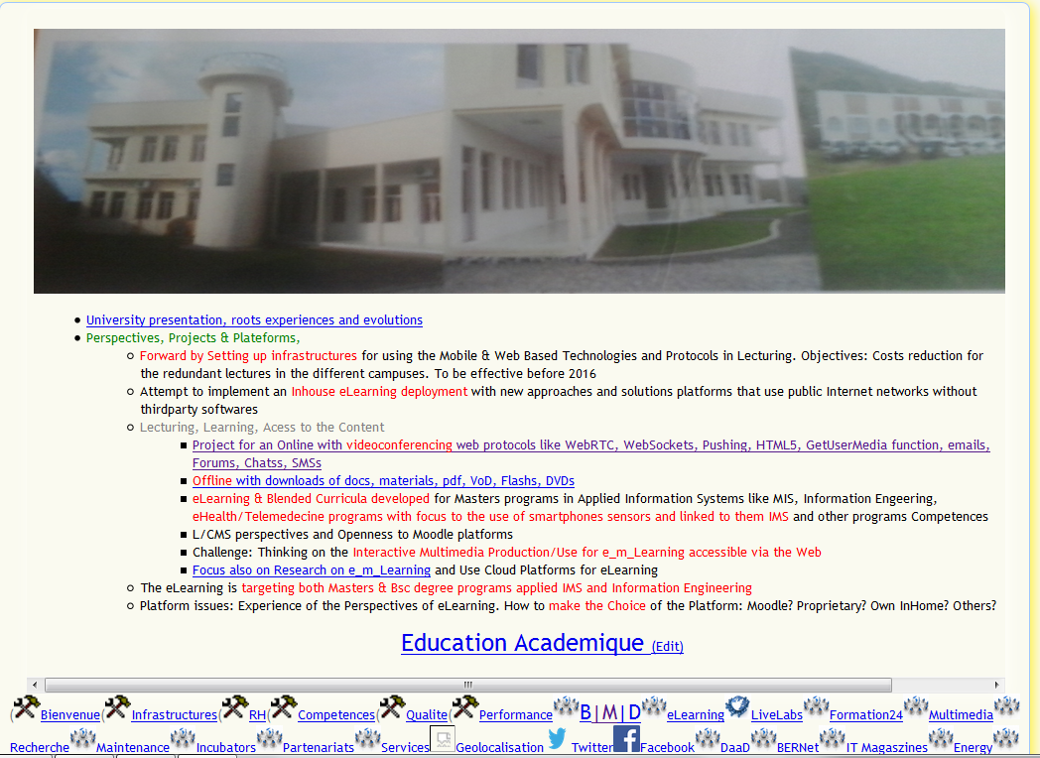
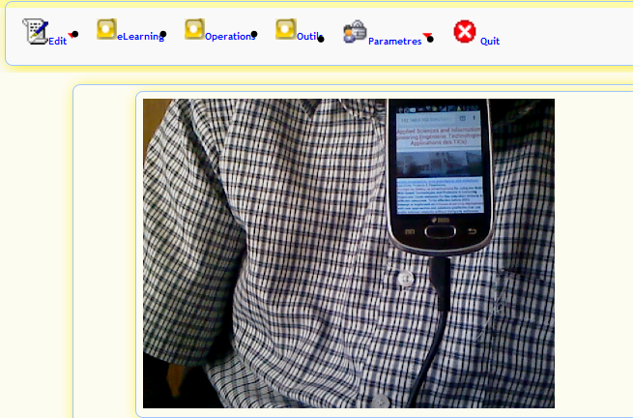

Perspectives: Mobile Technologies In Education and Skills

Slide 10
Thank You
Murakoze
Merci
Asante Sana

