Slide 1
Emerging ICT needs – a Practitioners Perspective
Broadband in Africa (Opportunities & Challenges)
Presented by: Kobel V. Humphrey
Head of Networks
Smile Communications Uganda Ltd

Slide 2
Introduction
Telecommunications is an enabler to deliver services:
Voice communication
Data communication (Messaging, internet, email, private leased circuits, etc.)
The rest is Technology – How BEST to Deliver.
Technology Advantages (efficiencies, speed, costs, security, etc.).
Limiting factors – Availability of the technology (coverage, fibre foot print, etc.)
Growing Demand to Transmit Higher Data Volumes:
Voice has not changed much in centuries.
Growing demand for higher data speeds is driving technological innovation.
Broadband (Remains an Evolving Market Demand)
ITU Standardization Sector defines Broadband as a “Transmission Capacity that is faster than 1.5 Mbps or 2.0 Mbps”.

Slide 3
Broadband in Africa
Broadband, Driving Factors:
Higher Bandwidth (Increasing Throughput – Speed of Data Transfer)
Quality of Service (for High Definition Services, e.g. HD Voice, HD Video, etc.)
Lower Latency (faster response times from the Network, e.g. Call setup times)
Network Efficiencies (Higher Network Capacity & Quality – limited Resources)
4G LTE & Broadband – What Advantages does 4G have over 3G?
The simple answer is that a 4G-LTE network will have a higher data transfer rate, with better network efficiencies.
Benefits Beyond Speed:
Better Audio Quality – CS networks offer narrow band Vs 4G wide-band audio.
Unified Communication & Collaboration – Presence, Chat, Video Conferencing.
Improved Network Administration – Dynamic & Efficient Sharing of IP Resources.

Slide 4
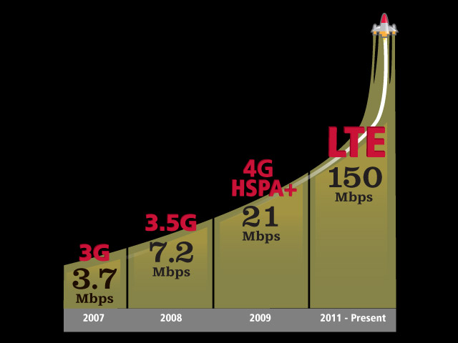
4G LTE – Opportunity for Broadband

Slide 5
4G LTE – Opportunity for Broadband
Technology Opportunities:
Support for HD Services (Voice over LTE - VoLTE, Video over LTE - ViLTE, End-to-End QoS Management, Guaranteed Bit Rates – GBR, etc).
Improved Network Efficiencies – for Higher Speed, Capacity & Quality:
  Spectrum Efficiency (60 Mbps, using 10MHz - FDD & 120Mbps with Carrier Aggregation).
  Increased DL, UL & Cell-Edge Throughput (Adaptive Modulation, MIMO, Rx Diversity).
  Lower Latency from reduction of network nodes.
  Self Optimised Networks (ANR, Faster UE Cell Reselection Saves Dropped Calls, etc.)
  Voice Service Continuity (CSFB to 3G and 2G Networks).
  Longer Battery Life for Users
LTE RAN is Designed for numerous Spectrum Band Plans, with Multi-Carrier Support in Base Band Unit (BBU). Band 20 (800 MHz) and Band 7 (2600 MHz) adopted for Africa.
Ref: Annexure A – Detailed LTE Band Plans (for FDD and TDD).

Slide 6
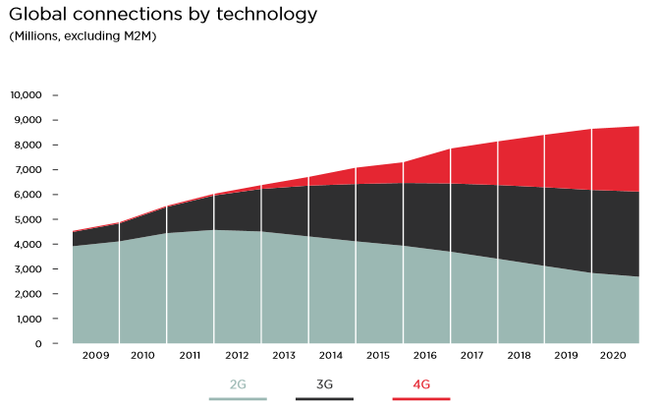
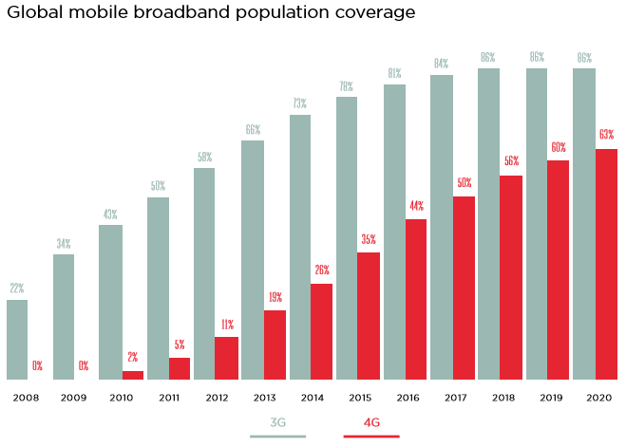
4G LTE – Opportunity for Broadband
Market Opportunities:
Low Penetration – Opportunity for Growth
  Sub-Saharan Africa has the lowest mobile penetration, with 12% CAGR in 2014.
  Rapid Shift to Mobile Broadband expected by 2020 (GSMA).
  http://www.gsmamobileeconomy.com/GSMA_Global_Mobile_Economy_Report_2015.pdf

Slide 7
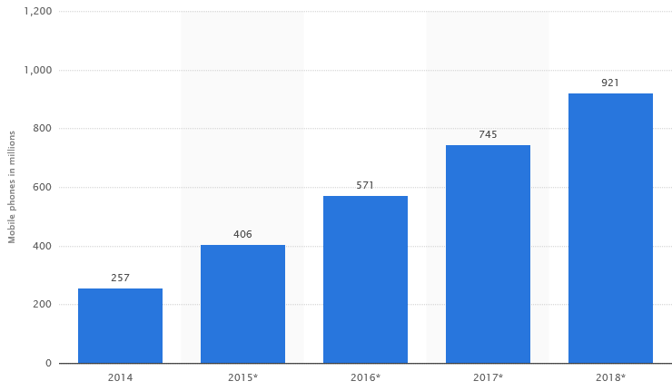
4G LTE – Opportunity for Broadband
Market Opportunities:
Handset Costs – Still to Come Down:
  Biggest Barrier to Entry of 4G LTE (Handsets Cost ~ US$ 100 – US$ 700).
  The Sweet-Spot in pricing, expected to be between ~ US$ 25 – US$ 50, for Africa. Handset Manufacturers are already working to meet this goal.
  http://www.gsmamobileeconomy.com/GSMA_Global_Mobile_Economy_Report_2015.pdf
  4G LTE Handsets Expected to more than double in 3 Years (by 2018).
  http://www.statista.com/statistics/503375/4g-lte-mobile-phones-in-use-worldwide/

Slide 8
4G LTE – Challenges
Challenges to Overcome:
Developing Business Case in a Mature, Competitive Market from GSM.
  High Network Rollout Costs (Expensive New Network Technology).
  Low Market Uptake (Expensive Handsets) but Promising Growth
  Slow Coming Profitability – Constraining Aggressive Rollout:
    Biggest Value Driver for Mobile Network Growths is Coverage.
  Competitive Product Positioning (4G-LTE Data Vs 3G & 2G Data – Price Sensitivity).
Transmission Infrastructure Limitations:
  High LTE throughput per Site – Demands High Transmission Bandwidth (10s -100s Mbps)
  Limited Fibre Optic Footprint - Microwave transmission is limiting for Backhaul.
Consumer Literacy – Adapting to Higher 4G-LTE Speeds, New Charging Models, etc.
Local Content for Broadband & Internet Consumption – Expensive IBH.
LTE Standardization, Government Policy (Licensing, Regulation, Legislation, etc.).
  Require Adoption for Broadband – Presently tailored Around Traditional 2G Models.

Slide 9
Thank You
The End
Any Questions??

Slide 10
Annexure A – FDD Spectrum, 1/2
FDD LTE Bands & Frequencies
LTE Band | Uplink | Downlink | Width of Band (MHz) | Duplex Spacing (MHz) | Band Gap (MHz)
Number | (MHz) | (MHz)
1 | 1920 - 1980 | 2110 - 2170 | 60 | 190 | 130
2 | 1850 - 1910 | 1930 - 1990 | 60 | 80 | 20
3 | 1710 - 1785 | 1805 -1880 | 75 | 95 | 20
4 | 1710 - 1755 | 2110 - 2155 | 45 | 400 | 355
5 | 824 - 849 | 869 - 894 | 25 | 45 | 20
6 | 830 - 840 | 875 - 885 | 10 | 35 | 25
7 | 2500 - 2570 | 2620 - 2690 | 70 | 120 | 50
8 | 880 - 915 | 925 - 960 | 35 | 45 | 10
9 | 1749.9 - 1784.9 | 1844.9 - 1879.9 | 35 | 95 | 60
10 | 1710 - 1770 | 2110 - 2170 | 60 | 400 | 340
11 | 1427.9 - 1452.9 | 1475.9 - 1500.9 | 20 | 48 | 28
12 | 698 - 716 | 728 - 746 | 18 | 30 | 12
13 | 777 - 787 | 746 - 756 | 10 | -31 | 41
14 | 788 - 798 | 758 - 768 | 10 | -30 | 40
15 | 1900 - 1920 | 2600 - 2620 | 20 | 700 | 680
16 | 2010 - 2025 | 2585 - 2600 | 15 | 575 | 560

Slide 11
Annexure A – FDD Spectrum, 2/2
FDD LTE Bands & Frequencies
LTE Band | Uplink | Downlink | Width of Band (MHz) | Duplex Spacing (MHz) | Band Gap (MHz)
Number | (MHz) | (MHz)
17 | 704 - 716 | 734 - 746 | 12 | 30 | 18
18 | 815 - 830 | 860 - 875 | 15 | 45 | 30
19 | 830 - 845 | 875 - 890 | 15 | 45 | 30
20 | 832 - 862 | 791 - 821 | 30 | -41 | 71
21 | 1447.9 - 1462.9 | 1495.5 - 1510.9 | 15 | 48 | 33
22 | 3410 - 3500 | 3510 - 3600 | 90 | 100 | 10
23 | 2000 - 2020 | 2180 - 2200 | 20 | 180 | 160
24 | 1625.5 - 1660.5 | 1525 - 1559 | 34 | -101.5 | 135.5
25 | 1850 - 1915 | 1930 - 1995 | 65 | 80 | 15
26 | 814 - 849 | 859 - 894 | 30 / 40 |  | 10
27 | 807 - 824 | 852 - 869 | 17 | 45 | 28
28 | 703 - 748 | 758 - 803 | 45 | 55 | 10
29 | n/a | 717 - 728 | 11
30 | 2305 - 2315 | 2350 - 2360 | 10 | 45 | 35
31 | 452.5 - 457.5 | 462.5 - 467.5 | 5 | 10 | 5

Slide 12
Annexure A – TDD Spectrum
TDD LTE Bands & Frequencies
LTE Band | Allocation (MHz) | Width of Band (MHz)
Number
33 | 1900 - 1920 | 20
34 | 2010 - 2025 | 15
35 | 1850 - 1910 | 60
36 | 1930 - 1990 | 60
37 | 1910 - 1930 | 20
38 | 2570 - 2620 | 50
39 | 1880 - 1920 | 40
40 | 2300 - 2400 | 100
41 | 2496 - 2690 | 194
42 | 3400 - 3600 | 200
43 | 3600 - 3800 | 200
44 | 703 - 803 | 100
Ref: http://www.radio-electronics.com/info/cellulartelecomms/lte-long-term-evolution/lte-frequency-spectrum.php

