Slide 1
By Emmanuel DUSENGE
Senior Engineer, ICT infrastructure development, MYICT
ROLE OF ICT IN COUNTRY ECONOMIC DEVELOPMENT
EACO GENERAL ASSEMBLY
20th June 2016

Slide 2
Outline
ICT in economic Development
ICT Strategy and roadmap
Key Achievements
Challenges
Way forward

Slide 3
ICT as enabler-Reflection of 10 yrs
ICT and Economic Growth
  enhanced competitiveness
  increased business opportunities
  access to market for rural communities
ICT and Improved Delivery of Social Services
  health/education/environmental/microfinance services
  reducing vulnerability to natural disasters
ICT for Greater Transparency
  improved efficiency on government procurement
  reduced corruption
  increased civil society participation
ICT for Empowerment of the Poor
  allowing the poor to better communicate their concerns

Slide 4







Rwanda’s Economic Development program
ICT is a cross-cutting area of Vision 2020
Good Governance and a Capable State
HRD and Knowledge based Economy
A Private sector-led Economy
Infrastructure Development
Productive and Market oriented Agriculture
Regional and International Economic Integration
Notes:
Rwanda recognizes the role Information and Communication Technologies continues to play in advancing its socio economic development
ICT was put at the Centre of our national socio-economic development agenda, by integrating it in development agendas as tool to enable other socio- economic sectors such as Education, Healthcare, Business, Agriculture

Slide 5

ICT Strategic Objectives-
To develop a vibrant ICT industry and position Rwanda as the Regional ICT Hub
To facilitate the creation of a highly competitive service sector, fueling economic growth (cross-cutting)
To promote social and cultural interaction and integration in the society through the use of ICT
Enable efficient and effective service delivery through ICT

Slide 6
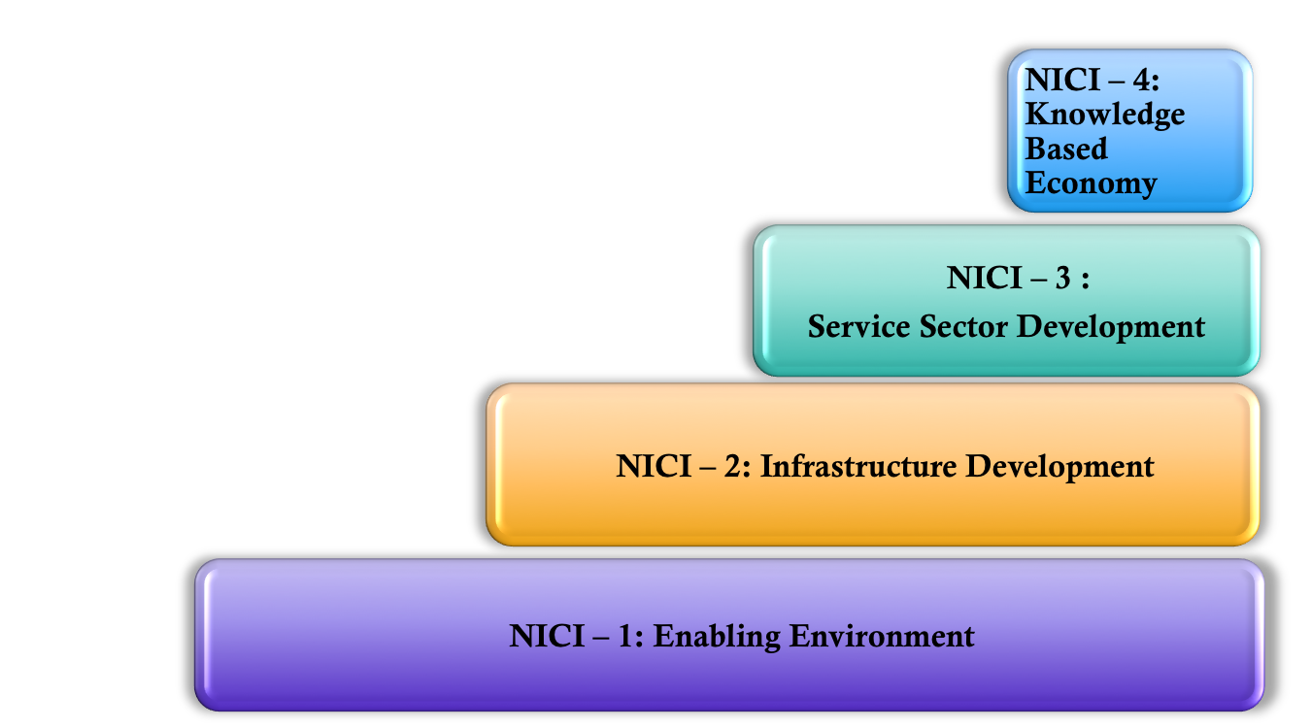
National ICT Strategy Roadmap
SRMP
Transition
2001-2005 2006-2010 2011-2015 2016-2020

Slide 7



ICT Sector institutional arrangement
Ministry:
Ministry of Youth and ICT
Policy and Sector Leadership
(Control Tower)
RURA:
Rwanda Utility and
Regulatory Authority
Regulate the ICT Sector
RDB:
Rwanda Development
Board-ICT
Implement and Coordinate
The National ICT Programmes

Slide 8







Key Flagships
Smart City
Smart Education
Land Planning, Kigali Master Plan,
Online Land Use, Construction
Permit MiS
OLPC, Computer Assembly
(Positivo), RwedNet, SmartSchool
Smart Government
Smart Business
Telepresence, GCC, Rwanda Online,..
Company registration, ESW, eTax,
Mobile Payments
ICT Innovations
Smart HealthCare
Klab, think, HeHe, GiraICT
Smart Agriculture
TracNet, OpenMRS, HMIS, RapidSMS,
Telemedecine.
E-Soko, EAX, mFarm,
Fertilizer Voucher MS

Slide 9


Slide 10


ICT Contribution to Rwanda Economy
  75,953,913
  (USD)
  FDI Investment
3%
Notes:
For FY 2015-2016, ICT sector recorded an average growth of 16% and it has continued to increasingly fuel the Rwandan GDP growth as it has been among the largest contributor to GDP growth (3%) and it is still persistent to be a primary target for foreign direct investment (FDI) into the country. It attracted US 75,953,913 FDI Investment and it has continued to be on the forefront of the government’s development strategy

Slide 11

Expanding Financial Inclusion
2016: 1,440,541 Mobile Money Subscribers
2016: 1,093 Billion FRW on Mobile Money Transaction

Slide 12

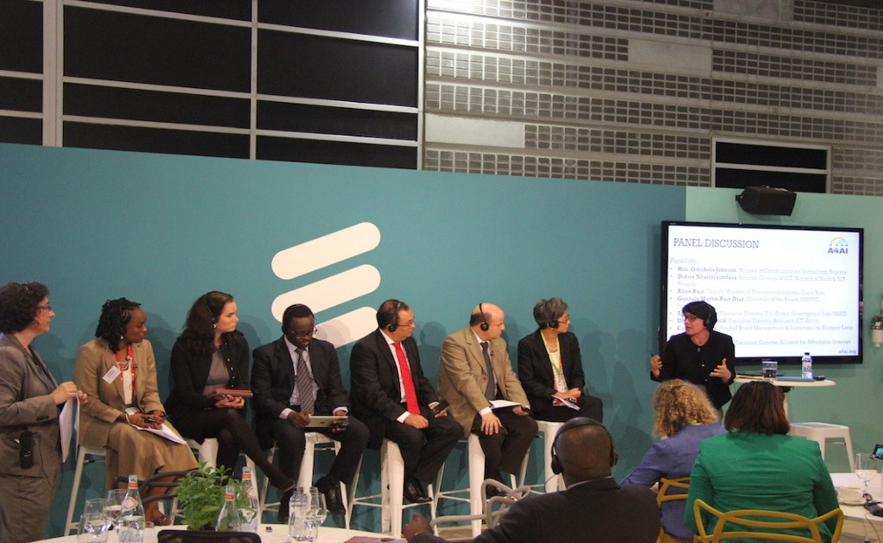
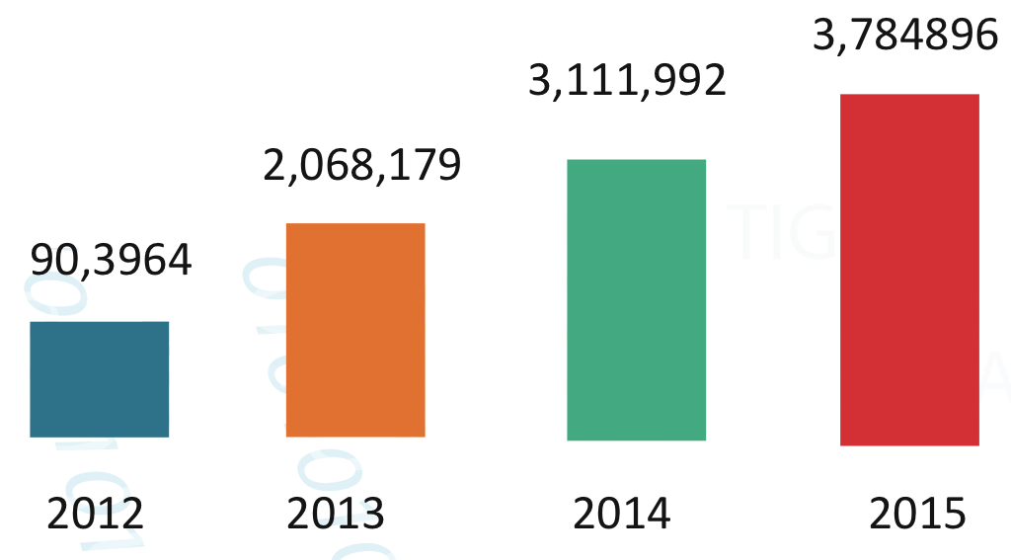
Mobile-telephone penetration and internet subscribers
RWANDA top the table of
affordable internet in Africa.
Source: The report’s ‘Affordability Index.
Internet Penetration Rate (%)
Performance indicator | Dec. 13 | May. 15 | YoY Growth
Active Mobile Subscribers | 63.5% | 75.49% | 11.5%
Internet Penetration | 20% | 32% | 12.5%

Slide 13



Growth of Telecommunication Sector
Launch 4G LTE
Digital
Migration
Today: 4G LTE in 21 cities of Rwanda

Slide 14
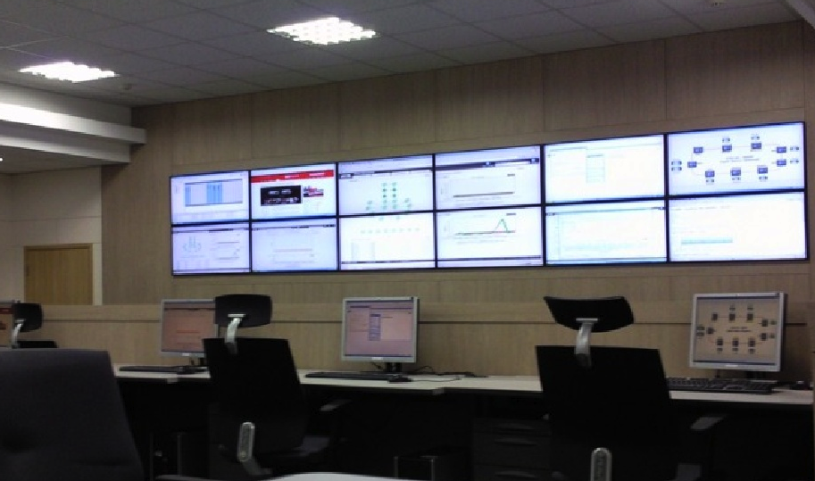

Kigali Metropolitan Network
Infrastructure development
57 km Fiber optic cable installed, connecting 54 government buildings, 63 agencies
Construction of NOC and National Data Center at Telecom House
1725 VoIP phones configured
Network Operation Center (NOC)
National Data Center
Notes:
Construction of high-speed Fiber-optic network in the kigali metropolitan area
Deployment of Network Equipment to provide IP data, voice and video services to all government agencies in Kigali city
Construction of a network Operations Control Center (NOC) for central network management and operation
STM-64 10Gbps ring, max1Gbps network equipment for each government site
Interconnection with the National backbone network

Slide 15

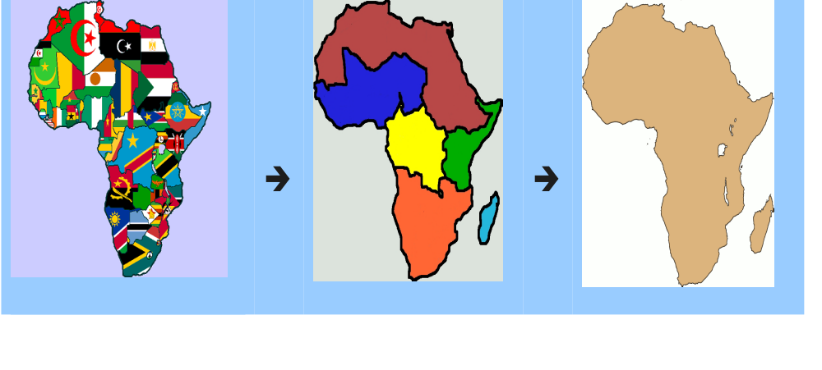


Driving Regional Integration
One-Network-Area
Northern Corridor member countries adopt “One-Network-Area”, roaming charges to be scrapped and cost of calls reduce by 60%
400%

Slide 16

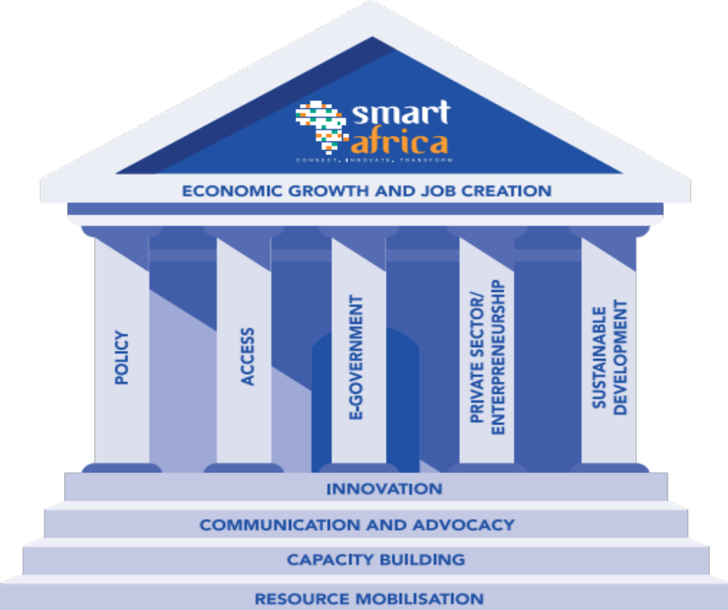



Smart Africa Alliance
Mission
Coordinate SMART Africa Alliance
Goals
Investment promotion
Skills building
Knowledge sharing
Innovation
Coordination

Slide 17
Smart Rwanda 2020 Master Plan (SRMP)
Approved by the Cabinet on 3rd/11/2015
Focus on business and innovation:
  Rwanda to become Africa’s ICT Hub
  Private sector driven economy
National economic digital transformation:
  Government Digital Transformation by 2018
  Broadband for all by 2020
  Digital Literacy for all
Future planning:
    Research and Development for exports and economic digital transformation (Internet of Things, Big Data and Analytics, Cyber Security Research, Creative Industries and Multimedia, Mobility and Digital Lifestyle).
SMART Rwanda 2020
Health
Finance
Education
Agriculture
WEM Tech
Government
Trade & Industry
Skills & Capacity
Secure & Shared Infrastructure
Governance & Management
Notes:
Strategic projects/Initiatives:
Kigali Innovation City Development (CMU Campus and New ICT Building)
Innovation Centre
Attract Investment/ FDIs
Establish Innovation fund
Promote Exports and BPO
Nurture homegrown ICT businesses ( Klab and Innovation Hubs)
Operationalize the Smart Africa Alliance
Improve Network Access and Hosting:
4G rollout (Focus: Connecting schools, health centers and local Govt)
Enhance Private Sector Access to the NBB Fiber Data Access (ORN)
Local traffic Price Differentiation (RURA)
Promote local IXP (RURA)
Establish Regional IXP (AU) ( RURA)
Promote local content hosting (Electricity and other cost factor subsidies) (RURA)
Viziyo Programs
Smart Device Penetration
Positivo
E-Government/Community Development:
Roll-out of the Government Enterprise Architecture
Government MIS
Rwanda Online (Phase 2)
Roll-out of Irembo Centres
Roll-out the National ICT awareness Programme
Digital Literacy Program
ICT International Professional Certification
Coordinate the development ICT Sector Strategies for key sectors (7 Pillars)

Slide 18

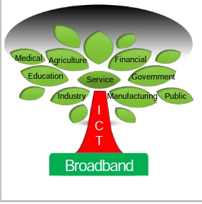


Challenges
Electricity
Digital Literacy
Local Content

Slide 19
ICT SECTOR – WAY FORWARD
  Focus on Innovation / Research & Dev’t
Smart Rwanda Master Plan
  Establishment of RISA and NCSA
  Position Rwanda as Africa’s ICT Hub
  Private Sector Dev’t – 100 companies with $ 50
  Digitally Transformed Gov’t – 24 hour self-service
  GDP contribution of 5 %
  1000 Jobs created for youth through projects/PPP’s
  Digital Literacy for all
  Broadband for all – Through 4 G roll-out & Fiber
  Safe & Resilient Cyber space – Through RCSA
  Step-up Innovation Eco-System – More kLab(s)
  Innovative Project Implementation models – PPP
  Drones/ Un manned Aerial Vehicles (UAV)
  Artificial Intelligence
  Internet of Things/Wearable/Social Media
  Big Data & Business Analytics
  Support Home grown innovations / IPRC
  Personalized Interactive Displays
  Key Initiatives/Flagships
  Develop Sub-Sector ICT Strategies
  Smart Africa alliance – Continued leadership
  Kigali Innovation City – Houses ICT Eco-system
  Positivo Africa Export– Use ASI distribution plan
  Curriculum digitization
  Cyber Security Center of Excellency – ITU Choice
  Over Top Service Initiative – RURA
  Smart Class Room – Smart Class Room
  Irembo Centers – Community access of ROL
  Mobile Number Portability
  Device penetration / TV (34) and Radios (10)
  Priority Sectors with ICT multiplier effect:
  [ Education, Agriculture, Health, Finance, Governance, Women & Youth, Trade & Industry ]
  Support each sector to develop respective ICT Strategies by June 2016 and shape how ICT will enable them achieve strategic objectives by
  reduced cost of doing bossiness, Efficiency and
  productivity

Slide 20

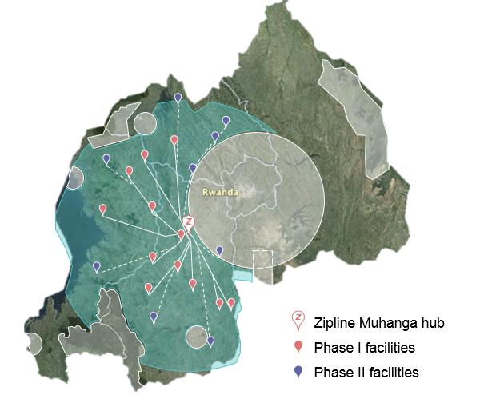
TANK YOU

