Slide 1


THE ICT SKILLS GAP IN THE ICT SECTOR:THE CASE OF BURUNDI
Speaker : Francine Ihorihoze
ECONET- LEO BURUNDI

Slide 2
KEY MESSAGE
Evidence of ICT Skills Mismatch
Evidence of Skills Shortage
Staff & students comments
Impact on ICT Sector Competitiveness
Recommendation

Slide 3
Evidence of ICT Skills Mismatch in Burundi

Slide 4
Skills Mismatch
Skills mismatch refers to a situation where existing staff in firms, with the required level of education, do not have the skills they need to do their job effectively (Quality).

Slide 5
Staff ranked having poor skills in key Positions
Departments | Poor Skills
Legal & Regulatory Affairs | 0%
Sales & Customer Experience | 2%
Marketing | 10%
IT | 23%
Networks | 27 %
Finance | 13,8%
HR & Administration | 11%

Slide 6
Evidence of ICT Skills Shortage

Slide 7
Current Job Vacancies
Comment: High level of vacancies is in IT and Networks due to lack of required skills in Burundi Market

Slide 8
Causes of Vacancies

Slide 9
Difficulties in filling in the vacancies
Time needed to fill in available positions? ICT % | ICT % | Non-ICT %
Junior staff | 2-3 weeks | 1week
Supervisory Position | 1month | 2weeks
Managerial Position | 1-2months | 3weeks
Executive Position | More than 2months | 1month

Slide 10
How do we find new Employees
How do we find new Employees | ICT % | Non ICT %
Public advertisements | 80% | 20%
Attachment Programs | 15% | 85%
Head-hunting | 80% | 20%
Personal contacts and references | 80% | 20%
Initiative on the employee side | 50% | 50%

Slide 11
KEY POSITIONS RECRUITMENT
Chief Executive Officer (CEO)
Legal & Regulatory Affairs
Marketing
Information Systems
Technical
Human
Resources & Administration
Risk and
Compliance
Marketing
Customer Experience
Consumer Business
Enterprise Business
Financial Services
Sales & Customer Services
Customer Experience
HR Manager
Company Doctor
Fraud & Assurance
Financial Reporting
Treasury& Collections
Consumer Business
Budgeting & Management Reporting
Financial Control
Enterprise Application
IT Infrastructure
Billing & VAS
IT Projects
Network Planning & Deployment
Network Operations
Roaming & Interconnect
Network Quality & Performance
Finance
Administration
Legal Advisors
Business Analyst
Staff Foreign Univesities
Staff from Local Universities
Administration

Slide 12
ECONETLEO ENGINEERS ACADEMIC BACKGROUNG
These numbers are closed .
This Clarify how skills are lacking in Burundi Universities.

Slide 13
ECONETLEO CRITICAL POSITIONS
At Executive Level,
Only 33% are local staff
And 67% are foreign
At Management level(next level)
46% are local and 54% are foreign

Slide 14
Training Cost-% of Training Budget -2014
Training Cost | Local Trainings | External Trainings
Legal & Regulatory Affairs | 1% | 1%
Sales & Customer Experience | 13% | 9%
Marketing | 15% | 18%
IT | 35% | 34%
Networks | 32% | 24%
Finance | 2% | 10%
HR & Administration | 2% | 4%

Slide 15
And Returns to Training are Substantial
Employees with basic IT skills and advanced (e.g. programming) computer skills earn 10%;20% and 31% percent higher wages, respectively, than those with no computer skills.
Workers who have received formal training from their current employers in the areas of technologies earn 30% percent higher wages, than those who have not received any training from these current employers.(Retention strategy)

Slide 16
High risk of Loosing critical skills

Slide 17
Top three Reasons why ICT Lose staff
Better offer in other sectors (The companies in the ICT sector find it harder to fill-in job positions, it takes them longer to do so)-scarcity of ICT qualified people
Staff going back to school.Inflexibility of educational system which runs during the same working hours push them to resign.(Technology is moving fast and staff have to upskill themselves to be able to meet the required standards)
Pressure of Work –ICT Sectors are very demanding(work- life balance is low)

Slide 18
Staff & student comments

Slide 19
IT STAFF & STUDENT COMMENTS
Maintenance
Academic package
-Theories
-Workplace
-Practises
Programming
-Academic package:
Basic Program:C+,C++,Pascal,HTML
Workplace
New Programs: JAVA,C SHOP; Dot Net; SGBD,SQL,ORACLE,PHP,….
Networking
Academic Package
-Non manageable Networks
-Plug &play
Workplace
-Manageable Networks(configuration,..)
Some universities starts having manageable devices but they use simulation .

Slide 20
OUR STUDENTS ATTACHES BACKGROUNG
Our attaches are selected by an inteview
Successuful ones get six(6)months attachement where they get a proper skills transfer program
After six month each attachee is evalaued
98%of starting point positions are recruited from them

Slide 21
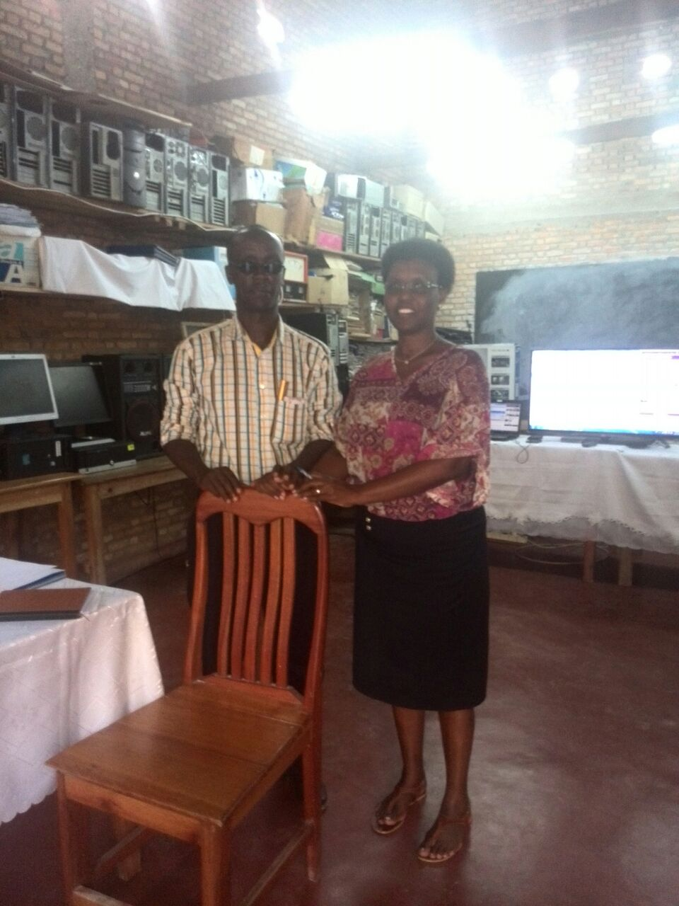
HEAD OF INITELEMATIC VIEW –PRIVATE ICT UNIVERSITY
Mr.Sadock –Head of the School:
Big challenge to adapt our academic program to the Market needs because of Budget issues
Big challenge to have qualified &experienced teachers
We pay them 15,000per hourx60hours of theories
For practice ,we look for very cheap teachers with limited knoweldge
We dodn’t have modern labo because of limited budget
We dodn’t have any partneship with other Academic Institution for skills sharing
We don’t have support from Goverment
We don’t have partnership with Organizations to train our students except Econet Leo & Smart

Slide 22
ECONET SKILLS GAPS ANALYIS AND SUCCESSION PLAN -2013
IN GENERAL:
All recommended Successors have limitations in their Technical and Business Competences. Supervisors need to give a clear Development plan with a deadline.
All recommended Successors need Leadership and supervisory Trainings. HR can deliver the Trainings.
The only way we can challenge the competition and manage our Succcession plan is to get the right people on the right Positions.There are some very critical skills in Leo ,Africell and Smart. Taking them on Board can be very helpul.

Slide 23
Impact on ICT Sector

Slide 24
Impact on ICT Sector
Poor Performance
Revenue Loss
Poor competitiveness
High training cost
High consultancy cost
High staff cost-Recruitment from outside the country(5% above he Budget)
Burundi foreign law constraint towards Education level-contradiction(foreign staff should not be above 5% at each level)

Slide 25
Recommendation

Slide 26
Recommendation
Burundi should focus on growing Burundi’s ICT capabilities and skills in the workforce by adopting an appropriate Education Policy.
Burundi should accelerate the development and implementation of the Technologies component in the Burundi Curriculum, with a particular focus on computing skills and training of teachers.
Higher education institutions should promote the strength and diversity of ICT related study and career paths to students
Businesses should provide opportunities for employees to develop their ICT skills through on the job training, workshops, upskilling courses and other business development initiatives.
Programs under the Department of Skill Development (Ministry of Labor ) should be strengthened and monitored for results (tracer studies…).
Businesses and Universities should develop partnership and provide internship programs to students.

Slide 27
THANK YOU!
MERCI!
MURAKOZE!
AKSANTE!
Mwebare !

