Slide 1
ITSO - Basics of Satellite Communications
Nishaal Goure Sunkurh
17 July 2017
Notes:
Choosing the “Title Slide” from the “New Slide: Slide Layout” dialog will give you this slide, the sub-section divider slide.

Slide 2
Introduction
Nishaal Goure Sunkurh
Customer Solutions Engineer at Intelsat
Based in the Sandton Office in Johannesburg
Tel: +27 11 535 4700
E-mail: Nishaal.GoureSunkurh@Intelsat.com
Guidelines
Mobile Phones: Kindly switch to Silent Mode
Please ask questions
Notes:
This page is set up as the “slide master” and any choices from “New Slide: Slide Layout” dialog will produce this slide, EXCEPT for the “Title Slide” option.

Slide 3
Contents
Introduction to Satellite Communications
  Satellite Economics
Satellite Network Design
Satellite Earth Station Equipment
Digital Communications Techniques
Modulation
Technology Trends
Notes:
This page is set up as the “slide master” and any choices from “New Slide: Slide Layout” dialog will produce this slide, EXCEPT for the “Title Slide” option.

Slide 4
Introduction to Satellite Communications
Notes:
Choosing the “Title Slide” from the “New Slide: Slide Layout” dialog will give you this slide, the sub-section divider slide.

Slide 5
What is a Telecommunications Satellite?
A telecommunications satellite is a complex machine located in outer space that:
  Receives signals from the Earth
  Converts, amplifies and sends signals back down to the Earth
  Reaches millions of locations at the same time
A telecommunications satellite comprises of:
  A platform (or bus) which includes the propulsion system, fuel tanks, batteries, solar panels, attitude and orbit control functions, etc.
  A payload of antennas, amplifiers, frequency converters, etc
Notes:
Satellites provide today’s businesses with a flexible, universal, reliable and quickly deployable means to address a wide range of communications needs. Satellite technology has become the flexible and cost-effective solution for distributing programming and establishing broadband data networks, irrespective of the user’s geographic location.

Slide 6
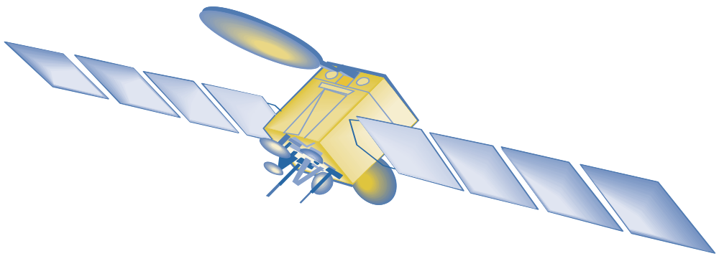
Basis Telecommunications Satellite template
Communications
Antennas
Communications
Payload
Spacecraft Control/Propulsion
Solar Arrays for
Electrical Power
Earth Deck with
Global Beam, Telemetry
And Command Antennas
Notes:
The platform is usually standardized by the manufacturer while the communications payload is customized for a given mission

Slide 7
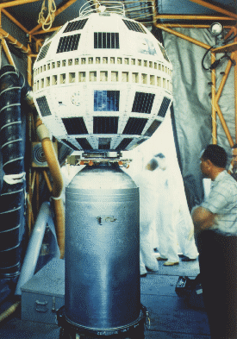
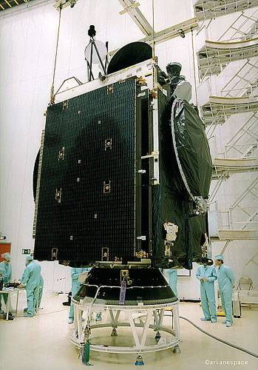
First types of Telecommunications Satellites
Telstar 1 (1962)
Intelsat 801 (1997)
Notes:
First satellites were no bigger than a 55 gallon barrel and weighed under 100 kilos vs 5 tons today

Slide 8
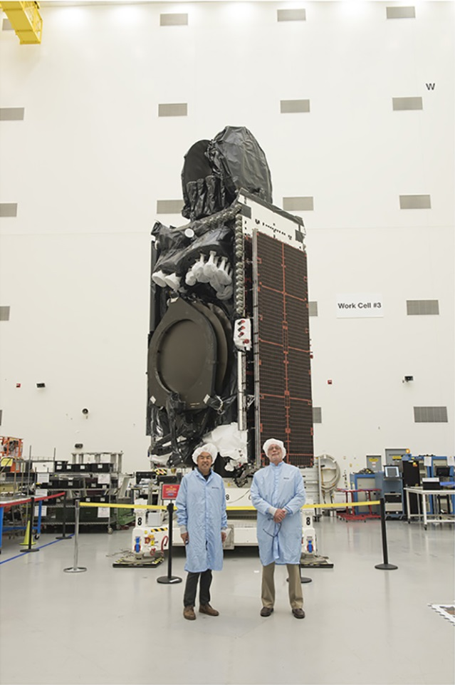
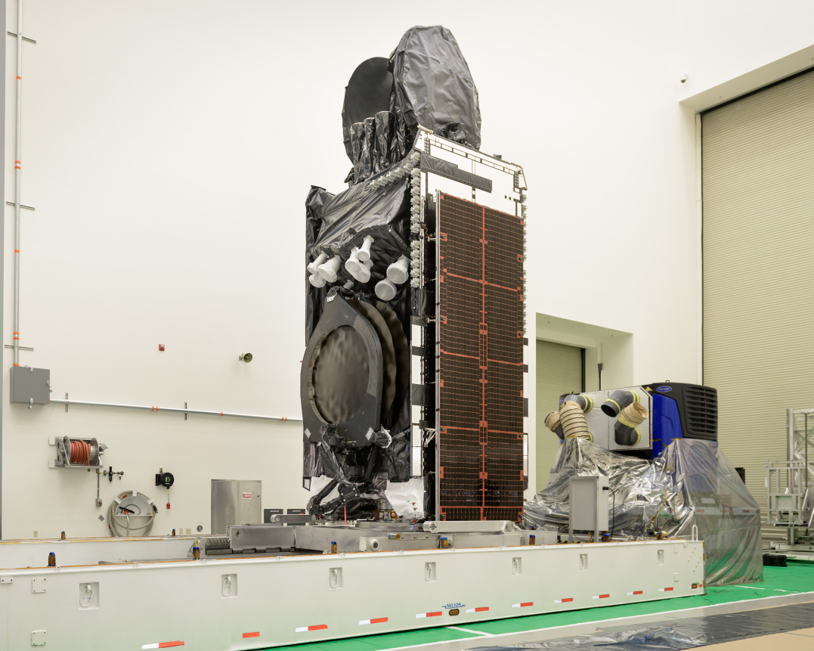
Telecommunications Satellite Today
IS-35e (2017)
IS-33e (2016)
Notes:
First satellites were no bigger than a 55 gallon barrel and weighed under 100 kilos vs 5 tons today

Slide 9
Satellite Economics:
Building and Launching a Telecommunications Satellite
It takes about 3 years to get a GEO telecom satellite built and launched
Satellite payloads are customized for a given mission
Satellites are heavily tested on the ground in facilities that reproduce the space environment:
  Mechanical, Thermal, Noise and RF tests
Typical cost of a satellite is $150-$250 million
  Some satellites can cost as much as $500 million
  Not including launch services ($55-$100 million) and insurance
Notes:
Insurance: 20-30% for launch, and 8-15% for orbit operational life.
GCS: 20-30MEur
Operation: 1MEur / year

Slide 10
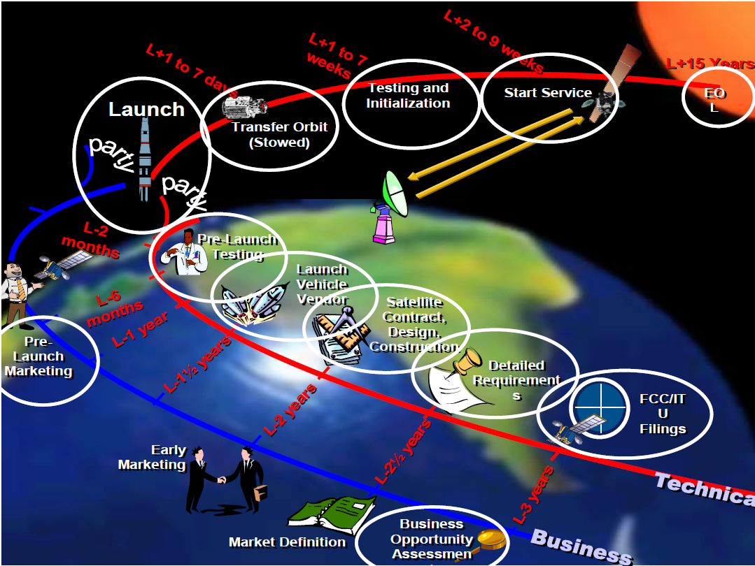
Launching the satellite

Slide 11
Orbital Slots
Consultation with the ITU for an orbital slot
Orbital slots are “owned” by the regional country
In orbital arc of 360°, theoretically there are 360 parking bays for satellites.
Satellites are co-located in the orbital slots
  Coordination is done so that the frequency, polarisation and other technical parameters do not clash.
Within the allocated orbital slot the operator is allocated a frequency of use at the slot : C; Ku or Ka etc

Slide 12
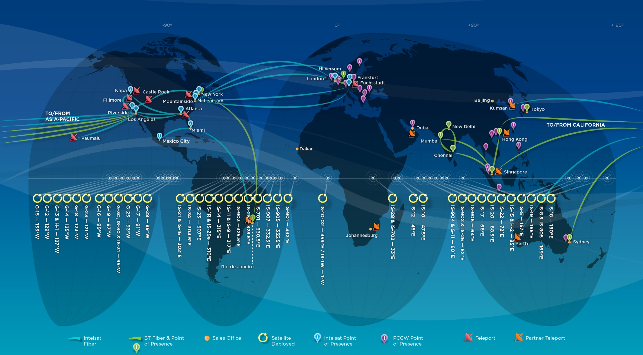
The Intelsat Globalized Network Infrastructure
Approximately 50 satellites plus IntelsatOne, a fully-integrated ground infrastructure
incorporating teleports, points of presence and IP/MPLS fiber network
Notes:
Which takes us to our SECOND ATTRIBUTE…our exceptional and flexible global network
My background is in the wireless industry
Impressive network reach, scale and complexity
Flexible network, designed to serve multiple applications simultaneously
Differentiates us from other operators
Access to growth without replacing ‘plant’
IntelsatONE [36k miles]
We are continually evolving the fleet layout, and can do so because we are supported by…
Exceptionally Flexible Global Network

Slide 13
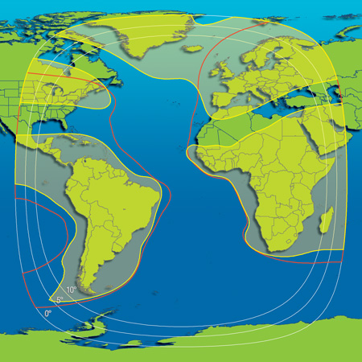
Satellite for the orbital Slot
Design of the satellite for the Orbital is based on the areas of coverage and the type of service to be deployed at the orbital location.
  Applications : Network Services or Media
  Network services: Trunking, VSAT networks, corporate networks
  Media : DTT or DTH
- Red Lines are Hemi Beams
- Yellow Outlines are the zone beams
- Blue line are the Global beams
IS-905 at 335°E

Slide 14
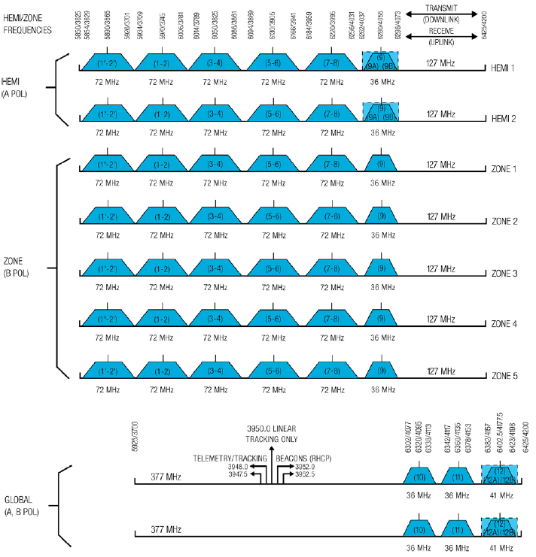
Frequency re-use on the satellite
Frequency of use on the satellite is important
Maximise of the use of the frequency that is allocated to satellite operator
Frequency re-use is achieved by geographically separated beams, polarisation
7 x 6 + 6 = 48 (36Mhz units)

Slide 15
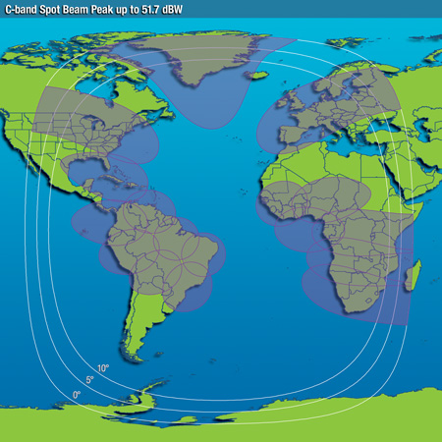
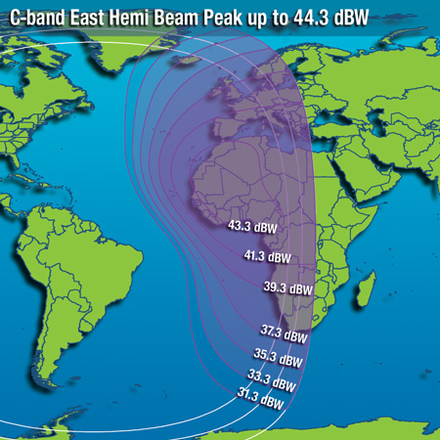
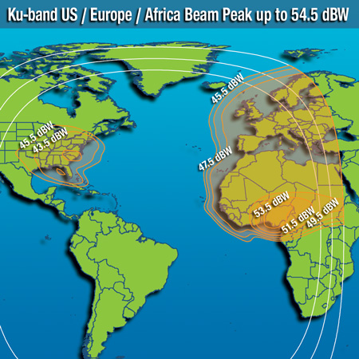
Typical Satellite Coverage
Coverage areas depend on the satellite type and targeted services
IS-905 C-band
Zone beams
IS-23 C-band
Hemi beam
IS-14 Ku-band
Zone beams

Slide 16
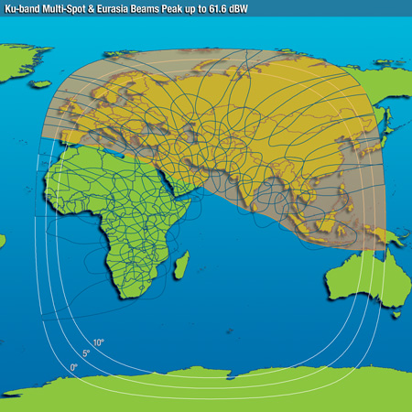
Typical Satellite Coverage
Intelsat’s next generation Epic^{NG} satellite coverage
IS-35e C-band
Spot Beams (2017)
IS-33e Ku-band
Spot beams (2016)

Slide 17
Key Applications of Satellite Communications
Cell Backhaul
Disaster Recovery
Enterprise
Maritime Communications
Oil & Gas
Aeronautical
Network Services
DTH
Satellite News Gathering
Mobile Video
Cable
Distribution
MCPC Platforms
Special Events
Media Services
ISR
Embassy Networks
Space Situational Awareness
Military Mobility
Hosted Payloads
End-to-End Communications
Government Services

Slide 18
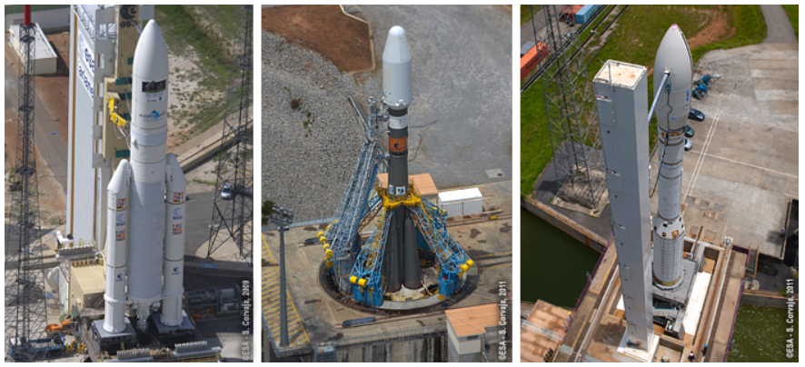
Vehicles used to Launch Satellites
Two types of launches: Sea and Land
Launch Sites:
  French Guinea, China, Russia, India and Cape Canaveral
Types of Launch Vehicles

Slide 19
Satellite Launch: IS-33e and IS-36
IS-33e and IS-36 was launched on the 24th August 2017

Slide 20
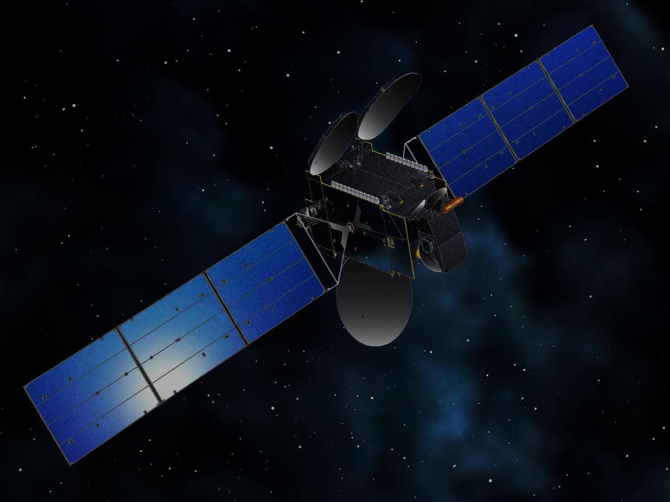

Thank you
Questions ?

