Slide 1
ITSO - Basics of Satellite Communications
Nishaal Goure Sunkurh
17 July 2017
Notes:
Choosing the “Title Slide” from the “New Slide: Slide Layout” dialog will give you this slide, the sub-section divider slide.

Slide 2
Satellite Earth Station Equipment
Notes:
Choosing the “Title Slide” from the “New Slide: Slide Layout” dialog will give you this slide, the sub-section divider slide.

Slide 3
Satellite Earth Station Equipment
Antenna
  Types
  Parameters
Uplink
  Modulation
  Up-Converters
  Transmitters
  Inter Facilities Link
RF Downlink
  LNA / LNB
  Down-convetors
  Demodulation
  Inter Facilities Link

Slide 4
Antenna
What is an antenna
  An antenna is a metallic structure that captures and/or transmits radio electromagnetic waves. Antennas come in all shapes and sizes from little ones that can be found on your roof to watch TV to really big ones that capture signals from satellites millions of miles away.
  The antennas that Satellite Communications use are special bowl shaped that focuses signals at a single point called a parabolic antenna. The bowl shape is what allows the antennas to both capture and transmit electromagnetic waves. These antennas move horizontally (measured in hour angle/declination) and vertically (measured in azimuth/elevation) in order to capture and transmit the signal.

Slide 5
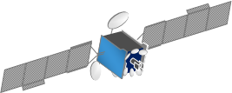
Antenna
A Satellite Earth Station Antenna
  An effective interface between the uplink equipment and free space
  Must be directional to beam and RF signal to the satellite
  Requires a clear line of sight between the antenna and the satellite
Omnidirectional Antenna
HPA
Interface and free space to antenna
Clear line of Site to Satellite
HPA
Isotropic Antenna

Slide 6
Antenna
Antenna Parameters
  Gain
  G(dBi) = 20.4 + 20 Log f + 20 Log D + 10 Log h
    f = frequency in GHz,
    D = Diameter in meters,
    h = Antenna Efficiency in Decimal format
  What should the be the gain of a 9.3m C-band antenna at 6.4 GHz that is at 62% efficiency?
    G = 20.4 + 20 Log 6.4 + 20 Log 9.3 + 10 Log 0.62
    G = 20.4 + 20 (0.806179) + 20 (0.968482) + 10 (-0.2076)
    G = 20.4 + 16.12 + 19.37 + -2.08
    G = 53.81 dBi

Slide 7
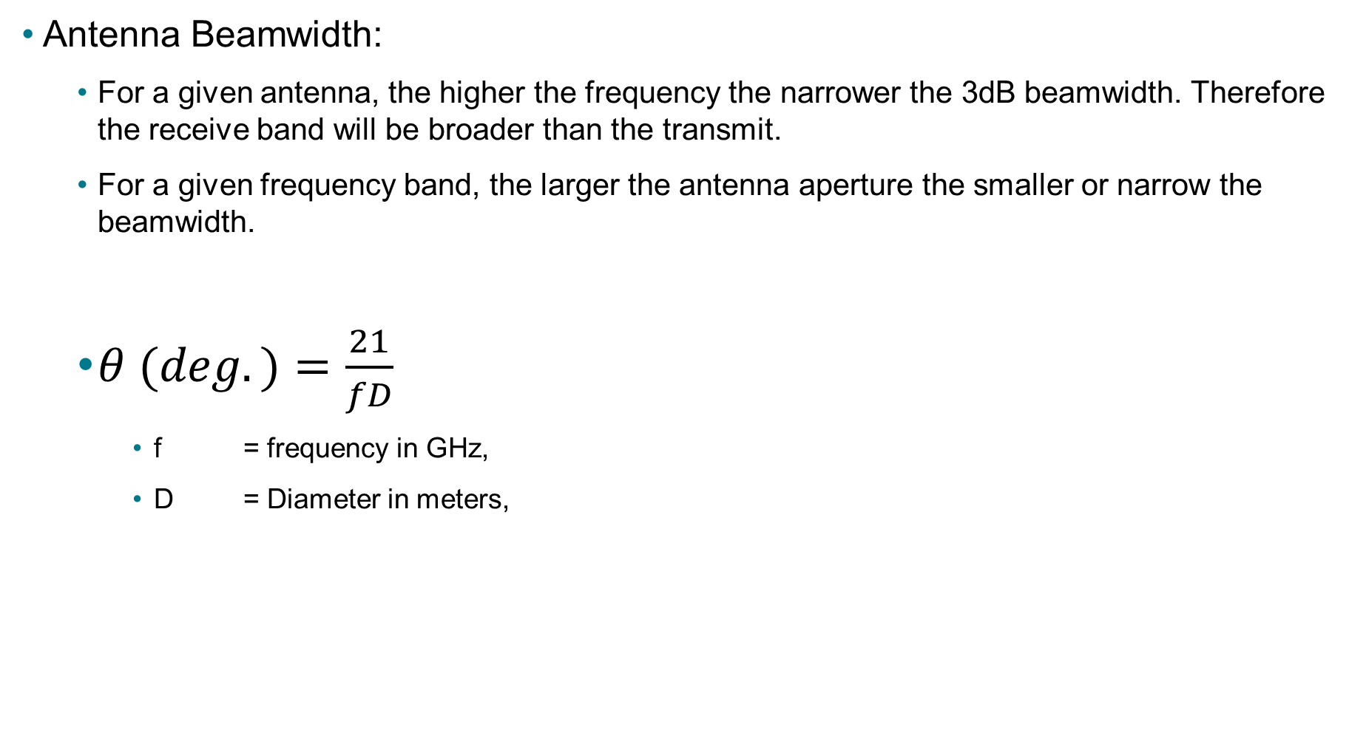
Antenna
Antenna Beamwidth:
  For a given antenna, the higher the frequency the narrower the 3dB beamwidth. Therefore the receive band will be broader than the transmit.
  For a given frequency band, the larger the antenna aperture the smaller or narrow the beamwidth.
  $θ (deg.)=\frac{21}{fD}$
    f = frequency in GHz,
    D = Diameter in meters,

Slide 8

Antenna
Antenna Beamwidth
The rectangular box shows the positional limits for a satellite in geostationary orbit, in relation to beams from a 32m antenna and 4.5 antenna
32m Antenna
4.5m Antenna

Slide 9
Antenna
Antenna Types
  Full Motion
    Motorized
    Azimuth ± 180˚ from antenna center line (C_{L})
    Elevation: 5˚ to 90˚
    Ability to track satellites in transfer orbit
  Limited Motion
    Typically Motorized
    Azimuth ± 60˚ from antenna center line (C_{L})
    Elevation: 5˚ to 90˚
    Ability to track satellites Incline orbit satellites
    Ability to change to different satellite orbital location
  Fixed
    Manual Movement
    Provides coverage of the entire satellite arc
    Peaked on satellite with no further adjustments

Slide 10
Antenna
Antenna Position Controllers (APC)
  Installed at base of the antenna (“Jog Controller”)
  Toggle switches for AZ (CW/CCW), EL (Up/Down) and Polarizer
  Serial data link for remote control with a computer
  Transducers provide AZ & EL and Polarizer angle readouts

Slide 11
Antenna
Antenna Control Unit (ACU)
  Manually position and polarize the antenna
  Preset satellite locations stored in memory
  Step Track
    Requires a suitable receiver to provide signal ACU
    Back and forth movement in AZ and EL to ensure peak signal level
  Memory Track
    Creates a model of satellite motion for twenty-four hour period
    Uses this model to track the satellite
  Computer Track
    Predict data from computer controls antenna movement
  Mono Pulse
    Relative signal phase and the sharp slope of a tracking null is used to determine peak position
    It is not necessary to step the antenna to determine satellite orientation
    Responds more accurately and faster to satellite dynamics
    Primary use is for tracking transfer orbits

Slide 12
Antenna
Antenna Feed System
  1 Port
    Receive Only
  2 Port
    Can Receive Two signals or
    Transmit One and Receive One
  3 Port
    One Transmit and Two Receive
  4 Port
    Two Transmit and Two Receive
  Polarization adjustment
    Single plane: transmit and receive are fixed and both rotate
    Dual plane: transmit and receive rotate separately

Slide 13
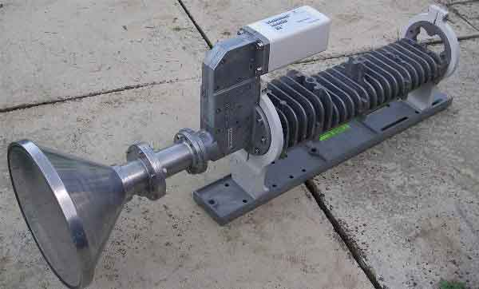
Antenna
OMT and TRF
  Ortho Mode Transducer (OMT)
    Changes feeds circular Wave Guide to two rectangular Wave Guides
    Separates and directs signals of two different polarities
    Determines isolation for Circular Polarization
  Transmit Reject Filter (TRF)
    Blocks transmit power from Low Noise Amplifier
  4 Port feed will have an OMT and TRF for each polarity
OMT
Rx
Tx
TRF

Slide 14
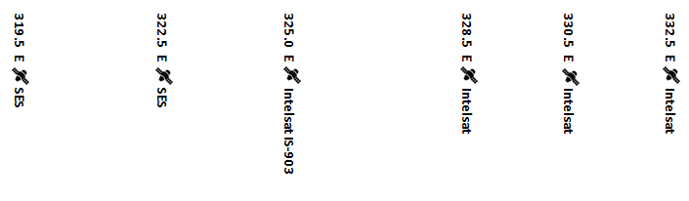
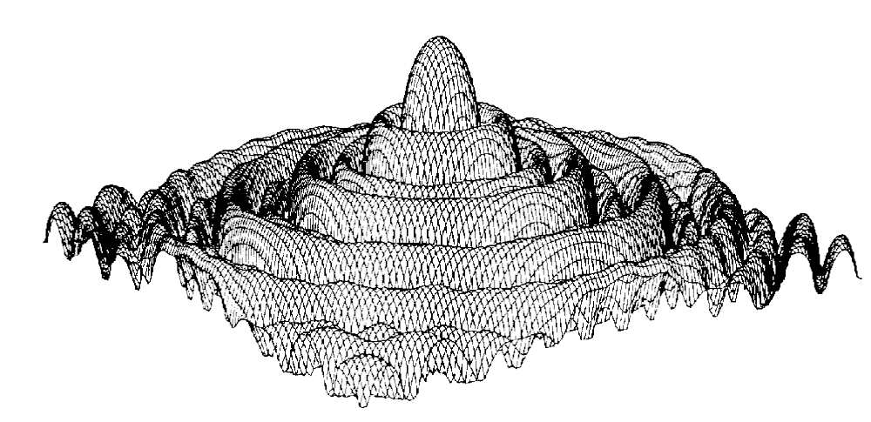
3D Antenna Radiation Pattern

Slide 15
Polarization
Provides increased satellite capacity (Allows frequency reuse)
The directional aspects of the electrical field of a radio signal
Linear (90o Out of Phase)
  Horizontal (H)
  Vertical (V)
  All Ku-Band satellites are Linear
Circular (180 o Out of Phase)
  Right Hand Circular (RHCP)
  Left Hand Circular (LHCP)

Slide 16
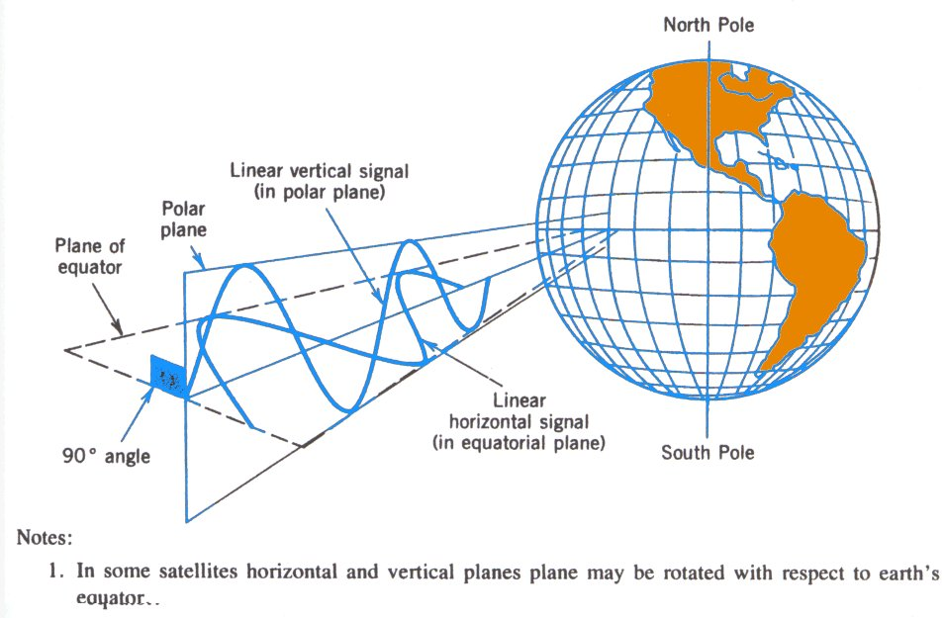
Linear Polarization
Linear Polarization
  The electrical field is wholly in one plane containing the direction of propagation
Horizontal
  Field lies in a plane parallel to the earth’s surface.
Vertical
  Field lies in a plane perpendicular to the earth’s surface.

Slide 17
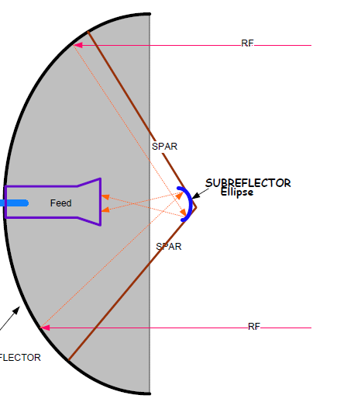
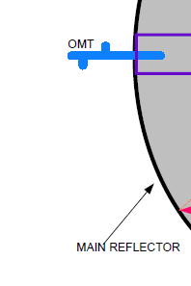
Antenna
Antenna Types
  Parabolic reflector Gregorian
    Typically use 5m or larger
    Parabolic main reflector
    Ellipse subreflector
    Subreflector and strut blockage small
    Small feed line loss
    Good G/T

Slide 18
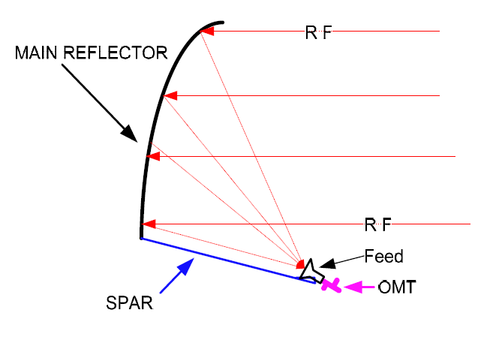
Antenna
Antenna Types
  Parabolic reflector offset feed
    Typically 3.7m and smaller
    Parabolic main reflector
    Ellipse subreflector
    Subreflector and strut blockage small
    Small feed line loss
    Good G/T

Slide 19
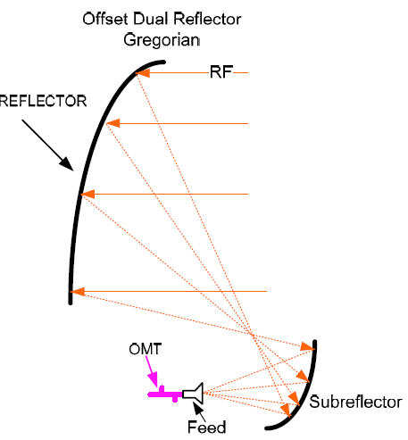

Antenna
Antenna Types
  Parabolic offset dual reflector gregorian
    Offset dual reflector system
    Main reflector parabolic
    Subreflector elliptical
    No Feed / Reflector blocking
    Small feed line losses
    Excellent C/I and cross pol purity
  Used on satellites

Slide 20
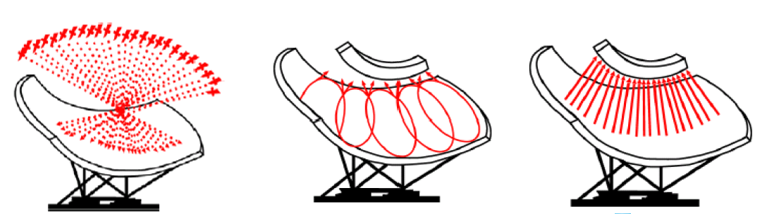
Antenna
Antenna Types
  Simulsat
    Receive Only
    Captures signals across a 70˚ view arc
    Upto 35 satellites are received with uniform performance
    Each satellite illuminates a specific area
    Signals reflect to their corresponding C-Band or Ku-Band feed
    Feeds are adjusted, no antenna movement

Slide 21
Antenna
Antenna Subreflector
  In a direct feed reflector, the feed horn is located at the focus or may be offset to one side of the focus
  Large earth station antennas have a subreflector at the focus
    The subreflector permits the antenna optics to be located near the base of the antenna
    Reduces losses because the length of the waveguide between the transmitter or receiver and the antenna feed is reduced.
    The system noise temperature is also reduced because the receiver looks at the cold sky instead of the warm earth
  Cassegrain
    The subreflector is convex with an hyperboloidal surface
    Hyperboloidal? A mathematical surface whose sections parallel to one coordinate plane form ellipses and those parallel to the other two coordinate planes form hyperbolas
  Gregorian
    The subreflector is concave with an ellipsoidal surface
    Ellipsoidal? A geometric surface or a solid figure shaped like an oval. Any section through an ellipsoid is either an ellipse or a circle.

Slide 22
Antenna
Antenna Focal Distance (f/d)
  focal distance formula: f/d = D² / 16d
    D = Antenna Diameter
    D = depth of Parabola
f/d
f/d
d = 0.8m
d = 0.6m
D = 3.8m
D = 3.8m
f/d = D² / 16d
D = 3.8 m
d = 0.6 m
f/d = 1.504 m
f/d = D² / 16d
D = 3.8 m
d = 0.8 m
f/d = 1.128 m

Slide 23
Antenna
Antenna Focal Distance (f/d)
  Shallow dish antenna
    Long focal length increases the feedhorn’s ability to illuminate the entire reflector area providing good gain
    More susceptible to:
      Earth noise at low elevation angles
      Terrestrial Interference
    Affects antenna noise temperature
  Deep dish antenna
    Short focal length decreases the feedhorn’s ability to illuminate the entire reflector area providing less gain
    Can provide advantages
      Low elevation angles
      Terrestrial interference
    Better antenna noise temperature

Slide 24
Antenna
Antenna De-Ice
  Freezing precipitation will impact antenna performance
    Snow or ice on the reflector surface
      Attenuates the signal
      De-focuses the antenna
  Areas with freezing precipitation requires antenna de-icing infrastructure
  Types of de-icing:
    Electric
      Blankets Glued to the back of the reflector
      Forced hot air with the back structure enclosed
    Natural Gas
      Forced hot air with the back structure enclosed
    Fabric Cover
      Prevent snow / ice accumulation in the dish
    Rain Blower
      Blows air across feed input to prevent water buildup

Slide 25
Antenna
Antenna Feed System
  1 Port
    Receive Only
  2 Port
    Can Receive Two signals or
    Transmit One and Receive One
  3 Port
    One Transmit and Two Receive
  4 Port
    Two Transmit and Two Receive
  Polarization adjustment
    Single plane: transmit and receive are fixed and both rotate
    Dual plane: transmit and receive rotate separately

Slide 26
Antenna
OMT and TRF
  Ortho Mode Transducer (OMT)
    Changes feeds circular Wave Guide to two rectangular Wave Guides
    Separates and directs signals of two different polarities
    Determines isolation for Circular Polarization
  Transmit Reject Filter (TRF)
    Blocks transmit power from Low Noise Amplifier
  4 Port feed will have an OMT and TRF for each polarity
OMT
Rx
Tx
TRF

Slide 27
3D Antenna Radiation Pattern

Slide 28
Polarization
Provides increased satellite capacity (Allows frequency reuse)
The directional aspects of the electrical field of a radio signal
Linear (90o Out of Phase)
  Horizontal (H)
  Vertical (V)
  All Ku-Band satellites are Linear
Circular (180 o Out of Phase)
  Right Hand Circular (RHCP)
  Left Hand Circular (LHCP)

Slide 29
Linear Polarization
Linear Polarization
  The electrical field is wholly in one plane containing the direction of propagation
Horizontal
  Field lies in a plane parallel to the earth’s surface.
Vertical
  Field lies in a plane perpendicular to the earth’s surface.

Slide 30
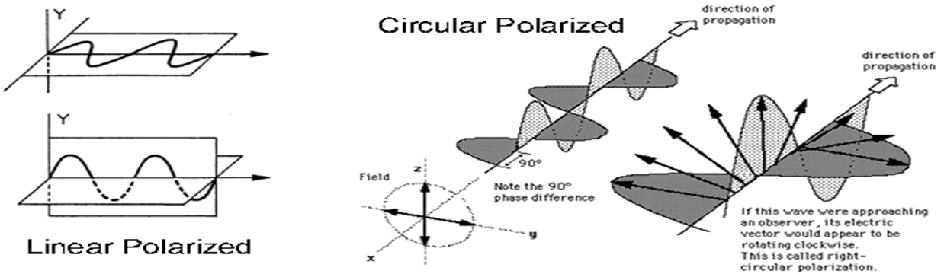
Circular Polarization
Circular Polarization
The electrical field radiates energy in both the horizontal and vertical planes and all planes in between
Right Hand Circular Polarization (RHCP)
  the electric field is rotating clockwise as seen by an observer towards whom the wave is moving
Left Hand Circular Polarization (LHCP)
  the electric field is rotating counterclockwise as seen by an observer towards whom the wave is moving

Slide 31
Linear Polarization
Advantage
  Lower Cost Antenna System
    Feed Assembly (OMT)
  Better Cross-Pol Isolation
Disadvantage
  Polarization Adjustment Required
  Polarization changes depending on Latitude and Longitude
  Greater chance of problems due to cross-pol interference
  Faraday rotation in the ionosphere
Notes:
Antenna peaking and x-pol adjustment is critical

Slide 32
Circular Polarization
Advantage
  No polarization adjustment required
    Fixed by Ortho-Mode-Transducer (OMT)
  Less chance of cross-Pol interference
Disadvantage
  Higher cost antenna systems
    Feed Assembly (OMT)
  Slightly lower cross-Pol isolation

Slide 33
Uplink
  Uplink Block Diagram
    Modulator / Modem
    Up-Converter
    Power Amplifier
    Antenna
    Inter Facility Link (IFL)
    Fiber Optics
    Co-axial cable Combiners / Splitters
    Waveguide

Slide 34
Uplink Block Diagram
  Modulator / Modem
  Up-Converter
  Power Amplifier
  Antenna
  Inter Facility Link (IFL)
    Fiber Optics
    Co-axial cable Combiners / Splitters
    Waveguide

Slide 35
Modems - Selection
SCPC
  Low Throughput 64Kbps
  High Throughput >300Mbps
  Carrier Cancellation
TDM/TDMA
  Simple Hubless solution
  Star Network
  Mesh network
Advanced features
  Roll Off

Slide 36
Modem Interfaces
RS232/RS422
HSSI/G703/Ethernet
  D-Type connector, BNC, Ethernet
IDR G703 E1/T1
IBS: RS422/RS232/ITU.V35
ASI
Ethernet
SDI

Slide 37
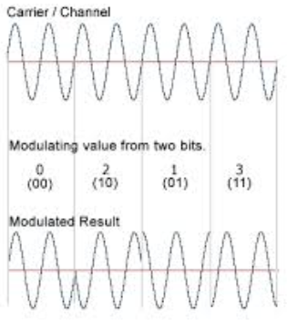
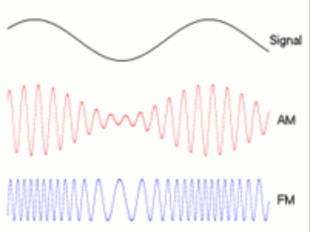
Common Modulation Techniques
Analogue Modulation
  AM, FM, QAM, SM, SSB
Digital Modulation
  ASK, APSK, CPM, FSK, MFSK, MSK, OOK,PPM,PSK, QAM, TCM

Slide 38
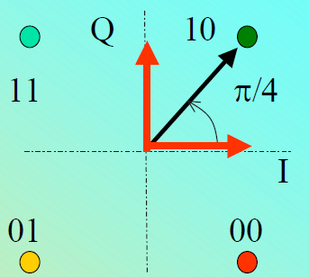
Modem – Modulation QPSK
QPSK
One of 4 phases
2 bits per symbol
00, 10, 01, 11

Slide 39
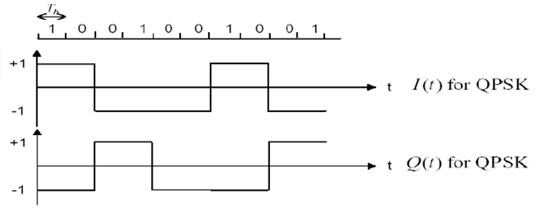
Modem – Modulation QPSK
When I and Q both change at the same time then signal transitions through Zero
  Power changes abruptly
  Signal distortions

Slide 40
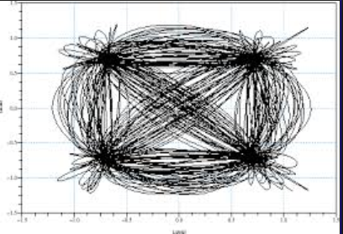
Modem – Modulation QPSK
When I and Q both change at the same time then signal transitions through Zero
  Power changes abruptly
  Signal distortions

Slide 41
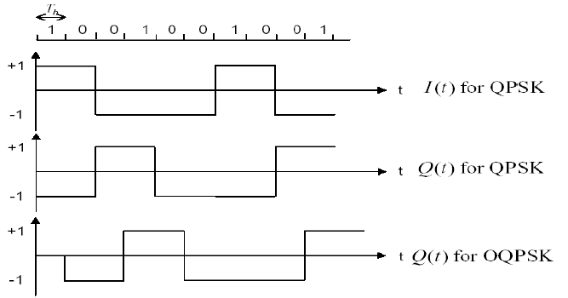
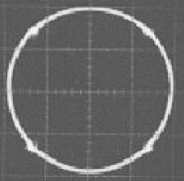
Modems - Modulation
Q – offset
  Signal never goes through Zero
  Better performance

Slide 42
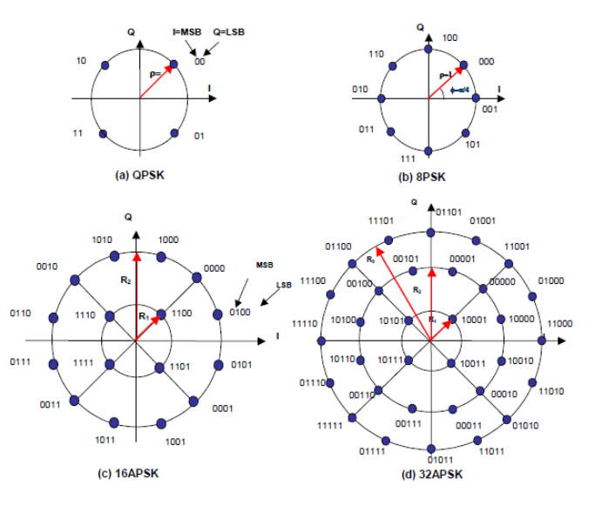
Phase shift Key
QPSK – 2 bits per symbol
8PSK – 3 bits per symbol
16APSK – 4 bits per symbol
32APSK – 5 bits per symbol
etc

Slide 43
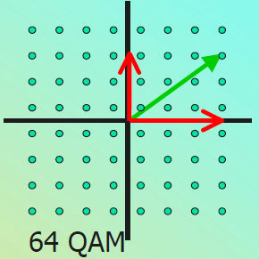
QAM
Varies the vecor amplitude and phase
Bits per symbol; same as nPSK
Requires linear power
Good Eb/No performance

Slide 44
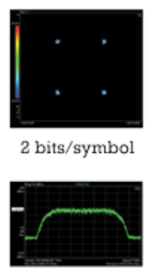
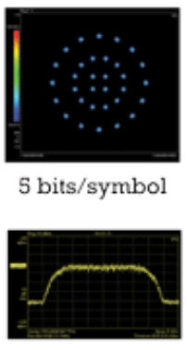
Digital Modulation - Spectrum

Slide 45
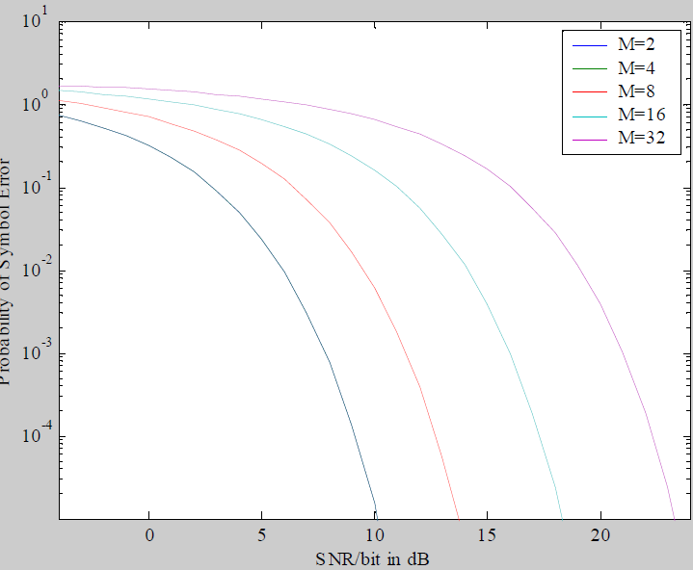
Effect of Higher order Modulation
Thermal Noise
Phase Noise
Linearity
Group delay

Slide 46
Uplink Block Diagram
  Modulator / Modem
  Up-Converter
  Power Amplifier
  Antenna
  Inter Facility Link (IFL)
    Fiber Optics
    Co-axial cableCombiners / Splitters
    Waveguide

Slide 47
Up-Converter (U/C)
A device that converts an input signal known as the intermediate frequency (IF) to a desired higher frequency without disturbing the intelligence (modulation) on the incoming signal
The method used to achieve the conversion is heterodyning. That is the mixing of two different frequencies into a non-linear device ( mixer ) to produce two other frequencies equal to the sum or difference of the first two, while maintaining it’s characteristics

Slide 48
Up-Converter (U/C)
70 / 140 MHz IF to L-Band
  70 MHz to L-Band
    70 ±18 MHz input
    950 – 1450 MHz output
    Non inverting
    36 MHz bandwidth
  140 MHz to L-Band
    140 ±72 MHz input
    950 – 1450 MHz output
    Non inverting
    72 MHz bandwidth

Slide 49
Up-Converter (U/C)
L-Band to C-Band
  950 - 1450 MHz input
  5.925 – 6.425 GHz output
  Non inverting (4.900 GHz LO)
  Inverting (7.375 GHz LO)
  500 MHz bandwidth
L-Band to Ku-Band
  950 - 1450 MHz input
  14.00 – 14.50 GHz output
  Non inverting (LO = 13.050 GHz)
  Inverting (LO = 15.450 GHz)
  500 MHz bandwidth

Slide 50
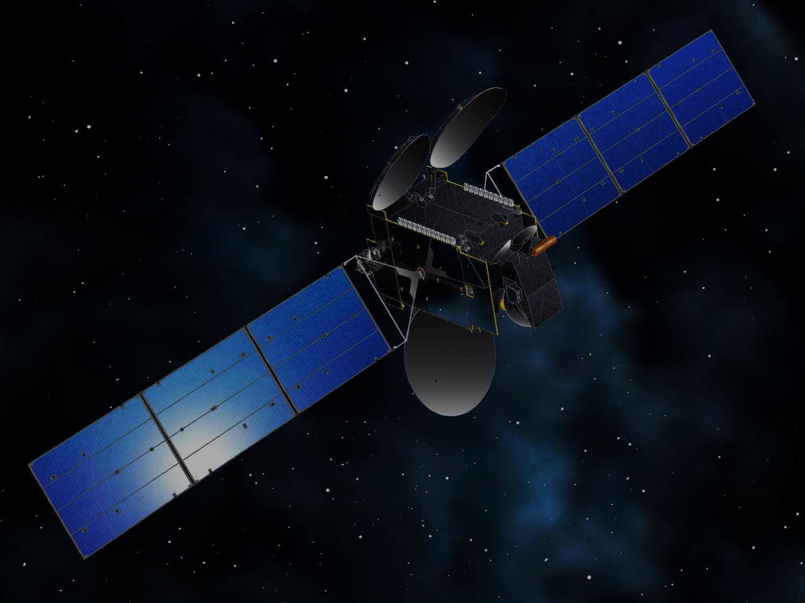

Thank you
Questions ?

