Slide 1

Non Planned Space Services
(Coordination and Notification procedures)
Akim Falou Dine
Akim.Falou-Dine@itu.int
International Telecommunication Union

Slide 2
Contents
Essence of coordination approach
Two stage procedure – A, N or C(A), N
Examination of Coordination Request
Publication of CR/C, CR/D and CR/E
Recording in MIFR
Resolution 49 and Resolution 552
BR Actions at the end Regulatory Time Limit
WRC-15 Results relating to Space Services

Slide 3
One of the Main Purpose of RR
is Interference-free operation
Mechanisms to achieve it
(Allocation, Limits, Licensing , Monitoring)
and
- Planned use
- Coordinated Use
→First Come First Served (subject to some restrictions) and Obligatory Negotiations

Slide 4
Elements of Coordination Approach
Publish a planned use of satellite network
Fulfil requirements mentioned in the RR
Negotiate with concerned administrations and get agreements
Record the coordinated assignments in the MIFR (Master International Frequency Register) to be taken into account by other administrations

Slide 5
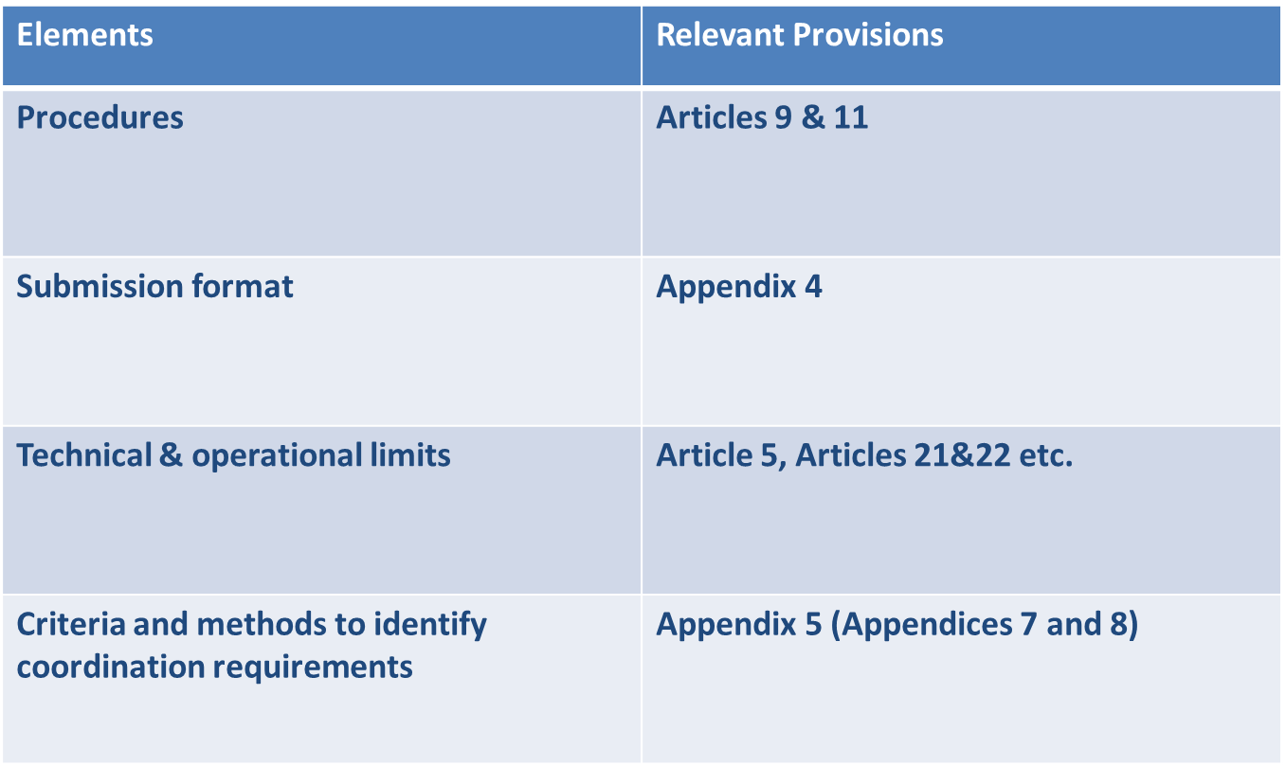
Elements of Coordination Approach

Slide 6
Coordination Approach
Satellite networks Not subject to Coordination Procedure
Advanced
Publication
Information
Notification
Start the clock
(7 years to bring into use)
Inform all administrations of any planned satellite network (certain Non-GSO) and its general description
No priority, No examination
Recording in Master Register
(international
recognition)
(Bringing into use)

Slide 7
ADVANCE PUBLICATION OF INFORMATION
ON SATELLITE NETWORKS
(Section I of Article 9)
Inform all administrations of any planned satellite network (GSO or Non-GSO) and its general description
Start of regulatory time limit to be recorded in the MIFR and brought into use
No priority, No examination

Slide 8
Coordination Approach
Satellite networks Subject to Coordination Procedure
Coordination
Notification
Advanced
Publication
Information
Inform all administrations of any planned satellite network (GSO & Non-GSO) and detailed description
Obligatory negotiation
(Goal: interference-free
operation)
Recording in Master Register
(international
recognition)
(Bringing into use)
Start the clock
(7 years to bring into use)

Slide 9
COORDINATION OF SATELLITE NETWORKS
Section II, Article 9 “Procedure for effecting coordination”
Contains (almost) all cases of coordination for non-planned satellite networks (GSO and Non-GSO), earth and terrestrial stations
  Not contained in Article 9
  (1) Non-Planed services w.r.t. Planned services
  (see Art 7 of AP30 and AP30A)
  (2) BSS sound in the 2.6 GHz w.r.t. Terrestrial Services
  ( See Res 539)

Slide 10

Request for coordination
AP4 submission
BR
API/C publication
Technical & regulatory Exam
+
Coordination requirements
Set regulatory period
Set priority subject to Res.2 and No.9.53
Findings
Affected adm

Slide 11
No.9.35 Examination
Examination w.r.t. in conformity with Allocation Table and Other provisions Listed in RoP under No.11.31
  Favourable and Unfavourable groups of frequency assignments are split
  Findings: Favourable A- Unfavourable N-
  Groups with findings N- are not examined further

Slide 12
No.9.36 Examination
Coordination Requirement for groups with “A –”
Establish forms of coordination
9.7, 9.7A, 9.7B, 9.11, RS33, 9.11A, 9.12, 9.12A, 9.13, 9.14,
9.21/A, 9.21/B, 9.21/C, Ap30/Art.7, Ap30A/Art.7, RS539
Identify administrations with which coordination may need to be effected for various forms of coordination
Identify list of satellite networks

Slide 13


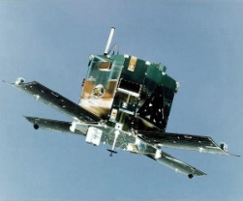



GSO
GSO
INTERFERENCE
nGSO
GSO
Tx-ES
.
.
GSO
Rx-ES
Terrestrial station

Slide 14
Forms of Coordination
  No.9.6:Before BiU or Notify, coordination shall be effected in this cases(No.9.27/AP 5 -Table 5-1)
Cases | Provision
GSO to GSO | 9.7, Art7 AP30/30A
Certain ES of GSO to NGSO | 9.7A
NGSO to Certain ES of GSO | 9.7B
BSS (GSO/NGSO) to Terrestrial Services | 9.11, Res.539
NGSO to NGSO | 9.11A/9.12
NGSO to GSO | 9.11A/9.12A
GSO to NGSO | 9.11A/9.13
NGSO/GSO to Terrestrial Services | 9.11A/9.14
the requirement to seek the agreement of other administrations is included in a footnote to the Table of Allocation | 9.21

Slide 15
Footnote refers Nos.9.11A – 9.14 or 9.21
No.9.11A (Coordination examined under No.11.32)
e.g. 5.208 The use of the band 137-138 MHz by the mobile-satellite service is subject to coordination under No. 9.11A.
See also RoP Table 9.11A-1; other space services to which 9.11A applies
No.9.21 (Agreement examined under No.11.31)
e.g. 5.286 The band 449.75-450.25 MHz may be used for the space operation service (Earth-to-space) and the space research service (Earth-to-space), subject to agreement obtained under No. 9.21

Slide 16
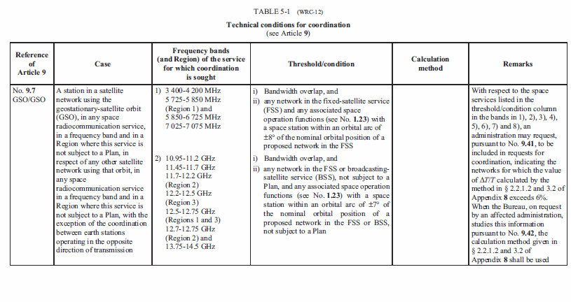
Criteria and methods for identification
Ap 5 Table 5-1: Forms of coordination, Frequency bands, thresholds/conditions:

Slide 17
Publication : CR/C
Special Section
The BR publishes the information (network data) in a Special Section of BR IFIC on DVD-ROM as well as
RADIOCOMMUNICATION BUREAU COMMENTS
Relating to the Findings with respect to No.11.31 (No.9.35 examination)
Relating to the coordination examination with respect to No.9.36
  Administrations identified under all Forms of Coordination
  List of Satellite networks (9.36.2)
  Potentially Affected Administrations for some (9.36.1) for information only

Slide 18
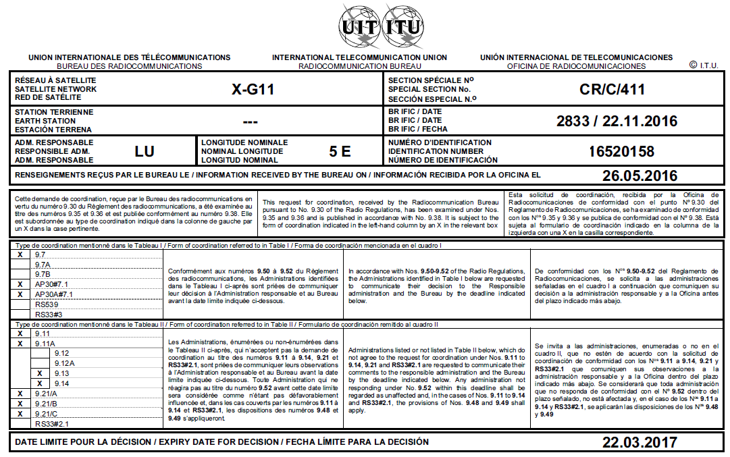

Slide 19
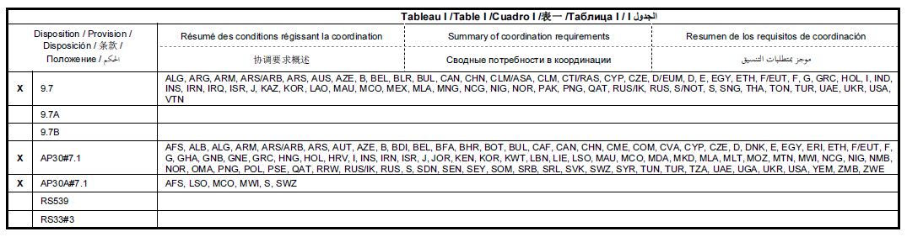
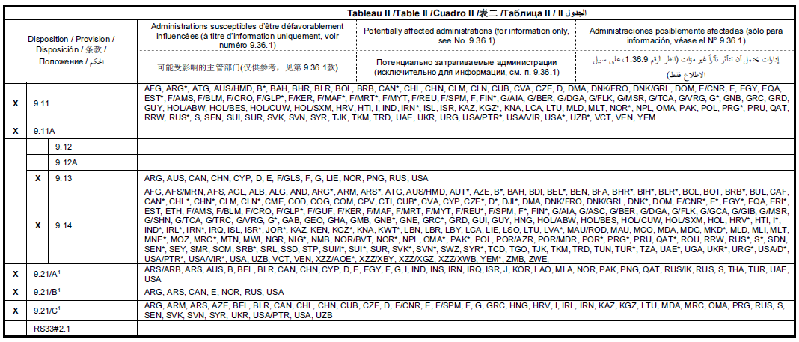
Page 3
Page 4

Slide 20
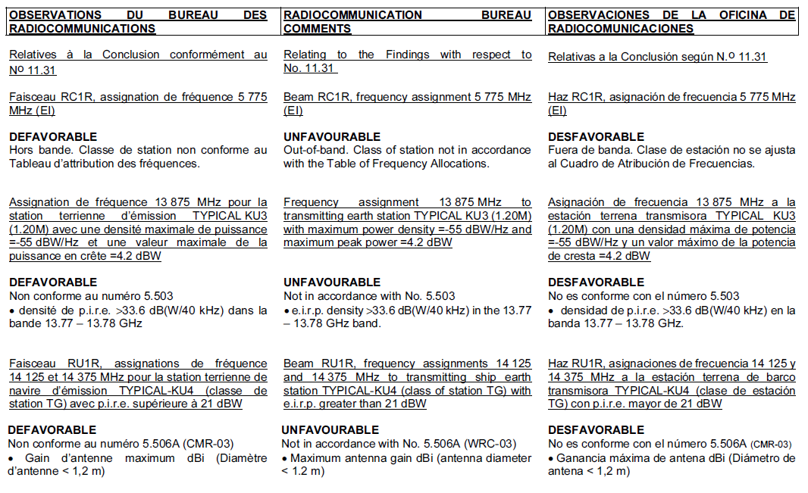

Slide 21
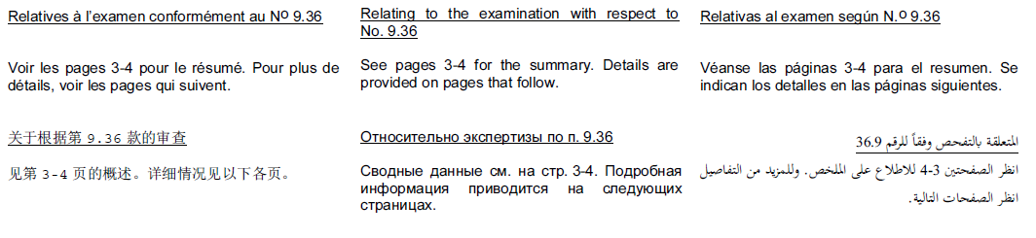
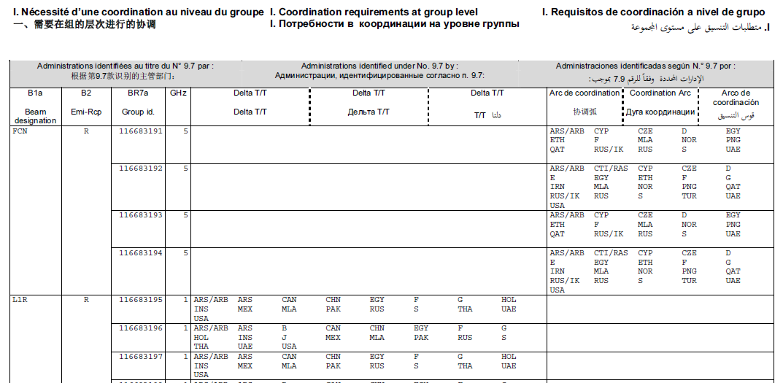

Slide 22
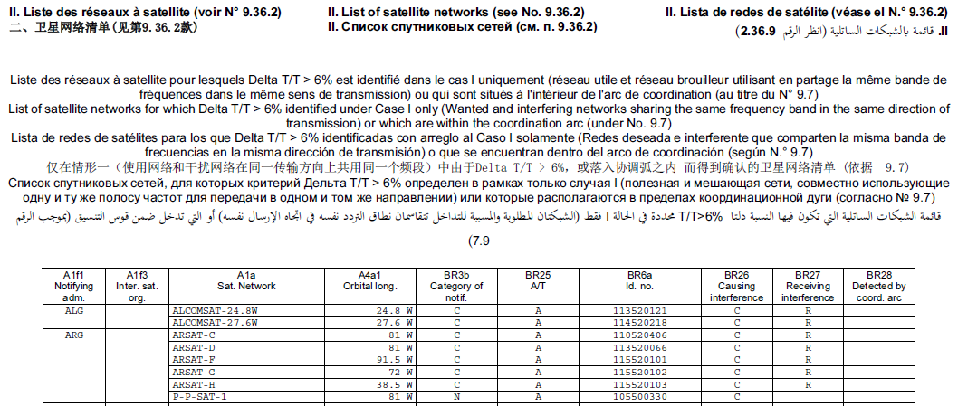
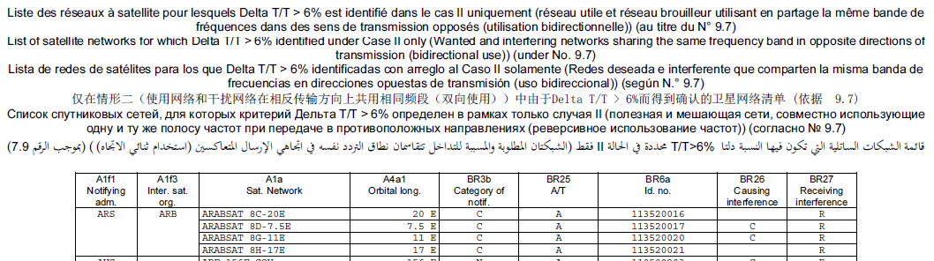

Slide 23
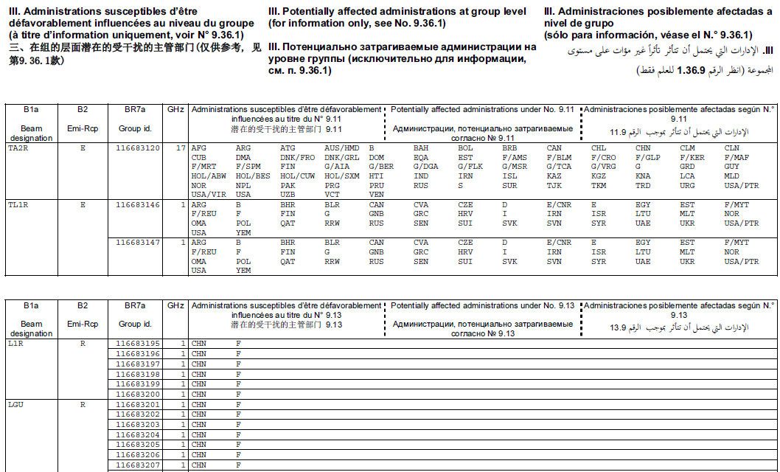

Slide 24
No more split of network for 21.4-22GHz BSS
21.4-22 GHz portion of a request for coordination has been removed and published in a separate special section (CR/F)
When the special procedure under Res.553 has been requested, the notice will still be treated independently and will be published in a CR/F special section

Slide 25
Comment on CR/C
An administration having received a request for coordination (through publication of CR/C) shall examine the matter with respect to interference which may be caused to, or caused by, its own assignments
inform the requesting administration and the BR within four months from the date of publication of the BR IFIC of either:
  its agreement to the proposed use, or
  its disagreement, giving reasons for the disagreement

Slide 26
Final Coordination Requirement
Special Section | Provision | Methods | Final/Subject
List of Adms in CR/C | 9.7, Art7 of AP30/30A | ∆T/T, pfd mask | Final
List of Adms in CR/C | 9.7 (9.7A, 9.7B) | Coordination Arc (Band Overlap, EPFD) | Subject to request for inclusion or exclusion under Nos.9.41/9.42
List of Adms in 21.4-22GHz band in CR/C and CR/F | 9.7 | Coordination Arc, pfd mask | Final, 9.41 does not apply
List of Adms in CR/C | 9.11 to 9.14, 9.21 | Band Overlap, eirp, pfd mask | Subject to comment under No.9.52

Slide 27
CR/E Publication (No.9.42)
An Adm requests for inclusion or exclusion of adm/network as coordination requirement under No.9.41 using SpaceCom within 4 month
No request within 4 month means agreement to the requirements published in CR/C (No.9.43)
CR/E contains list of administrations/ satellite networks, requested and confirmed by the Bureau for inclusion (No.9.42)
Final List of coordination requirements (Adms and networks) published in CR/E + CR/C
During coordination additional networks can be included with mutual agreement (No.9.42.1)

Slide 28
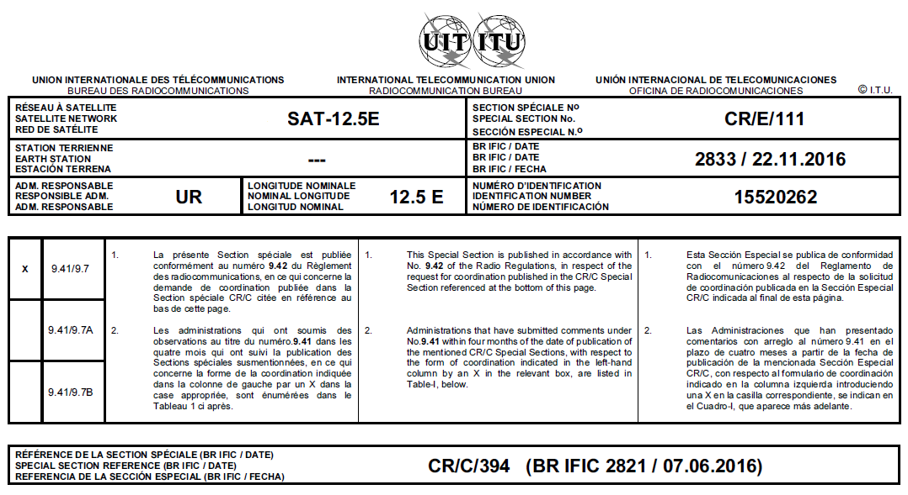
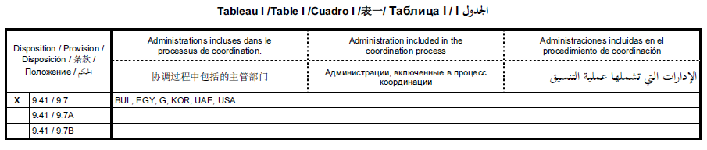
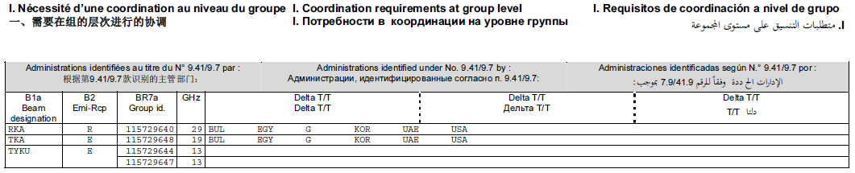
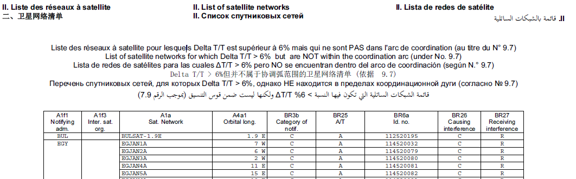

Slide 29
CR/D Publication (No.9.53A)
An Adm informs its disagreement under No.9.52 using SpaceCom within 4 month
No disagreement within 4 month means agreement to the proposed assignments in CR/C (No.9.52C)
CR/D contains list of administrations having submitted their disagreement (No.9.53A)
Final List of coordination requirements (Adms ) published in CR/D

Slide 30
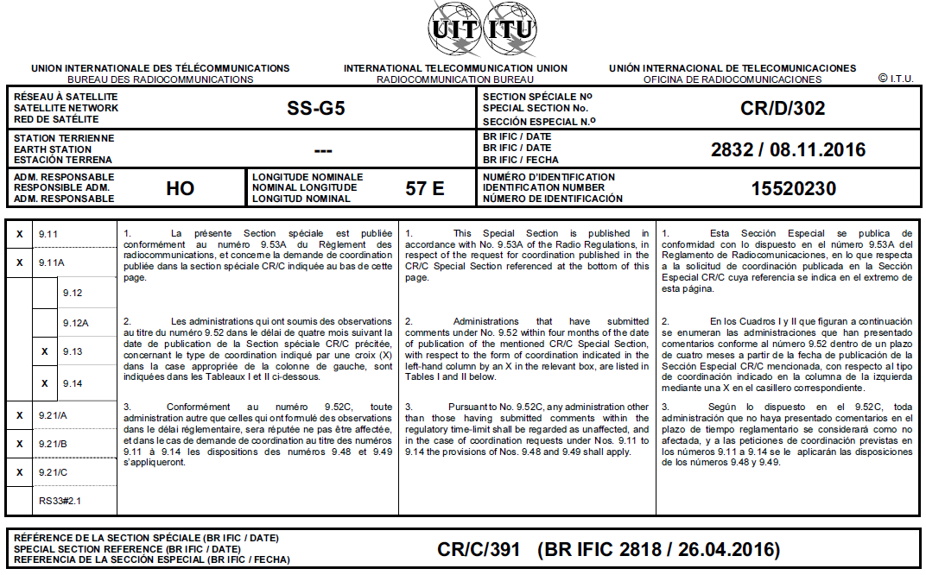
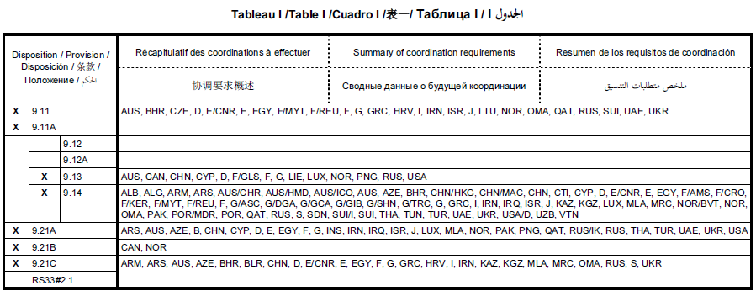
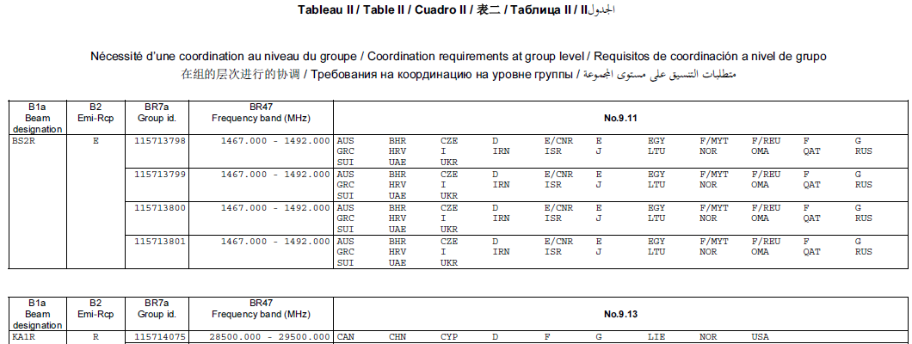

Slide 31
Coordination Approach
Earth Station Coordination Procedure
Coordination
Notification
Inform concerned administrations of detailed descriptions of planned earth stations (no publication, no identification of affected administrations by the Bureau)
Earth stations should be associated with a satellite network for which API and/or CR have been published
Recording in Master Register
(international
recognition)
(Bringing into use by the Planned date)

Slide 32
Article 11 Notification
Assignments (final characteristics) have to be notified under Article 11 to be recorded in the MIFR for international recognition within the regulatory period
In order to be recorded in the MIFR
Assignments shall
  Be in conformity with Allocation Table and Other provisions listed in RoP under No.11.31 (No. 11.31 examination)
  Complete required coordination requirements (No. 11.32 examination)
  Or
  Be favourable in examination on probability of harmful interference (C/I) (No.11.32A examination)

Slide 33
Article 11 Notification
Assignments can also be recorded in the MIFR if requested:
  Under Nos.4.4/8.4
    Unfavourable finding under No.11.31
    Information only – no international recognition
  Under No.11.41
    Unfavourable finding under Nos11.32 and 11.32A
    Requirement of No.11.41.2 (indication of coordination effort) and No.11.42 (elimination of harmful interference)
Bringing assignments into use has to be confirmed in the notification process (11.47 and 11.44B) within the regulatory period

Slide 34
Publication in Parts of the BR IFIC
Part I-S - Acknowledgement of receipt, particulars of complete frequency assignment notices
Part II-S - Findings (mostly favourable) resulting in the recording of the frequency assignment in the MIFR;
Part III-S - Unfavourable Findings resulting in the return of the notice to the notifying administration.

Slide 35

Notification
(recording in Master Register)
Coordination /
API (Advance Publication)
Due Diligence Information
Suspension
Maintenance of MIFR etc.

Slide 36
Due Diligence – Res 49
Resolution 49: To address the problem of orbit and spectrum reservation without actual use (Res 18 of Kyoto PP)
Applies to satellite network in the FSS, MSS, BSS that is subject to coordination Procedure
Information on Identity of the satellite network, Spacecraft and Launch services provider is required
Not submitted within the regulatory deadline results in suppression of submissions

Slide 37
Due Diligence – Res 552
Resolution 552: Similar to Res 49 to some extent
Applies to BSS in R1,R3 21.4-22G
Update of DD is required for relocation/deorbitting
Submission of DD within 30 days after the commencement of the use
ITU-ID for new satellites

Slide 38
Suspension
Frequency Assignments can be suspended for a period of 3 years under No.11.49
BR should be informed of suspension of use, no later than 6 months from the date of suspension. If not, 3 year suspension period will be reduced by amount of delay
Frequency Assignments are considered brought back into use only if conditions of No.11.49.1 are met

Slide 39
CT ITU Reminder
Verification of requirements under Nos.11.44/11.44.1 and Res49 in application of No.11.48
Reminder sent 6 months before expiry of the 7-year regulatory “time limit”
  - CT ITU is posted on the ITU Web site
If the BIU, due diligence information or notification is not received in time, relevant special sections and assignments recorded in the MIFR shall be cancelled

Slide 40
Art 13 – Maintenance of MIFR
BR is responsible for maintenance of the MIFR
Under No.13.6 BR consult administrations and request more information about DBIU and/or continuous use based on reliable information available
Cancel of the entry shall be subject to a decision of the RRB

Slide 41
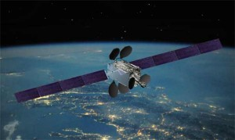
Summary of Coordination Approach
Inform/Publish characteristics
Fulfil requirements in RR
Negotiate with concerned administrations and get agreements
Record the coordinated assignments in the MIFR
Thank you !

